Slide 1
Colorado River Management Plan FY 2024 Work Plan
Colorado River Authority of Utah Board Meeting
Lily Bosworth, Staff Engineer
Betsy Morgan, Staff Engineer
JUNE 22, 2023
SALT LAKE CITY, UTAH

Slide 2
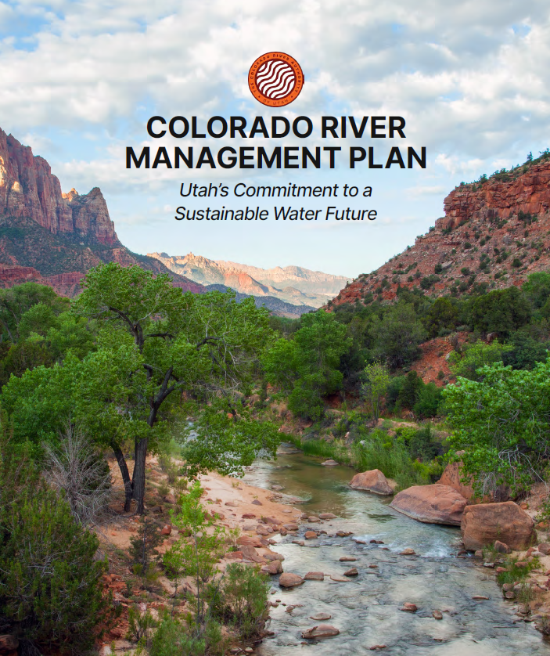
5-Year Mangement Plan
Five-year Management Plan
April 2022
Measurement
Drought Mitigation
Hydrology & Operations
FY 2023 Work Plan
June 2022
FY 2024 Work Plan
June 2023
Notes:
-To accomplish mission, the Authority adopted a 5-year management plan with three priority areas.
-Measurement, Hydrology and Operations, Drought Mitigation.
-These priorities are in place for 5 years, as described in the Plan, and specific actions are described in the Fiscal Year work plans
-The FY 2024 work plan is under development now.

Slide 3
Management Plan Budget Allocations Total Allocated: $32,271,700
*Includes Authority and in-kind contribution staff salaries
**Work Plan budgets are subject to adjustment depending on conditions and activities in the Colorado River Basin that may be unknown when the Work Plan was developed.
***Estimated costs are for Authority staff and in-kind contributions only and do not include charges of other state agencies participating.
Notes:
-To accomplish mission, the Authority adopted a 5-year management plan with three priority areas.
-Measurement, Hydrology and Operations, Drought Mitigation.
-These priorities are in place for 5 years, as described in the Plan, and specific actions are described in the Fiscal Year work plans
-The FY 2024 work plan is under development now.

Slide 4
Fiscal Year 2024 Budget Allocations Total Proposed: $7,529,400
*Includes Authority and in-kind contribution staff salaries
**Work Plan budgets are subject to adjustment depending on conditions and activities in the Colorado River Basin that may be unknown when the Work Plan was developed.
***Estimated costs are for Authority staff and in-kind contributions only and do not include charges of other state agencies participating.
Notes:
-To accomplish mission, the Authority adopted a 5-year management plan with three priority areas.
-Measurement, Hydrology and Operations, Drought Mitigation.
-These priorities are in place for 5 years, as described in the Plan, and specific actions are described in the Fiscal Year work plans
-The FY 2024 work plan is under development now.

Slide 5
Advisory Council Recommendations
Authority Engagement
-Feedback/engagement with councils
-Fact-finding site visits
-Education and outreach
Improve Measurement
-Standardize
-Best Available Science
-Conveyance Losses
Other
-Pursue and use federal funding
-Protect people and wildlife
-Water prices/water banking
Measurement
Drought Mitigation
Prioritize Conservation
-Agricultural optimization
-Environmental health
Hydrology & Operations
Prepare for Curtailment
-Shepherding
-Options for water users
Protect Utah’s Interests
-Protect Flaming Gorge/DROA

Slide 6
Interstate Activities: 20 Committees
Standing UCRC Committees (2)
Ad Hoc UCRC, Upper Division State and Basinwide Work Groups and Committees (8)
Environmental and Water Quality (4)
Upper Colorado River Fish Recovery Program (4)
San Juan Recovery Implementation Program (2)

Slide 7
Workplan Structure
Project Title
Measurement
Description
Project Title
FY 2023 Progress
Hydrology & Operations
FY 2024 Work Plan
Contract, Budget, Funding
Drought Mitigation
Key Partners

Slide 8
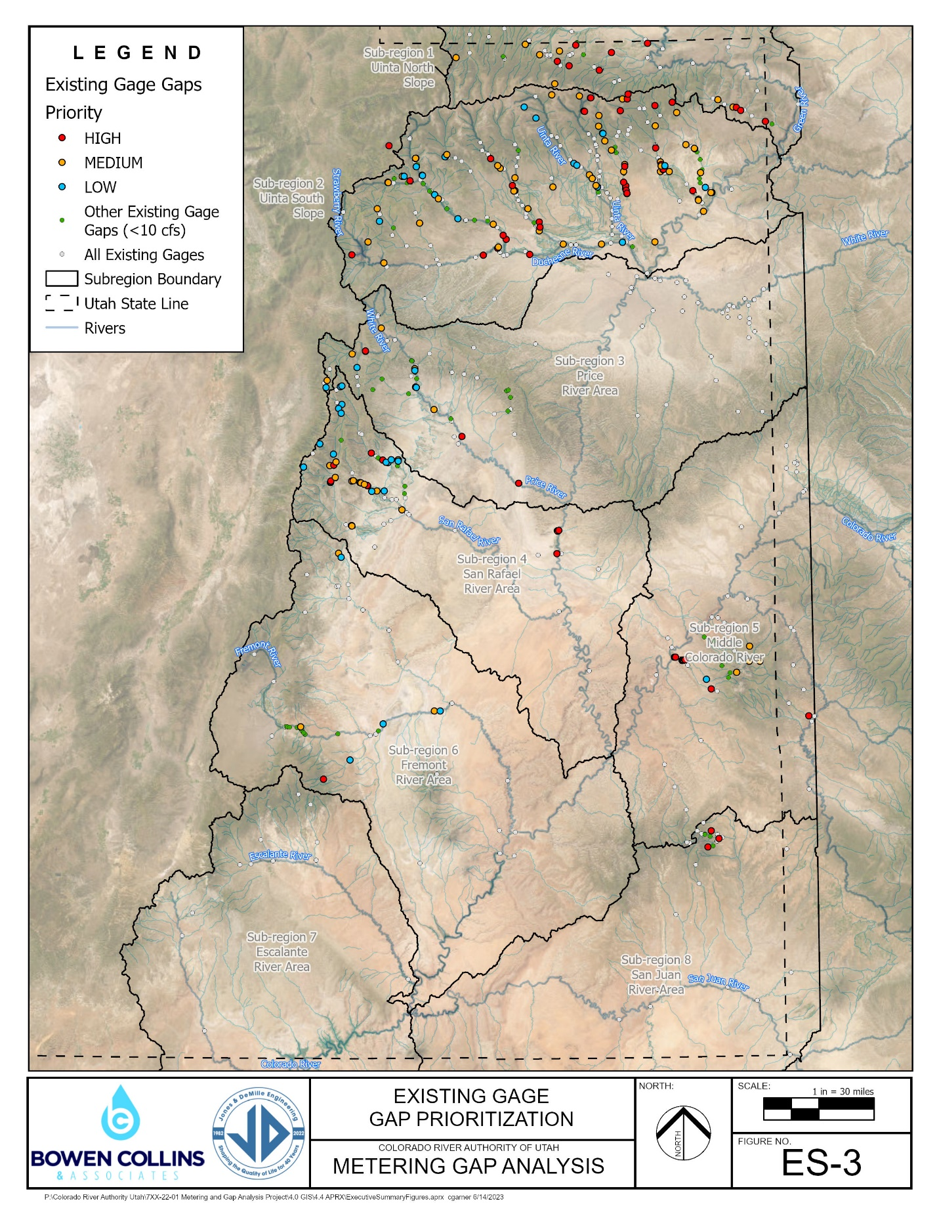
Measurement
preliminary, do not cite
Streamflow & Diversion Measurement
Metering & Gaging Gap Analysis
FY23
Coordination & Implementation Plan
FY24
Instrumentation & Maintenance
FY24-27

Slide 9
Measurement
Consumptive Use Measurement
Utah Flux Network
FY23-27
OpenET
FY23-27
PC: Paul Inkenbrandt, UGS

Slide 10
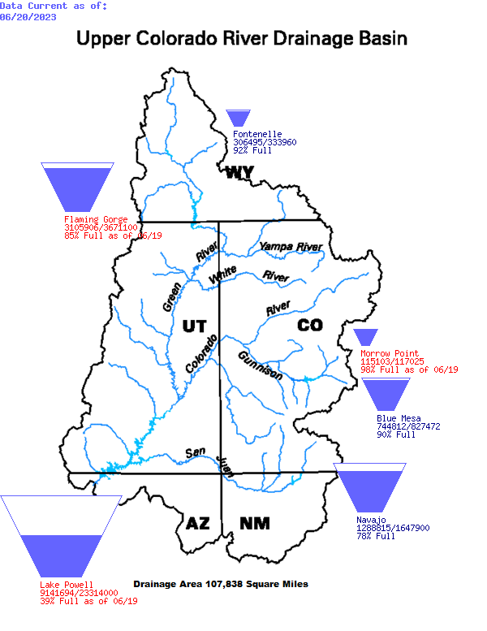
Hydrology & Operations
Short- & Mid-Term Operations Modeling
FY23-27
Long-Term Operations Modeling
FY23-27

Slide 11
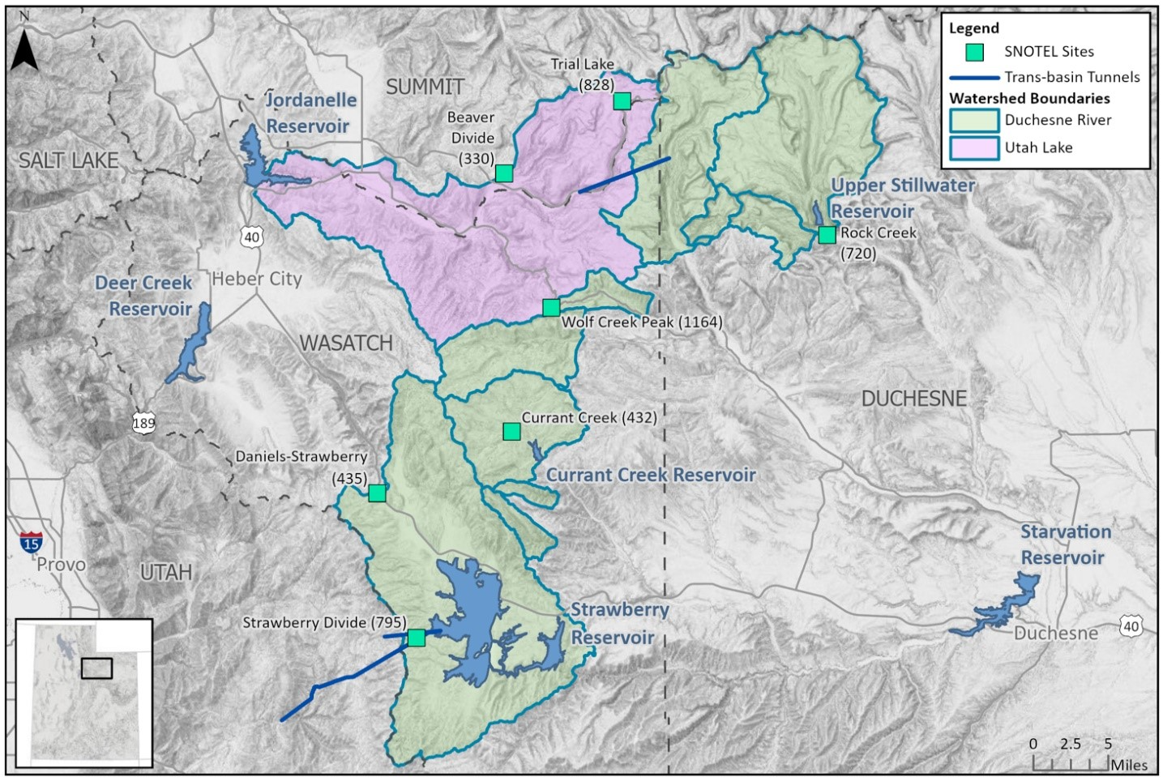
Hydrology & Operations
Climate & Hydrology Research
FY23-27
Snowpack & Runoff Hydrology Research
FY24-27
PC: Central Utah Water Conservancy District

Slide 12
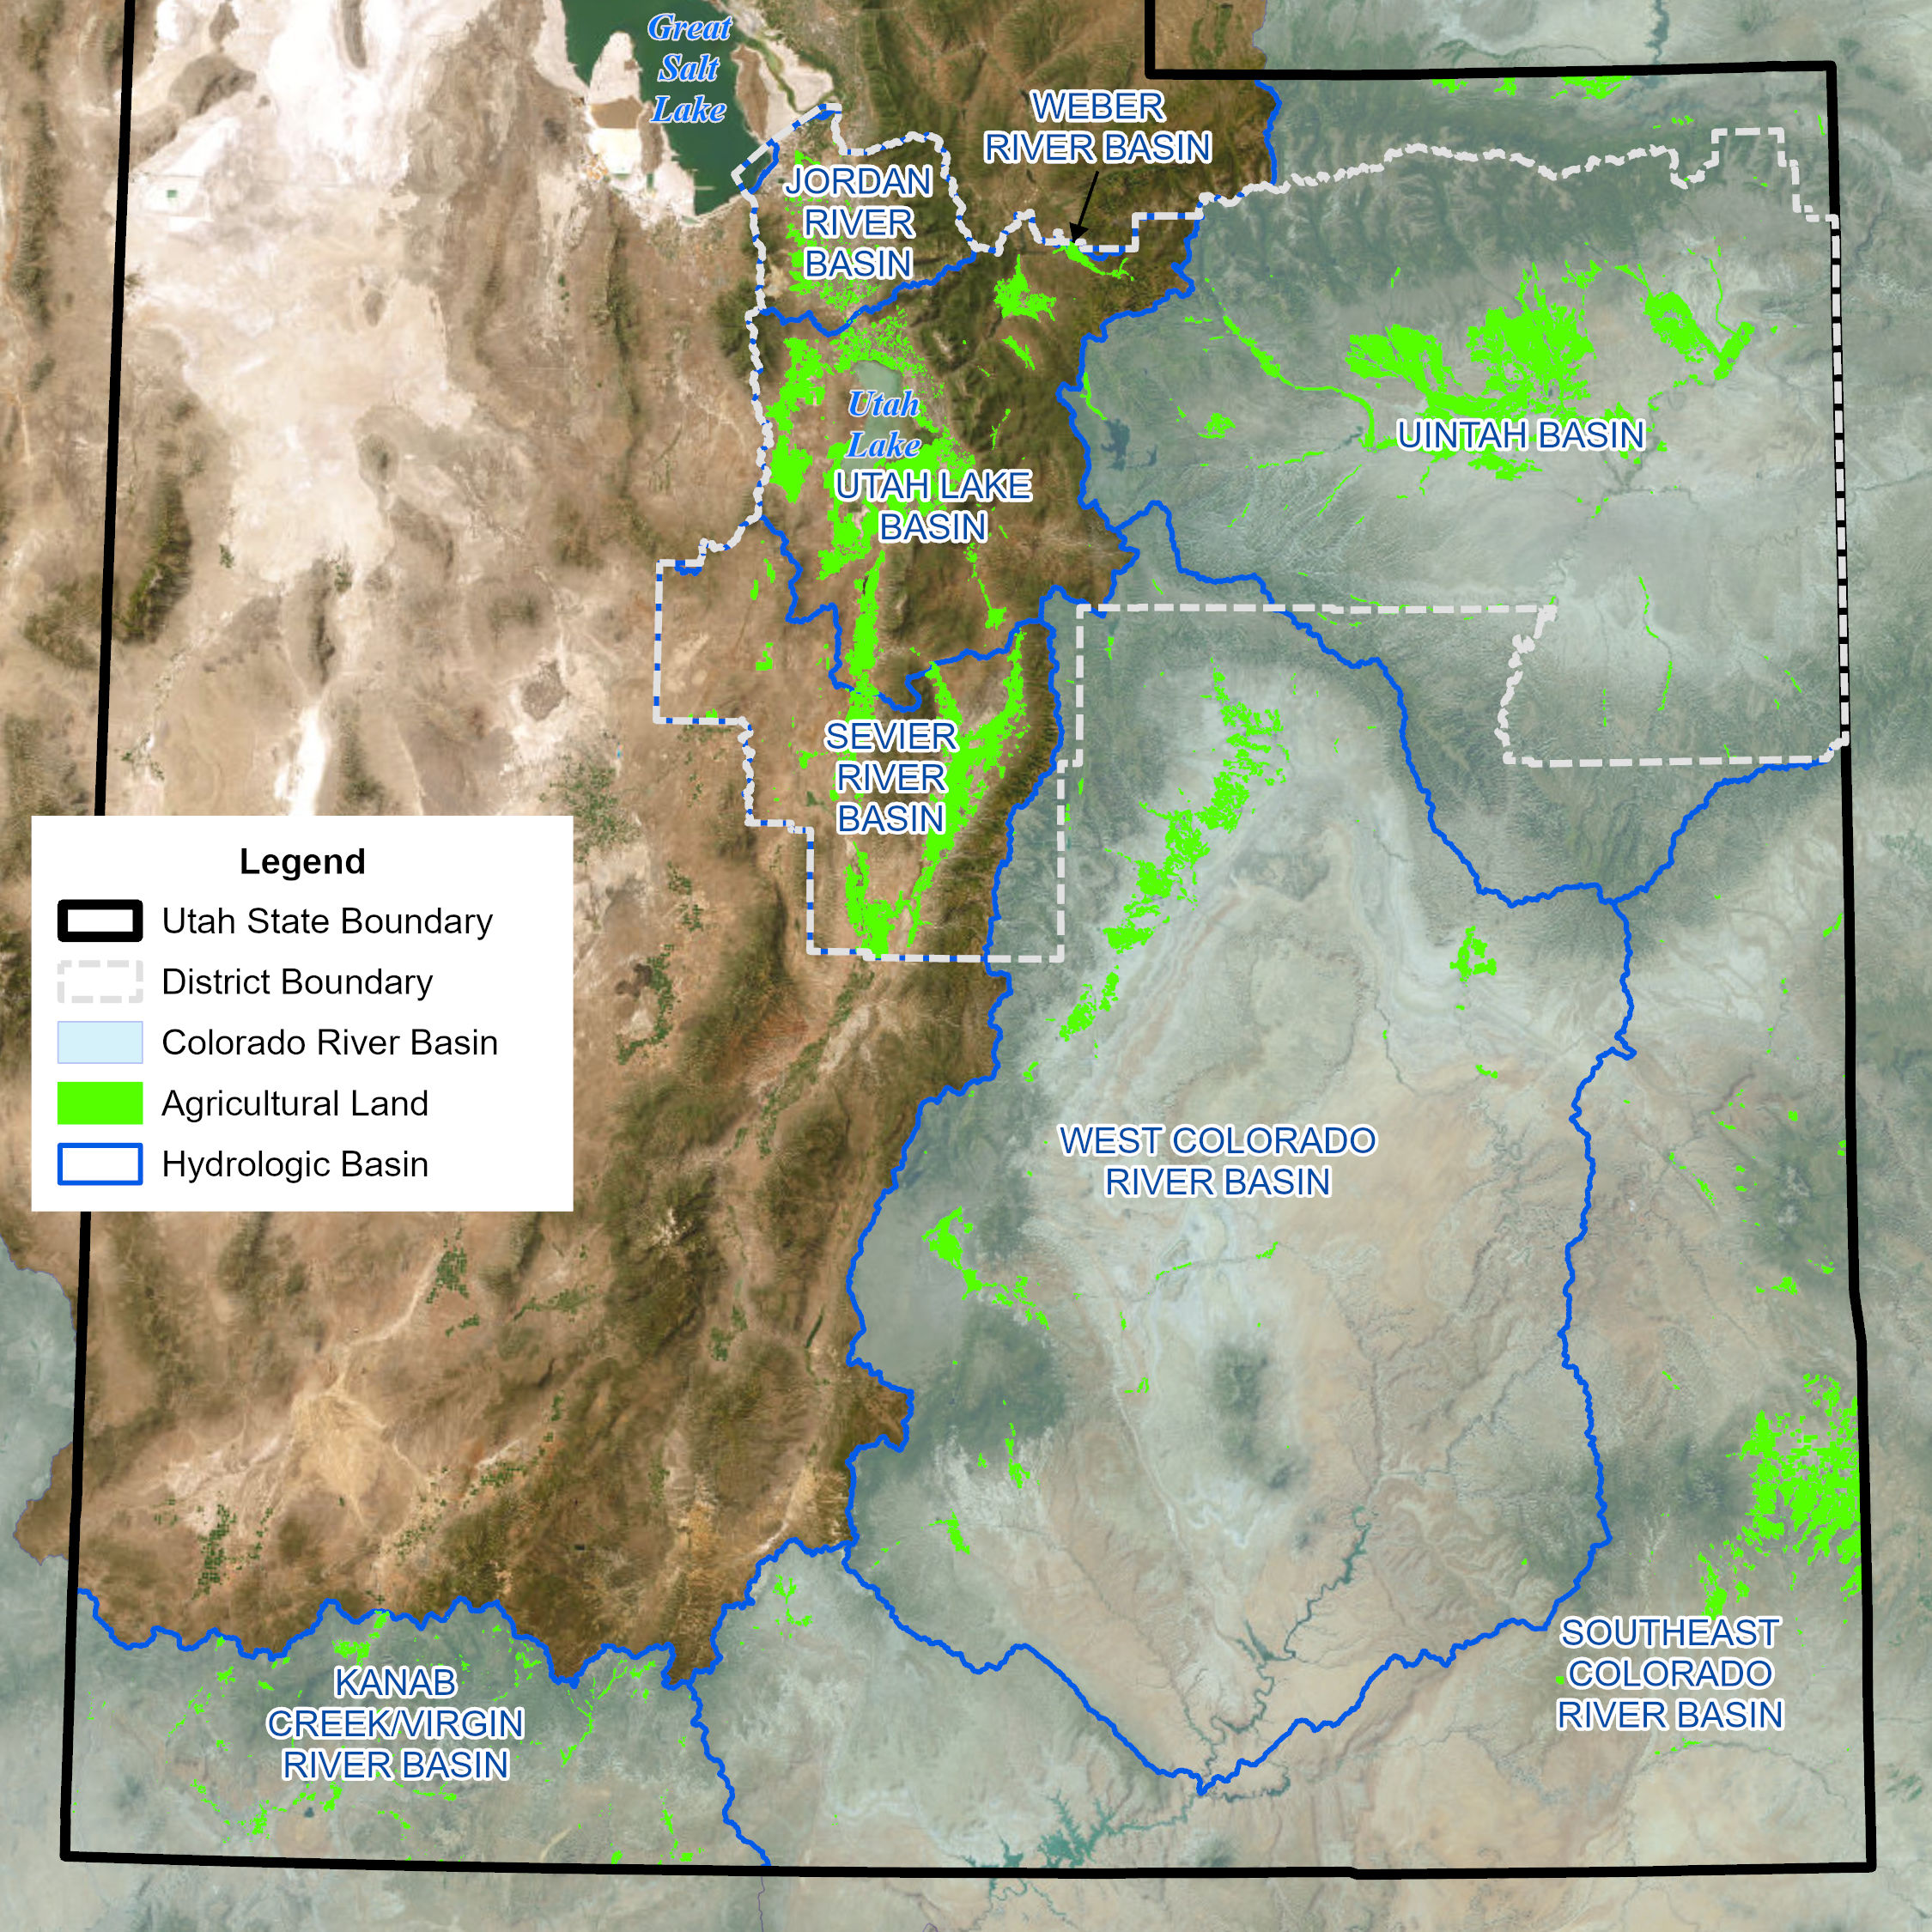
Drought Mitigation
Agricultural Water Resiliency Study
FY23-24
Agricultural Water Optimization Investigations
USU Ag Water Optimization Project
FY23
NDrip Irrigation Project
FY23
PC: Jacobs Engineering

Slide 13
Drought Mitigation
Agricultural Water Resiliency Initiatives
System Conservation Pilot Program for 2023
FY23-24
Ag Water Demonstration, Research, & Implementation Pilot Program (AgDRIP)
FY23-27
Demand Management Pilots
FY24-27

Slide 14
Drought Mitigation
Utah Colorado River Accounting and Forecasting Model (UCRAF)
Duschesne River Drainage Pilot
FY23-25
San Rafael & Price River Drainages
FY24-25

Slide 15
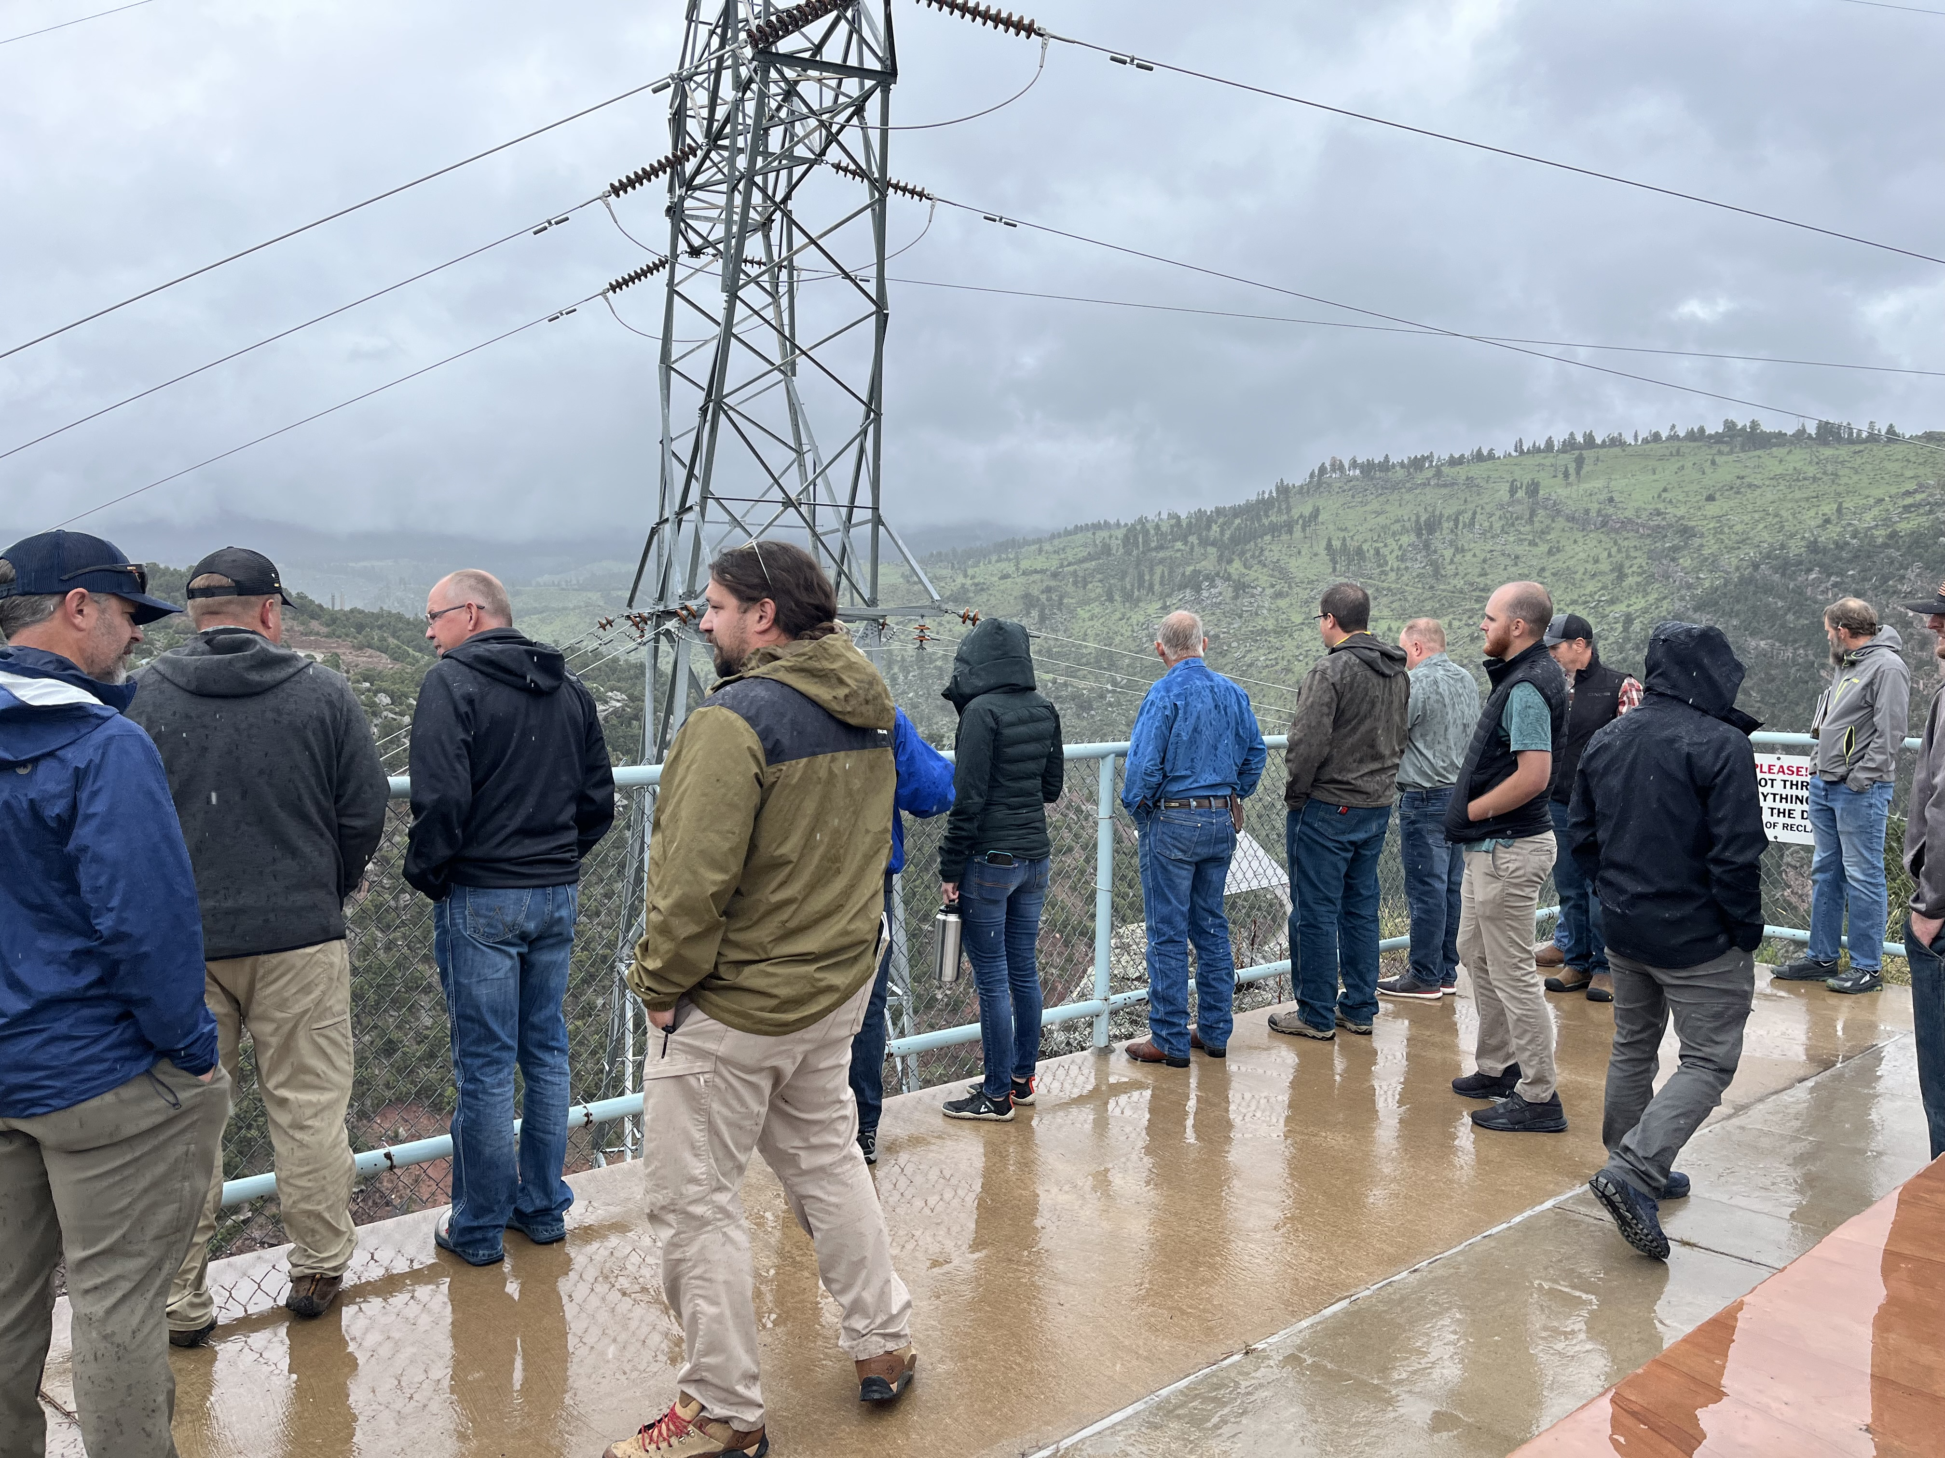
Advisory Councils
FY23-27

Slide 16
Next Steps
June 22, 2023
July 1, 2023
Board Action in Board Meeting
Final Draft Released

Slide 17
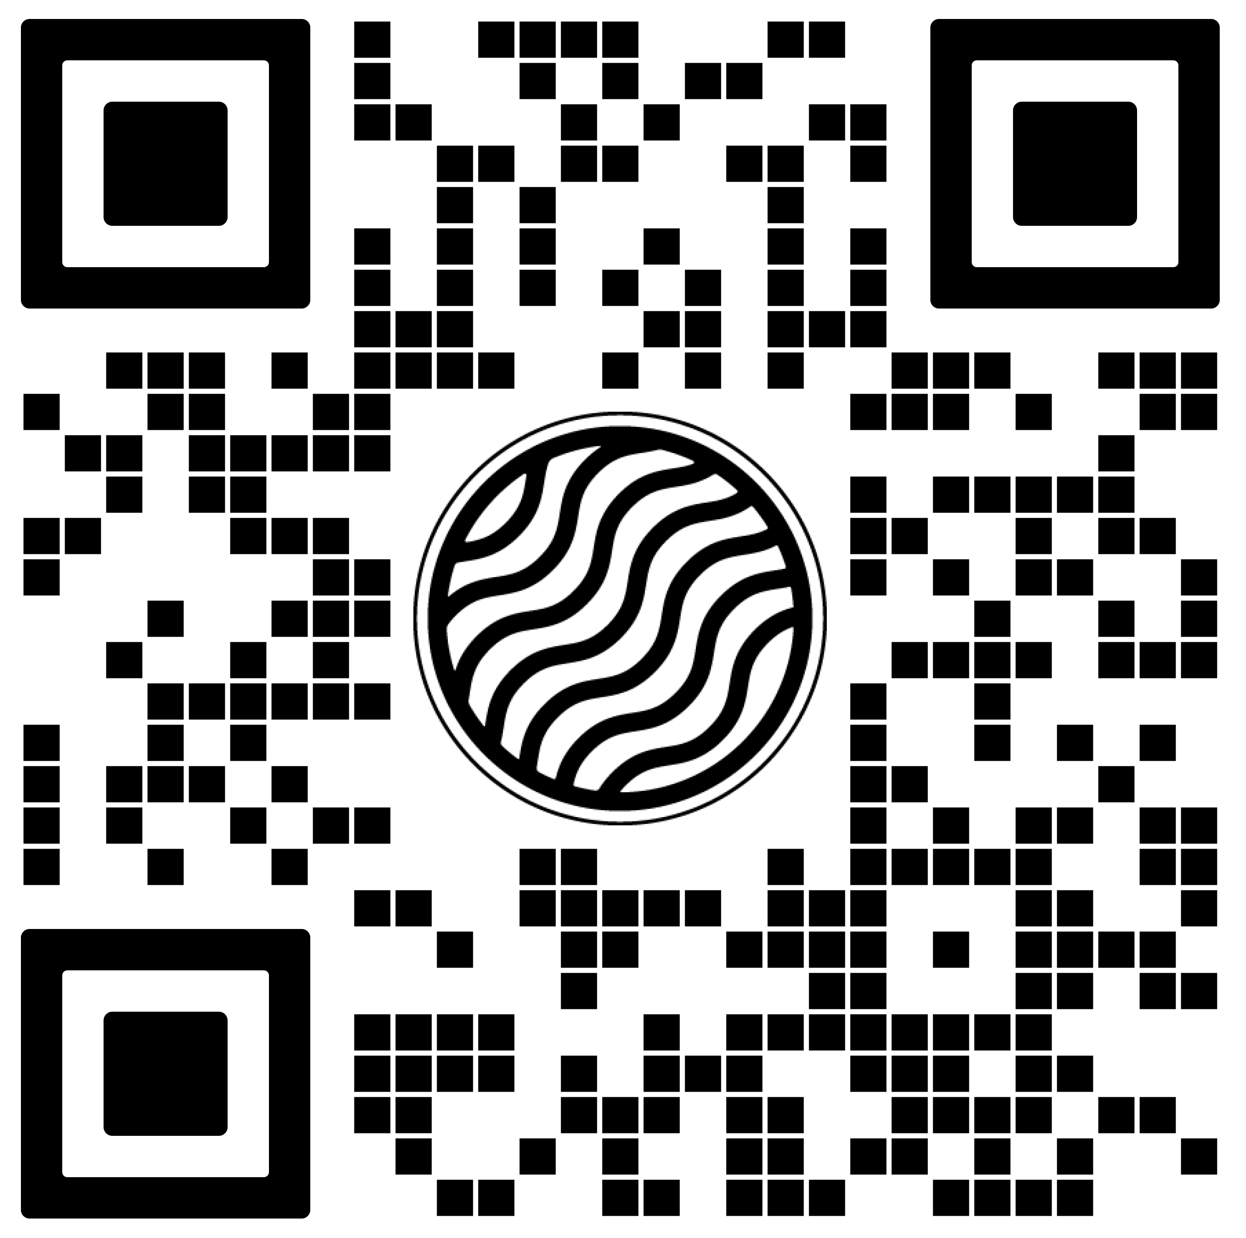
cra.utah.gov
@AuthorityUT
@AmyHaasColoRivr

