Slide 1
Hydrology Update
Board Meeting
June 22, 2023

Slide 2
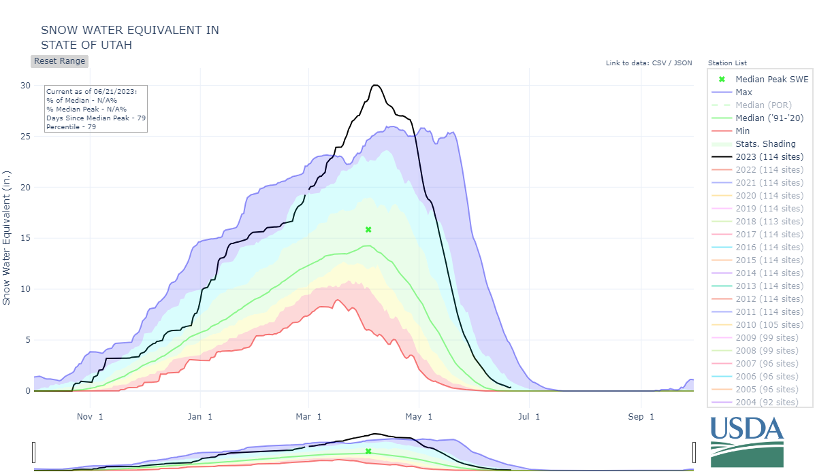

Slide 3
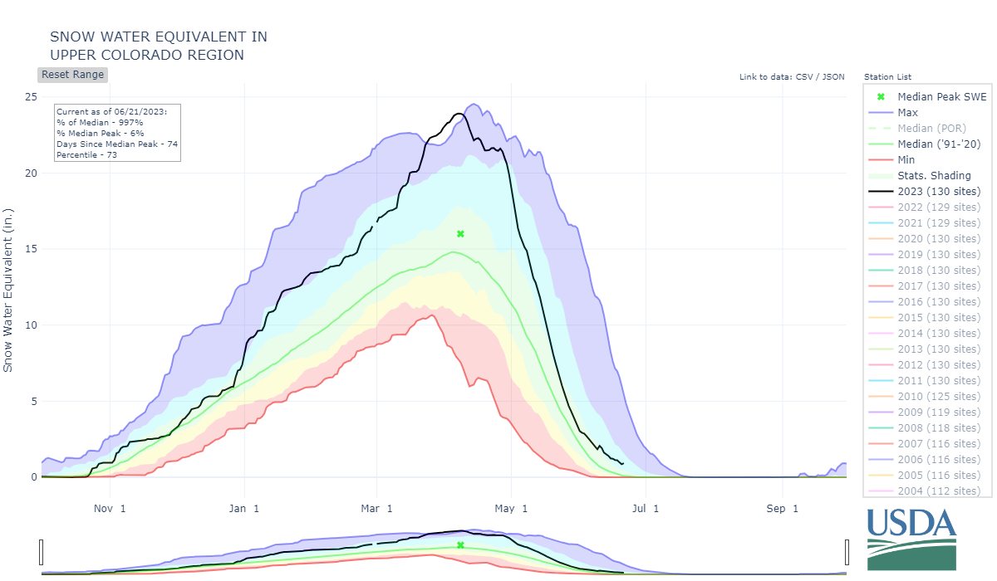

Slide 4
Reservoir | Percent Full |  | Content (MAF) | Content (MAF) | Elevation (feet)
Status | 4/16 | 6/20 | 4/16 | 6/20 | 4/16 | 6/20
Lake Powell | 23% | 39% | 5.318 | 9.142 | 3,521.00 | 3,578.08
Lake Mead | 29% | 31% | 7.461 | 8.081 | 1,046.90 | 1,055.44
Total System Content | 32% | 43% | 19.131 | 25.074 | NA | NA
Total System Content (one year ago) | 35% | 35% | 20.647 | 20.839 | NA | NA
WATER YEAR 2023 PRECIPITATION TO DATE 121%

Slide 5
Min 3,579
Most 3,588
Max 3,616

Slide 6
Min 1,065
Most 1,069
Max 1,081

Slide 7
Drought Response Operations Agreement

Slide 8
Drought Response Operations Agreement
Sept 30, 2023, DROA FG Balance* = ~333.5 KAF
*Values based on 2023 DROA plan; Volumes based on Flaming Gorge Elevation Capacity Curve

