Slide 1
System Status Update October 2023
Colorado River Authority of Utah Board Meeting
Lily Bosworth, Staff Engineer
OCTOBER 19, 2023
SALT LAKE CITY, UTAH

Slide 2
Hydrology

Slide 3
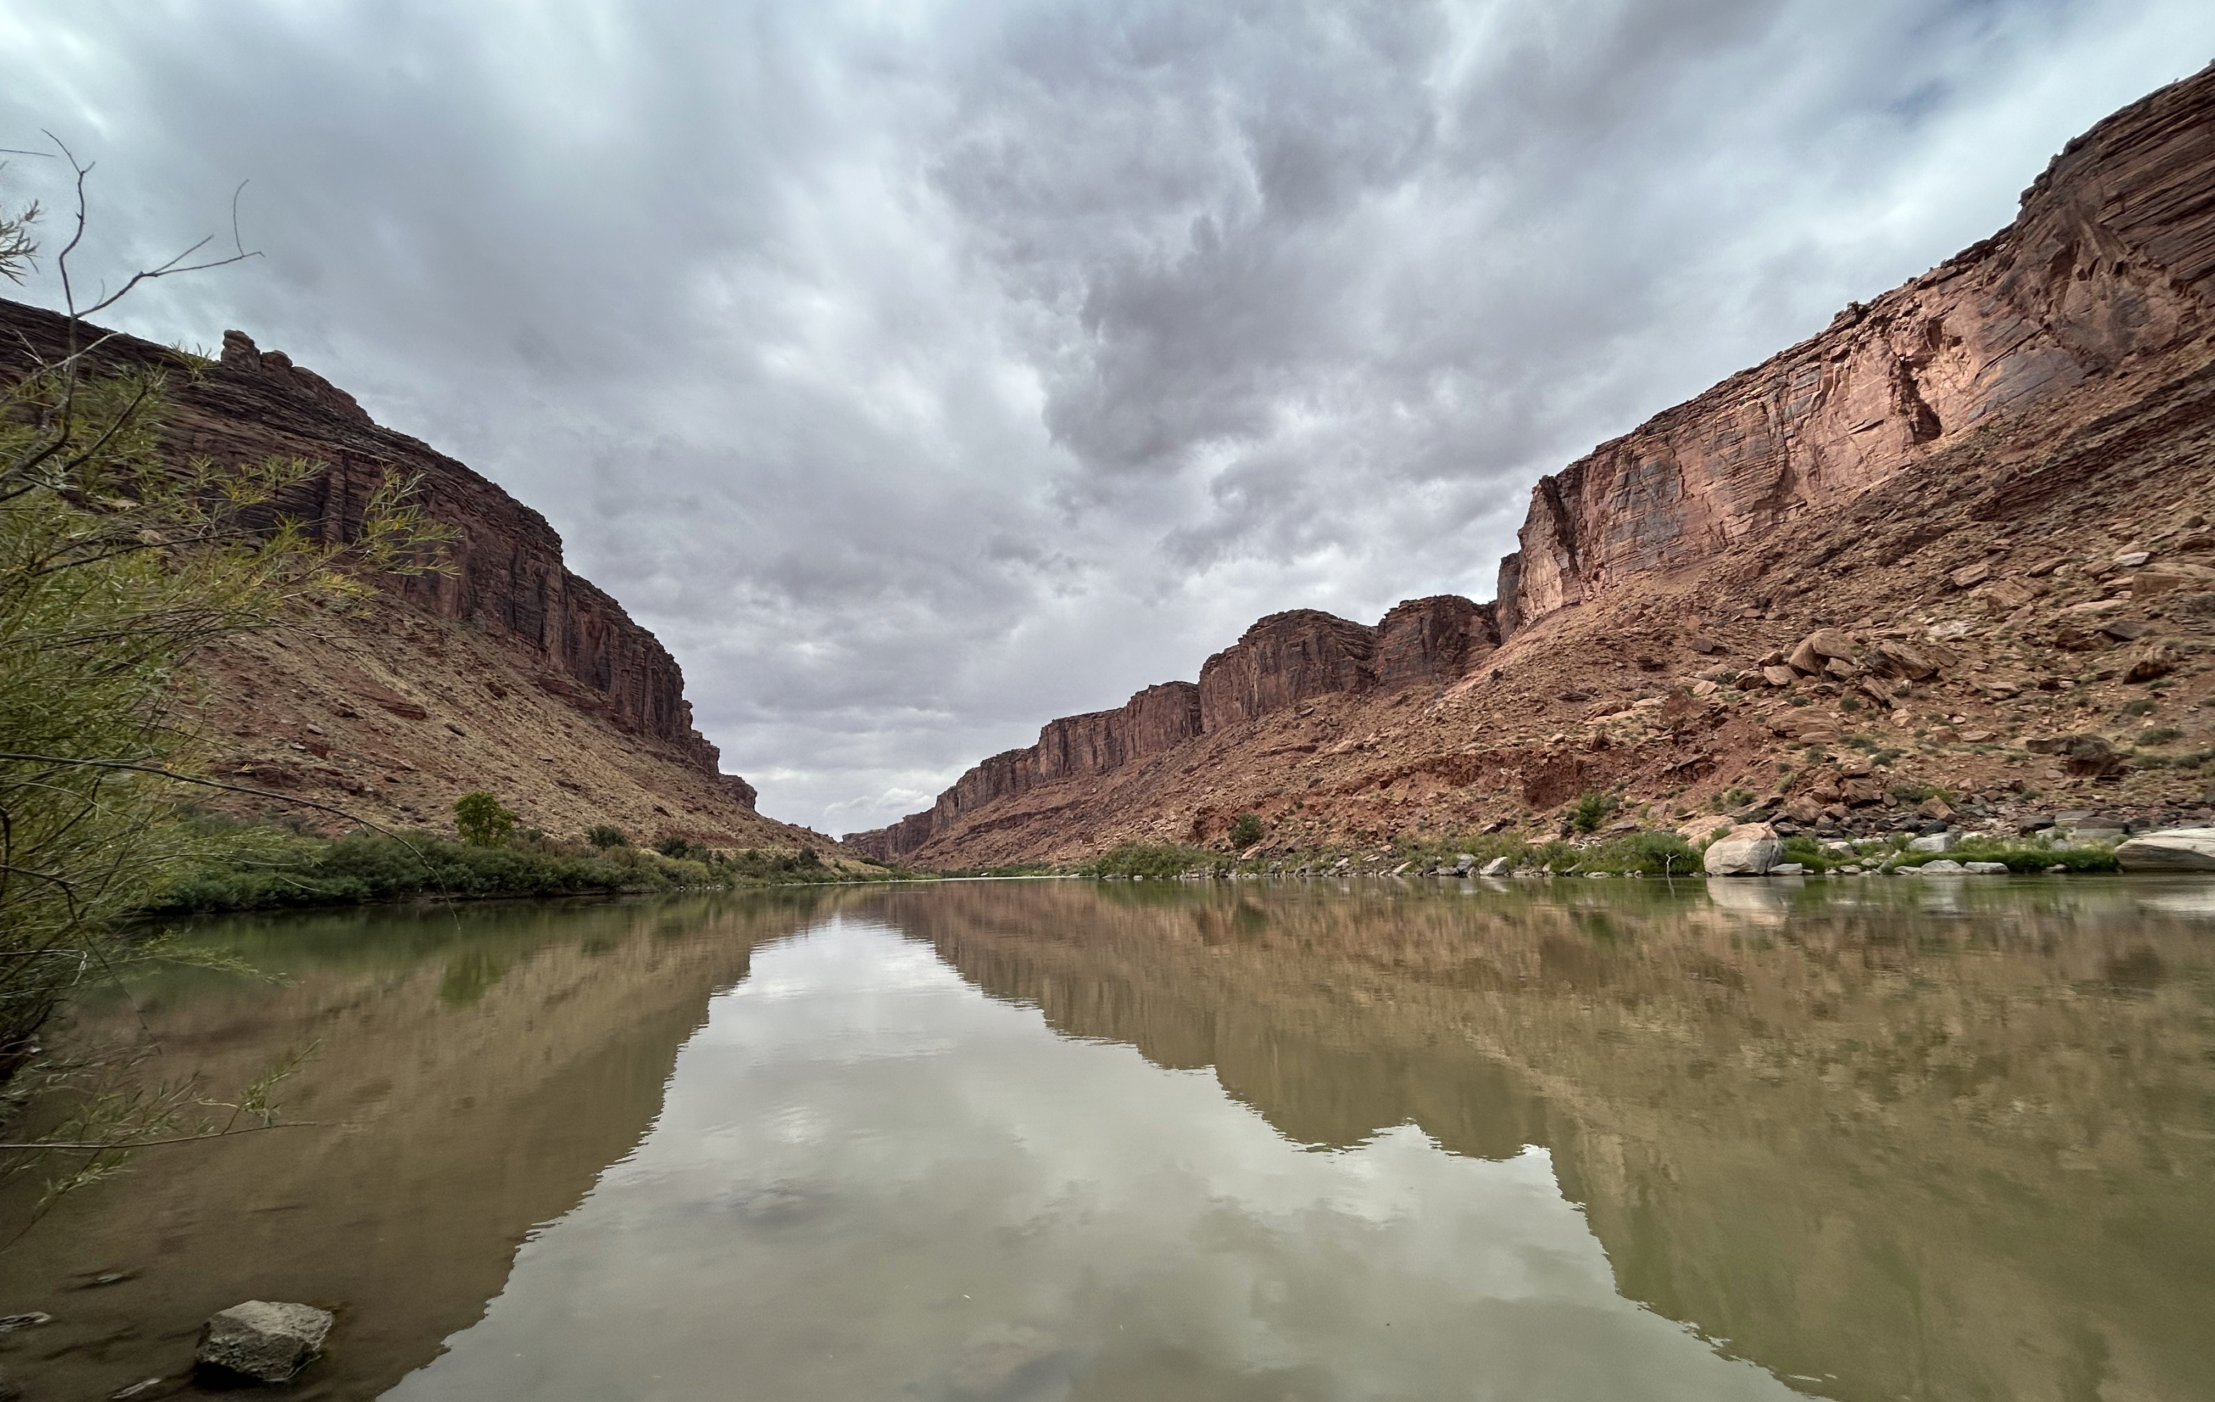
Colorado River on October 1, 2023

Slide 4
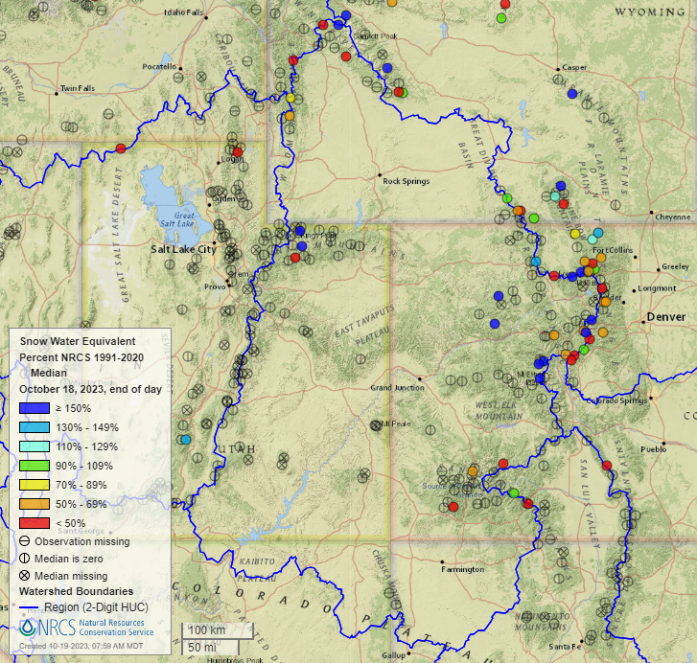
Surface Hydrology: October 18 Snow
Dry subsurface conditions suggest long-term drought impacts remain
Early snow in the high country – storm and melt cycles
ASO Proposal Selected
ASO agreement executed

Slide 5
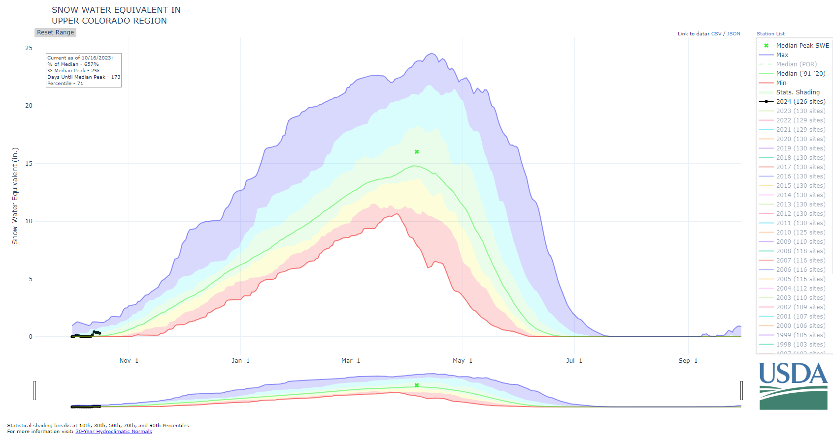
Surface Hydrology: Water Year 2024 Snow
Early snow accumulation beginning

Slide 6
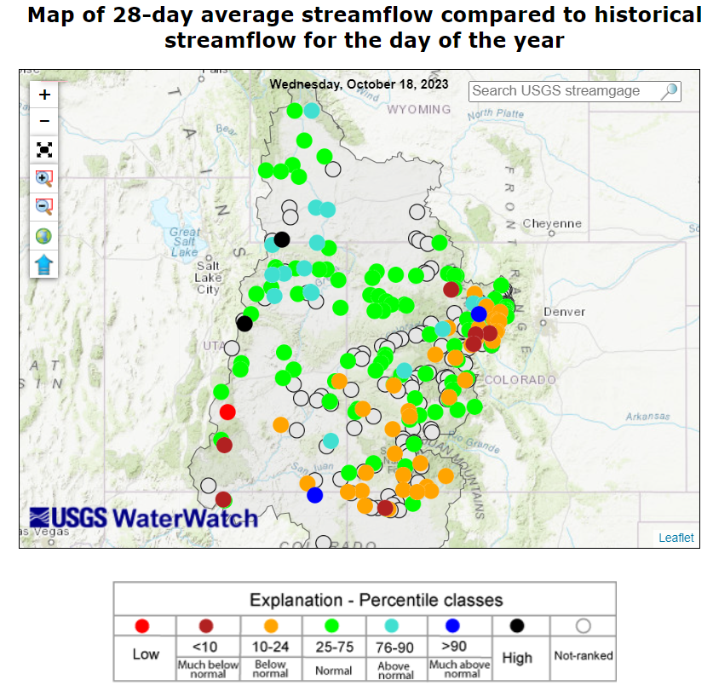
Surface Hydrology: Mid-October 2023
Normal streamflow in the north
Dry, below normal conditions expand in the south

Slide 7
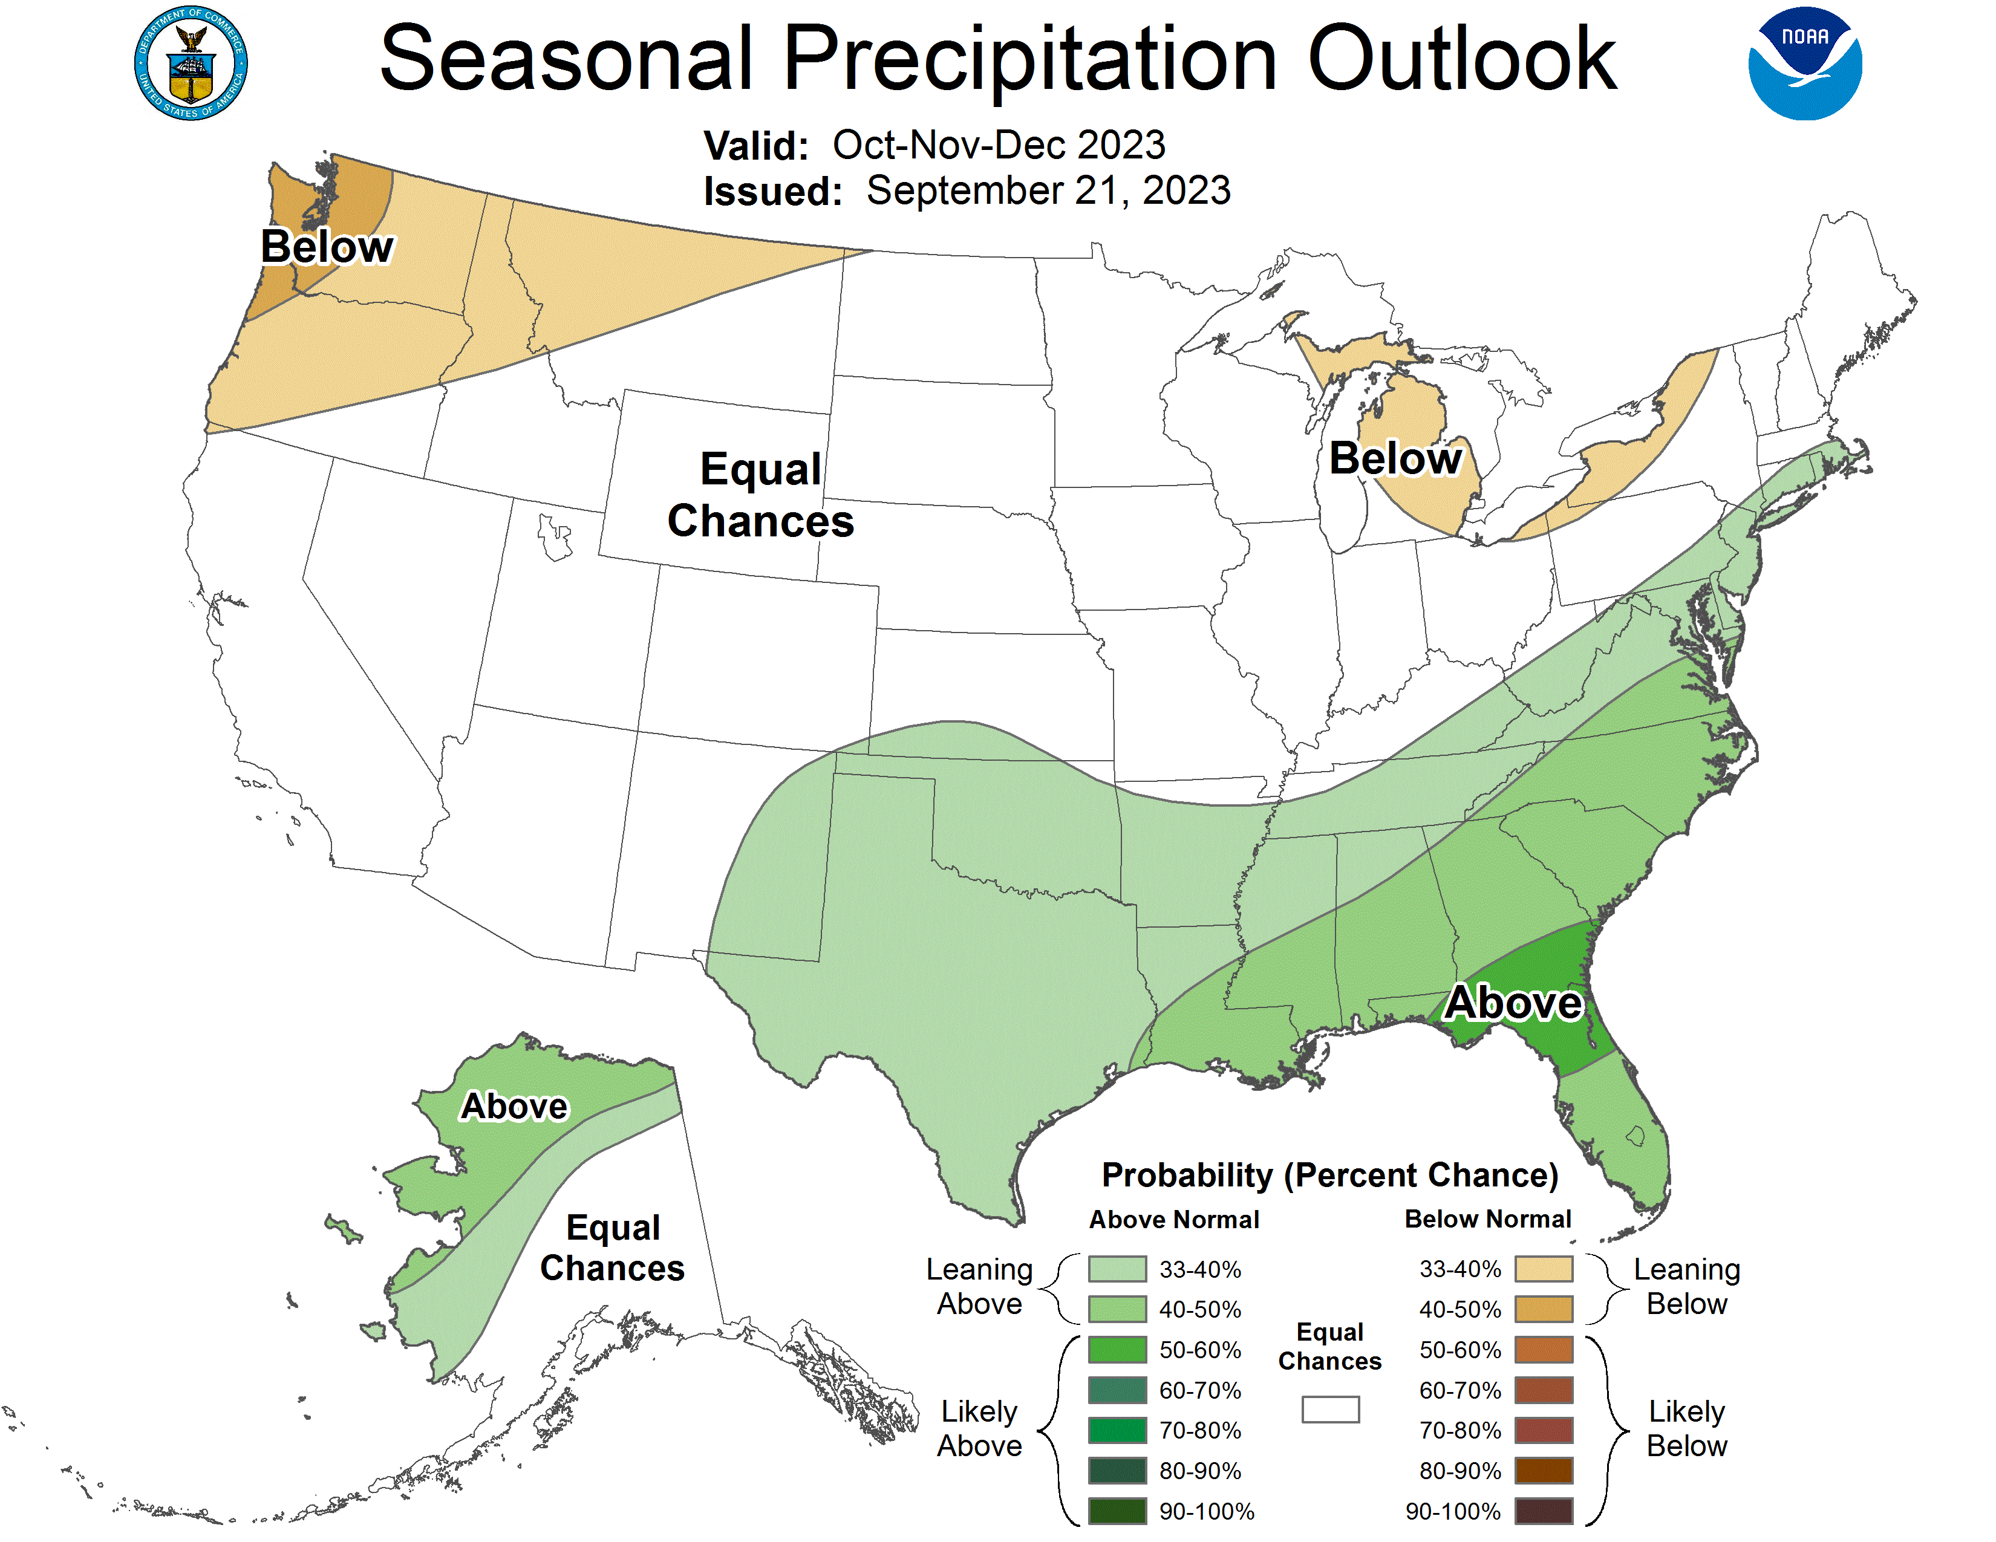
Atmospheric Hydrology: Precipitation Outlook
Quarter 1 of WY 24 Upper Colorado River Basin precipitation likely normal

Slide 8
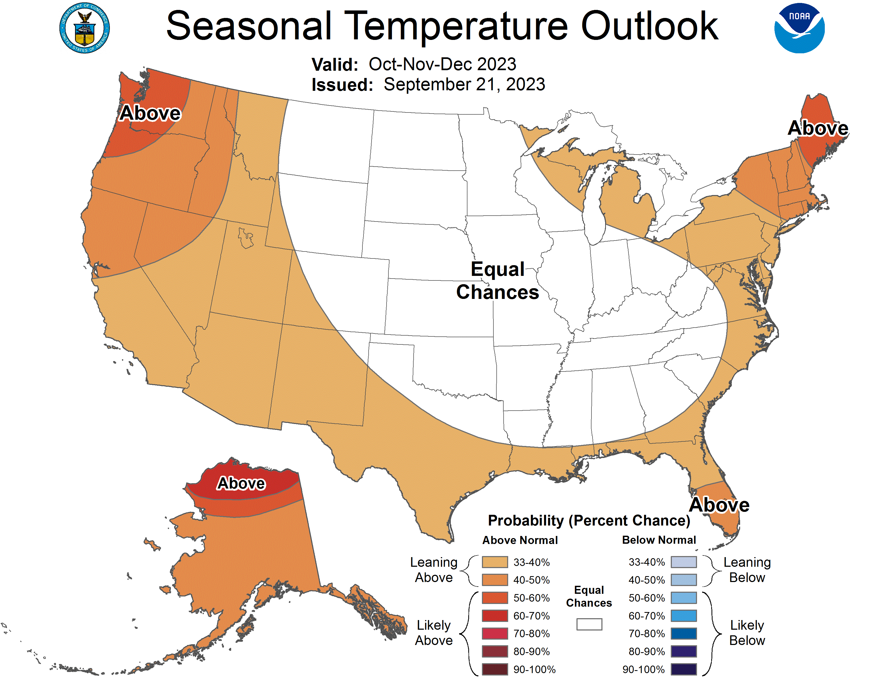
Atmospheric Hydrology: Temperature Outlook
Quarter 1 of WY 24 Upper Colorado River Basin temperature likely above normal

Slide 9
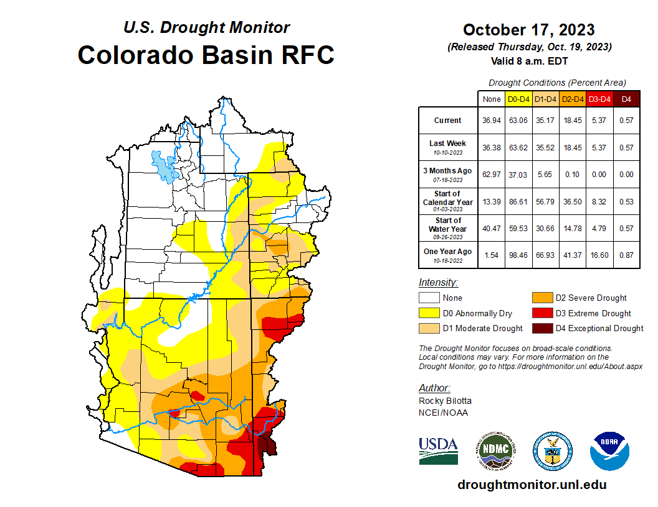
Drought Conditions: Current U.S. Drought Monitor
None to Moderate in Upper Colorado River Basin
Increased severity in SE Colorado River Basin
Beginning Water Year 2024, drought conditions persist in the Colorado River Basin

Slide 10
System Operations

Slide 11
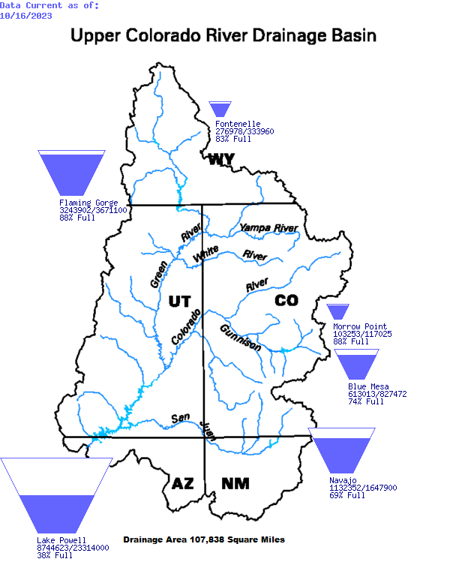
Upper Basin Storage: October 16, 2023
Northern units relatively full
Lake Powell remains relatively low

Slide 12
Powell, Mead and System Storage: October 16, 2023
Reservoir | Percent Full | Storage (MAF) | Elevation (feet)
Lake Powell | 38% | 8.748 | 3,573.02
Lake Mead | 34% | 8.903 | 1,066.23
Total System Content | 43% | 25.111 | NA
Total System Content (one year ago) | 33% | 19.513 | NA

Slide 13
Lake Powell Unregulated Inflow: Water Year 2023
 | Volume (MAF) | Percent of Normal
Preliminary Observed WY 2023 | 13.421 | 140%
Observed April-July 2023 | 10.619 | 166%
Observed September 2023 | 0.224 | 65%

Slide 14
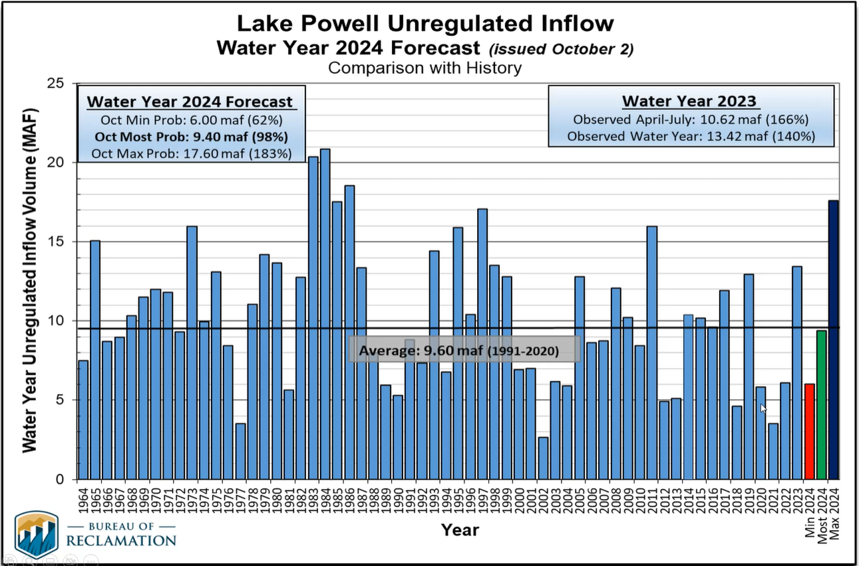

Slide 15
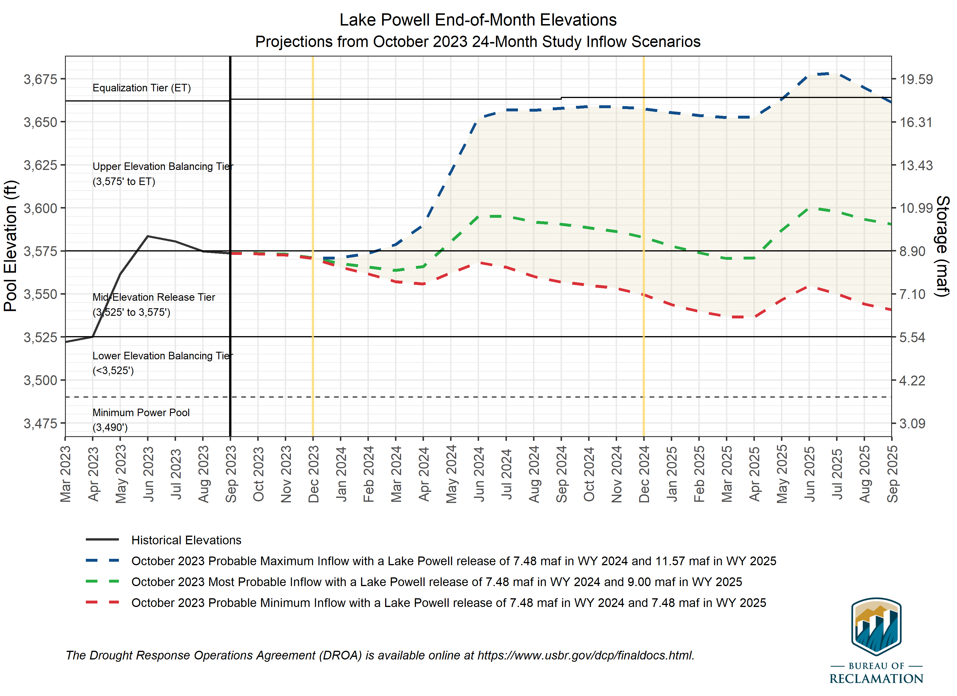
Most probable end of CY24: 3582.9’ (41% full)
Min/Max Range: 3549.4’ – 3657.4’
Most probable end of CY23: 3570.9’ (37% full)

Slide 16
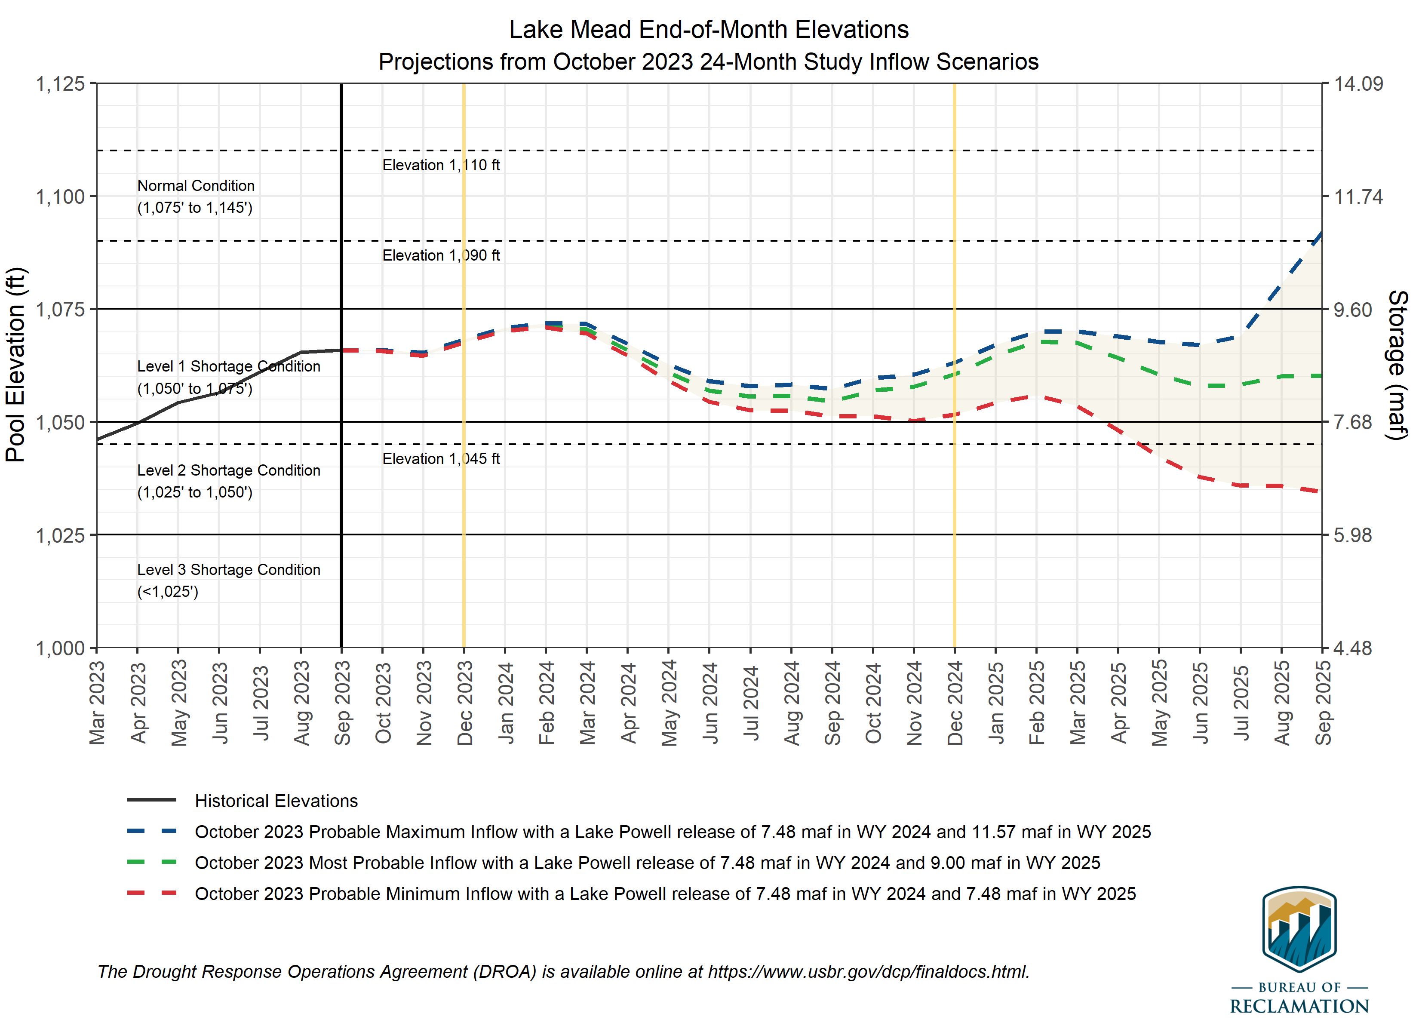
Most probable end of CY24: 1060.5’ (32% full)
Min/Max Range: 1051.6’ – 1063.1’
Most probable end of CY23: 1067.9’ (35% full)

Slide 17
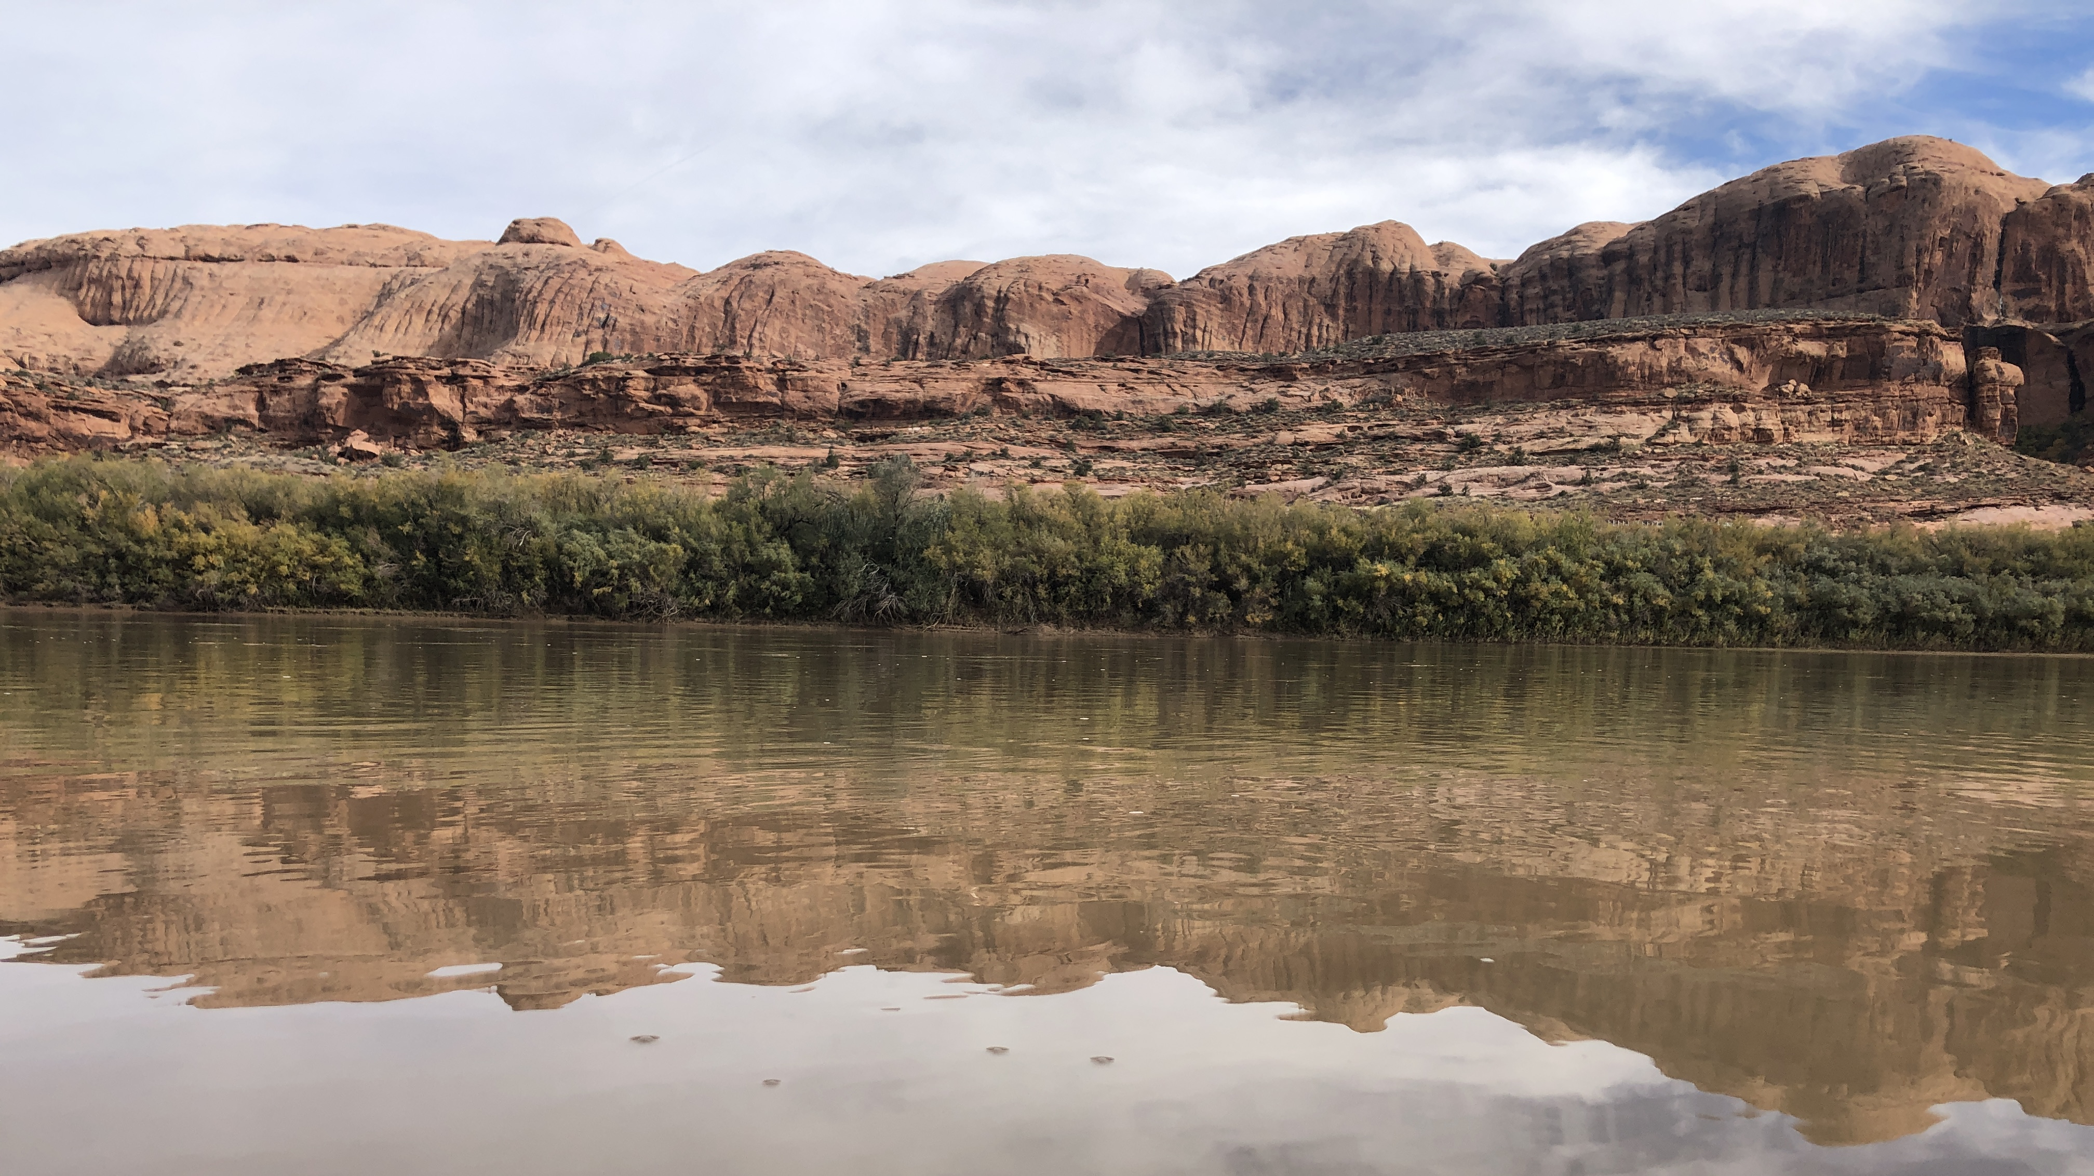
8
cra.utah.gov
@AuthorityUT
@AmyHaasColoRivr

