Slide 1
2024 System Conservation Pilot Program
Colorado River Authority of Utah Board Meeting
Lily Bosworth, Staff Engineer
OCTOBER 19, 2023
SALT LAKE CITY, UTAH

Slide 2
What is SCPP?
An opportunity for Temporary, Voluntary, and Compensated consumptive water use reduction in the Upper Colorado River Basin.
Open to municipal, industrial, and agricultural water users.
Federally funded, administered by the Upper Colorado River Commission.
Notes:
On June 14th, facing declining levels in Lakes Mead and Powell, the United States Bureau of Reclamation (BOR) outlined the need for an additional 2.0 – 4.0 MAF/year of contributions to Lake Powell and Lake Mead to avoid critically low reservoir levels. On July 19th the Upper Division States of Colorado, New Mexico, Utah and Wyoming, acting through the Upper Colorado River Commission (UCRC) outlined a 5 Point Plan to provide contributions from the Upper Division States. A key component of the 5-Point Plan is establishing a System Conservation Pilot Program (SCPP) for 2023. The purpose of the SCPP is to create conserved water from temporary, voluntary, and compensated measures with the goal to mitigate the impacts of on-going drought and depleted storage in the Upper Colorado River Basin. Previously, the UCRC, BOR, Upper Division States along with municipal funders conducted a system conservation pilot program from 2015 through 2018. The new SCPP will be conducted by the Upper Division States acting through the UCRC in cooperation and funded by BOR.

Slide 3
What is not SCPP?
A “buy and dry” program.
A Demand Management program involving water shepherding.
Notes:
On June 14th, facing declining levels in Lakes Mead and Powell, the United States Bureau of Reclamation (BOR) outlined the need for an additional 2.0 – 4.0 MAF/year of contributions to Lake Powell and Lake Mead to avoid critically low reservoir levels. On July 19th the Upper Division States of Colorado, New Mexico, Utah and Wyoming, acting through the Upper Colorado River Commission (UCRC) outlined a 5 Point Plan to provide contributions from the Upper Division States. A key component of the 5-Point Plan is establishing a System Conservation Pilot Program (SCPP) for 2023. The purpose of the SCPP is to create conserved water from temporary, voluntary, and compensated measures with the goal to mitigate the impacts of on-going drought and depleted storage in the Upper Colorado River Basin. Previously, the UCRC, BOR, Upper Division States along with municipal funders conducted a system conservation pilot program from 2015 through 2018. The new SCPP will be conducted by the Upper Division States acting through the UCRC in cooperation and funded by BOR.

Slide 4
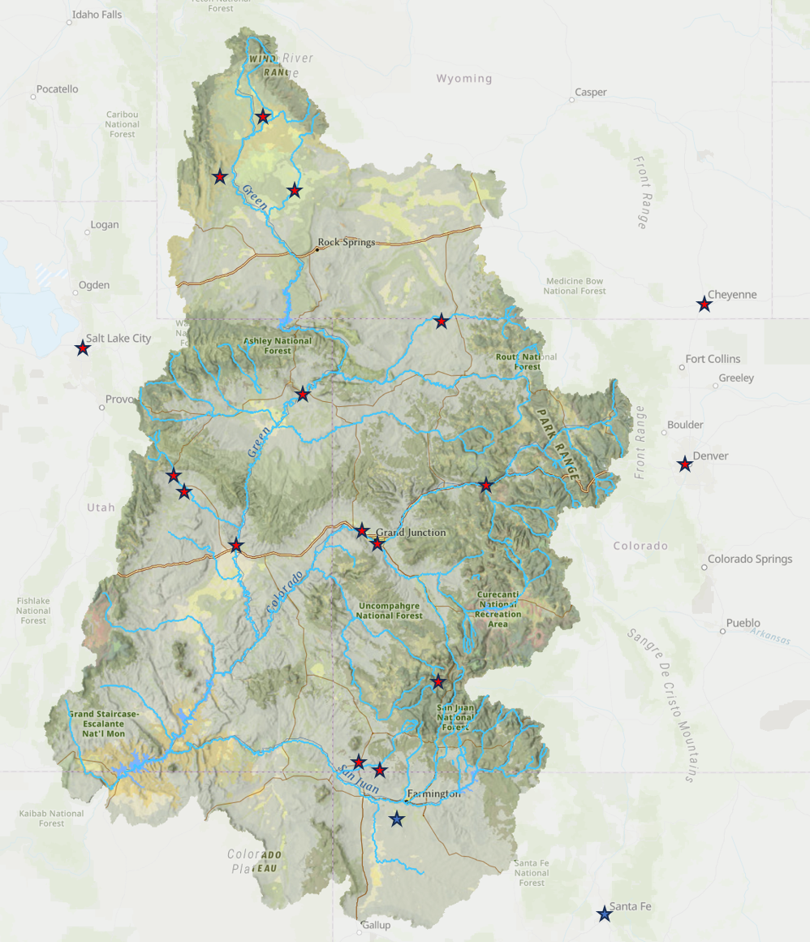
Recap SCPP 2023: Lessons Learned
UCRC SCPP 2023 Feedback Tour
Timing
Pricing
Conserved Consumptive Use
Messaging
Transparency
Notes:
Attendees know more acutely than most Utahns that we are in a severe drought.
Water supply on the Colorado River above Lake Powell has been significantly lower than average,
Limiting water availability for agricultural users, and drawing down Lake Powell’s elevation to a critical point.
The drought threatens Utah’s agricultural and rural economies and culture,
Our ability to provide reliable water and power to those who depend on Lake Powell operations,
And Utah’s obligations to the other basin states and Mexico under the 1922 Colorado River Compact

Slide 5
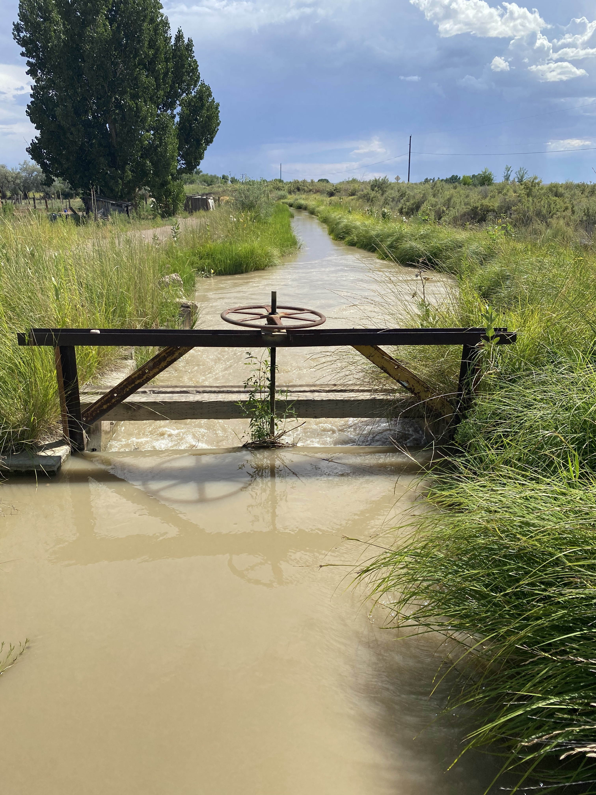
SCPP Reauthorized for 2024
Focused scope of eligible projects:
Exploration of Demand Management feasibility and/or
Support innovation and local resiliency in water conservation
Lessons learned applied
Notes:
Attendees know more acutely than most Utahns that we are in a severe drought.
Water supply on the Colorado River above Lake Powell has been significantly lower than average,
Limiting water availability for agricultural users, and drawing down Lake Powell’s elevation to a critical point.
The drought threatens Utah’s agricultural and rural economies and culture,
Our ability to provide reliable water and power to those who depend on Lake Powell operations,
And Utah’s obligations to the other basin states and Mexico under the 1922 Colorado River Compact

Slide 6
Timeline
Tentative Info Sessions:
1 Virtual, 5 In-Person
November 3-9
09.21.2023
10.27.2023
12.2023
UCRC Press Release on Reauthorization
Utah-Specific Outreach
(Details TBD)
Contracting, Implementation, & Verification
UCRC Reauthorized SCPP for 2024
10.04.2023
RFP Release & UCRC Kick-Off Webinar 10 am
11.2023
Proposals Due
(Day TBD)
2024

Slide 7
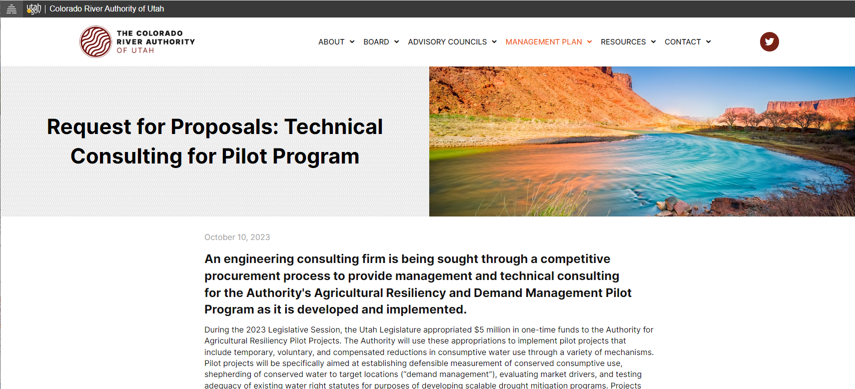
Request for Proposals: Program Management and Technical for Consulting for Agricultural Resiliency and Demand Management Pilot Program
RFP Opened 10/10, Closes 11/15 - Access on Website

Slide 8
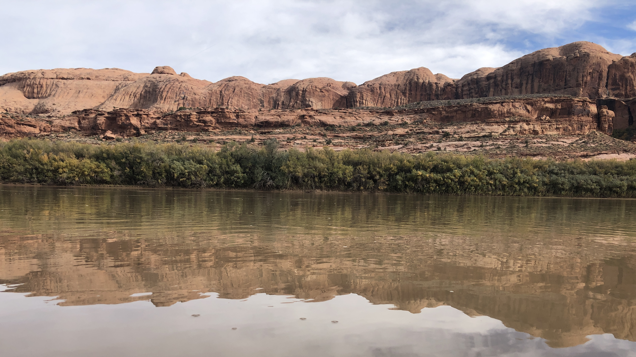
8
Contact Lily Bosworth with questions.
lbosworth@utah.gov | (801) 824-9037
cra.utah.gov
@AuthorityUT
@AmyHaasColoRivr

Slide 9
Recap SCPP 2023: Outcomes
Proposals by State: | Selected: 64
Utah | 20
Colorado | 22
Wyoming* | 21
New Mexico | 1
Total: | 4-State | Utah
Selected Projects | 64 | 20 (31% of total)
Project Types | Ag, Municipal, Industrial | Ag, Municipal, Industrial
Conserved Volume (Acre-Feet) | 37,810 | 15,090 (40% of total)
Total Expense | $15,969,035 | $5,439,590 (34% of total)
Average Price Per Acre-Foot | $422 Weighted | $360 Weighted
Notes:
Attendees know more acutely than most Utahns that we are in a severe drought.
Water supply on the Colorado River above Lake Powell has been significantly lower than average,
Limiting water availability for agricultural users, and drawing down Lake Powell’s elevation to a critical point.
The drought threatens Utah’s agricultural and rural economies and culture,
Our ability to provide reliable water and power to those who depend on Lake Powell operations,
And Utah’s obligations to the other basin states and Mexico under the 1922 Colorado River Compact

Slide 10
Will my water right be subject to abandonment if I participate?
Forfeiture and abandonment do not apply to a water right if its place of use is contracted under an approved state agreement or federal conservation fallowing program like SCPP.
Utah Code (73-1-4(2)(e)(ii))
(iii) A water right, found to be valid in a decree entered in an action for general determination of rights under Chapter 4, Determination of Water Rights, is subject to a claim of forfeiture based on a seven-year period of nonuse that begins after the day on which the state engineer filed the related proposed determination of rights with the court, unless the decree provides otherwise.
…
(e) This section does not apply to:
(i) the beneficial use of water according to a lease or other agreement with the appropriator or the appropriator's successor in interest;
(ii) a water right if its place of use is contracted under an approved state agreement or federal conservation fallowing program;
(iii) those periods of time when a surface water or groundwater source fails to yield sufficient water to satisfy the water right

Slide 11
How is SCPP funded and administered?
Federal Inflation Reduction Act of 2022
$4,000,000,000 to
Bureau of Reclamation
for drought mitigation
$125,000,000 to
Upper Colorado River Commission for SCPP
Verification is conducted by UCRC and Authority
Water Users with approved proposals contract with and are paid by UCRC
Colorado River Authority of Utah and UCRC coordinate SCPP in Utah, receive, and review proposals
Upper Colorado River Commission
Board reauthorization
Water Users submit proposals to Authority and UCRC
Federal SCPP reauthorization via
Fiscal Year 2023 Omnibus Appropriations Bill
Optional:
Agents of Water User support proposal design and contracting process

Slide 12
Proposal Process
Water right must be historically, beneficially, comsumptively used.
Past use estimated with eeMetric – assistance available from Wilson Water Group
00
On the ground inspection with UCRC & others
eeMetric preferred, with other metering case by case
02
Assess Land & Water Use
Identify Verification Strategy
Optional:
Use an Agent
01
Assess Economics
03
Fixed firm price by project type
Option to propose and justify a higher price
Proposals due December (?) 2023

Slide 13
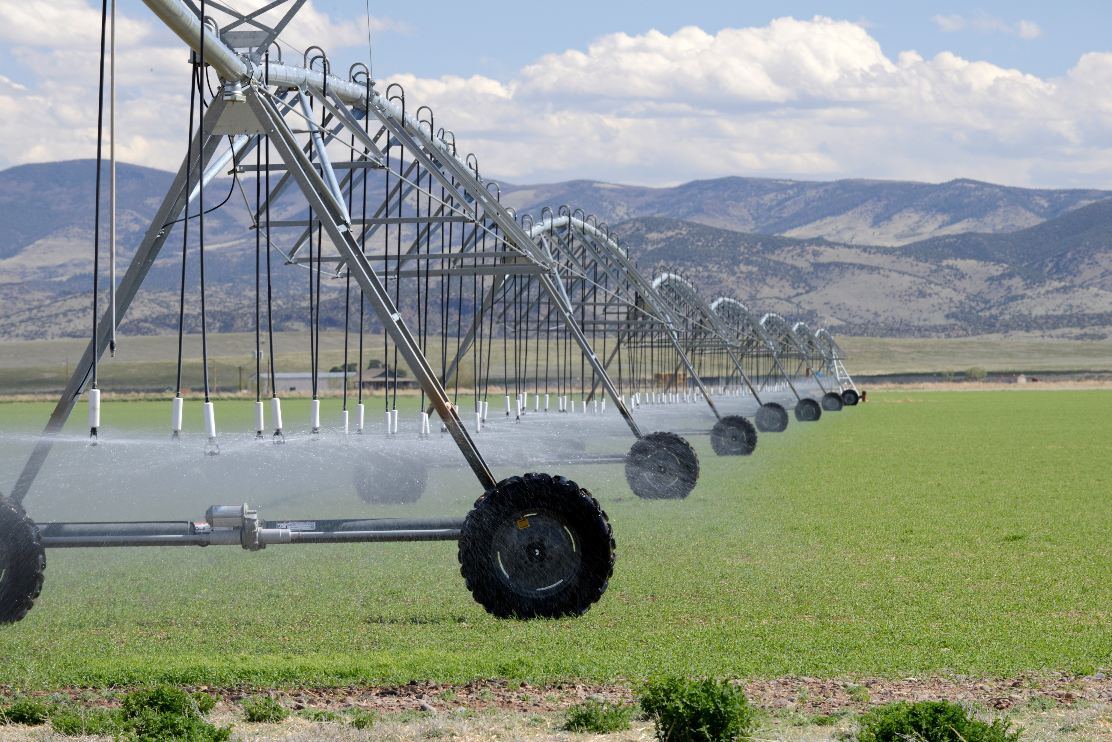
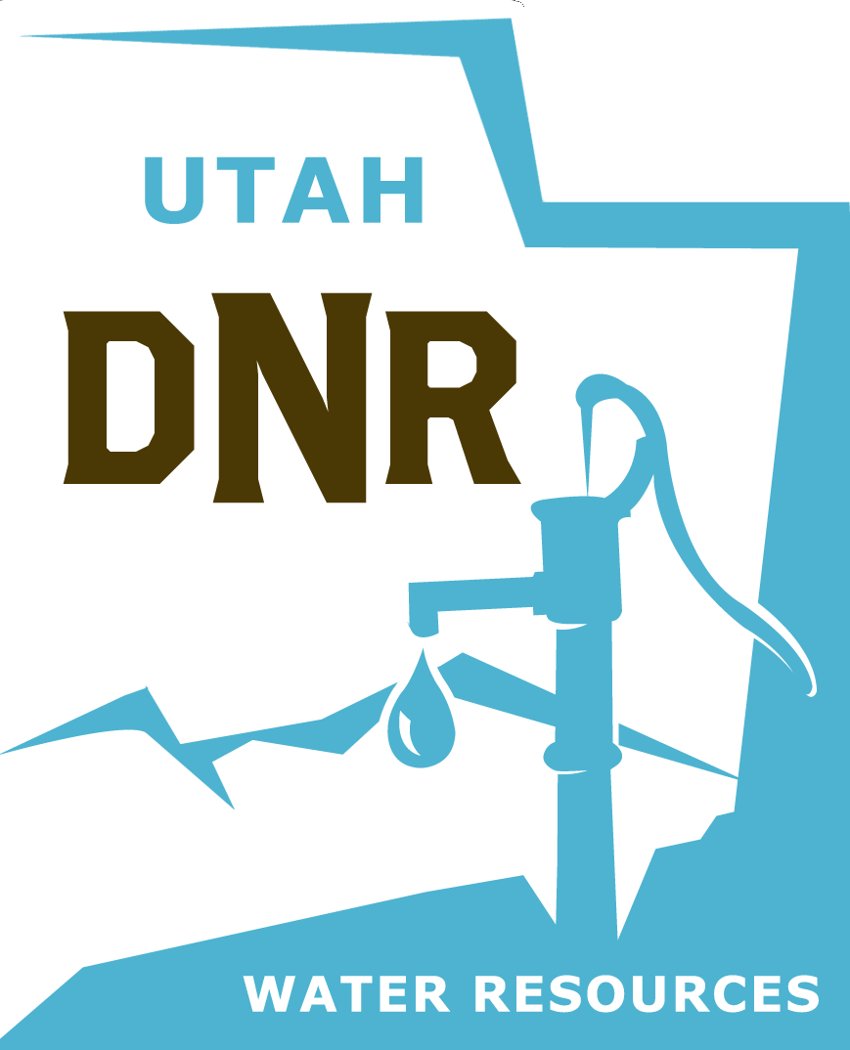
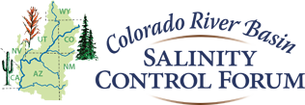
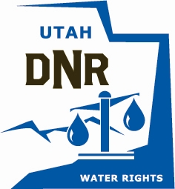
How does SCPP 2024 fit in with other ag water programs?
Ag Water
Optimization
Program
investment in infrastructure for water conservation
Water Users
AG-DRIP
Ag
Resiliency
Pilots
quantify and shepherd reduced depletion
Reduce water depletion to increase the resilience of water supply and maintain Colorado River Compact compliance
Water
Banking
Upper Basin-Wide
Ag Water
Conservation
SCPP 2023/24
Bucket 2
BIL (Dmd Mgmt)
implementation of operation-specific water conservation
resource for ag community to tailor water conservation opportunities to their operations
compensate for reduced depletion
Other Federal
Programs
investment in infrastructure for water conservation and quality
Engagement with:
Division of Water Rights
NGOs
Research Community

Slide 14
Details for Outreach
Define program administration contacts (UCRC, State rep, consultant, Reclamation).
Define what the program is compensating for (conserved, consumptively used water, or depletion, not diversion or acreage), and explain how compensation is calculated.
Detail on the compensation structure (provide fixed pricing-per-acre-foot by project type).
Context of program approvals and funding (i.e. federal funding authorized by Congress).
Water Rights protections.
Project review scoring structure and selection criteria.
Push applicants for more detail earlier – coordinates for verification infrastructure, letters from canal companies, etc.
Provide application preparation resources:
Connect with other conservation funding opportunities (i.e. Utah’s AgDRIP)
NGO Support
Mapping and Water Rights resources
Template Verification Plan
Timeline and milestones for applicants to expect

