Slide 1
System Status Update February 2024
Colorado River Authority of Utah Board Meeting
Betsy Morgan, Staff Engineer
February 27, 2024
SALT LAKE CITY, UTAH

Slide 2
Hydrology

Slide 3
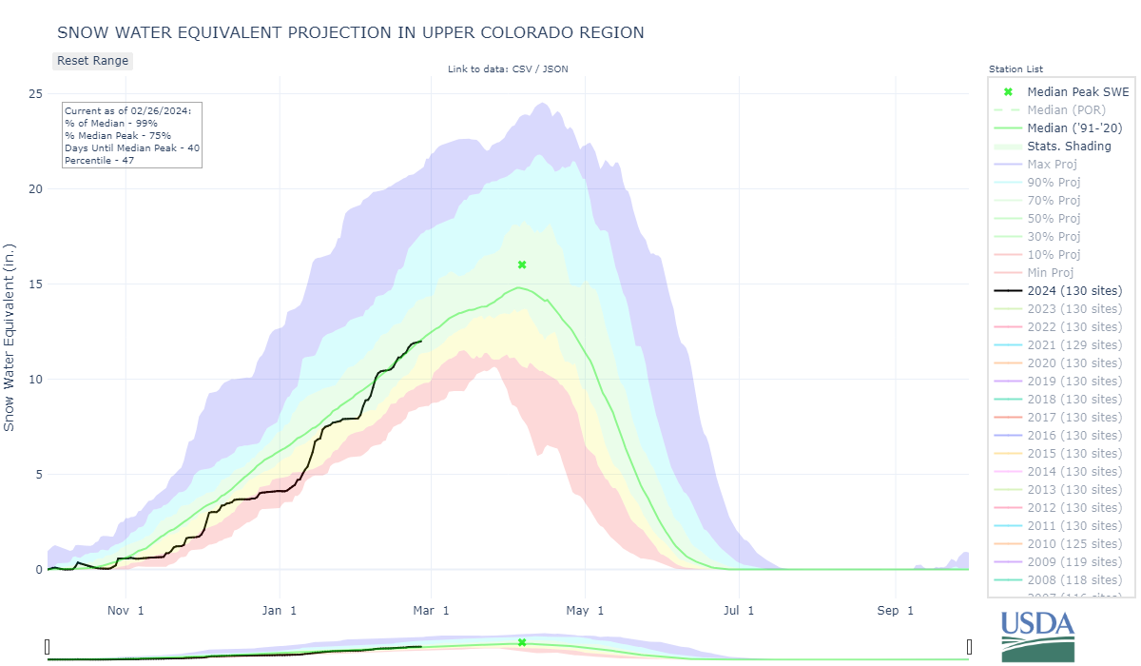
Upper Colorado River SWE
99% of Median
Early to mid-month storms
New Link! https://nwcc-apps.sc.egov.usda.gov/awdb/basin-plots/Proj/WTEQ/assocHUC2/14_Upper_Colorado_Region.html

Slide 4
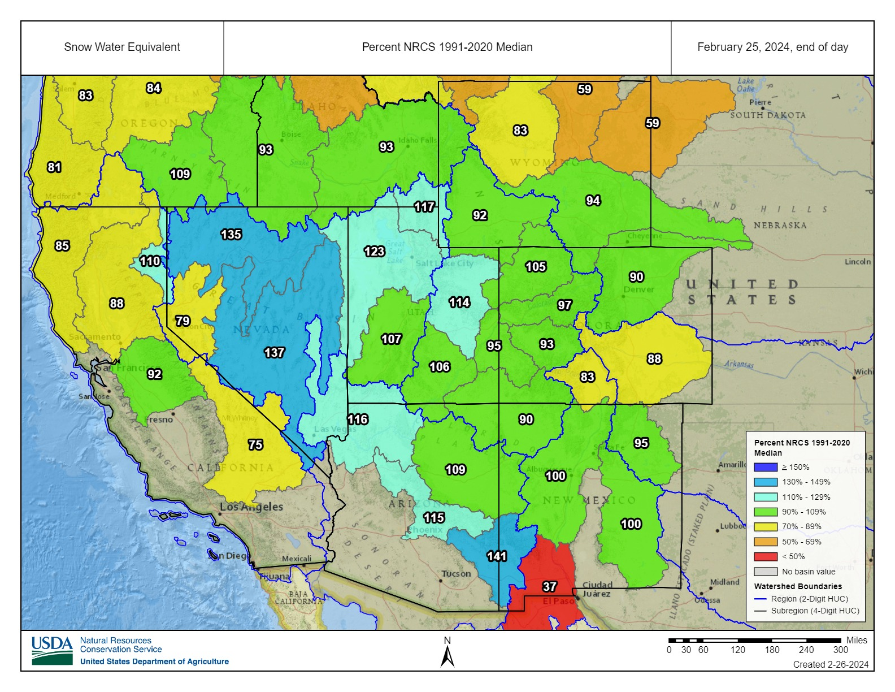
Sub-Basin SWE
Near-average SWE is reflected in sub-basin totals

Slide 5
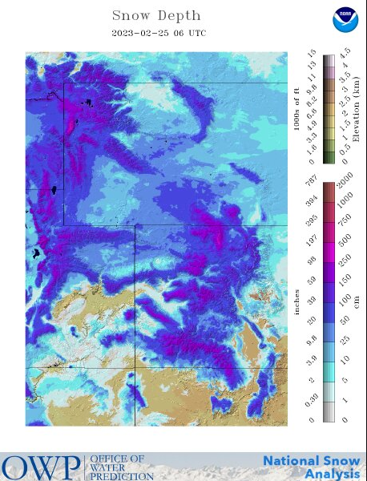
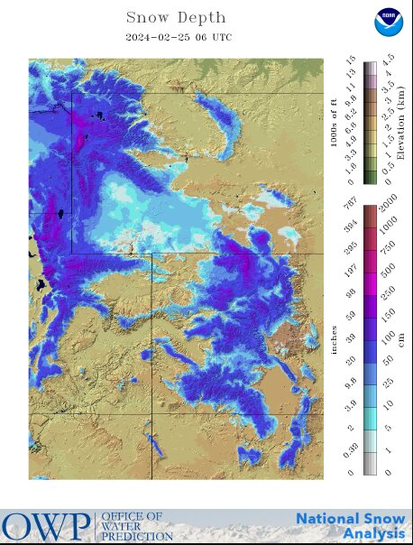
2023 vs. 2024 Modeled Snow Depth
Higher amounts of low elevation snow in WY 2023 (left) compared to WY 2024 (right)
Notes:
Low elevation Snow – follow up from last Meeting. 2023 had far greater low elevation snow at this time compared to 2024

Slide 6
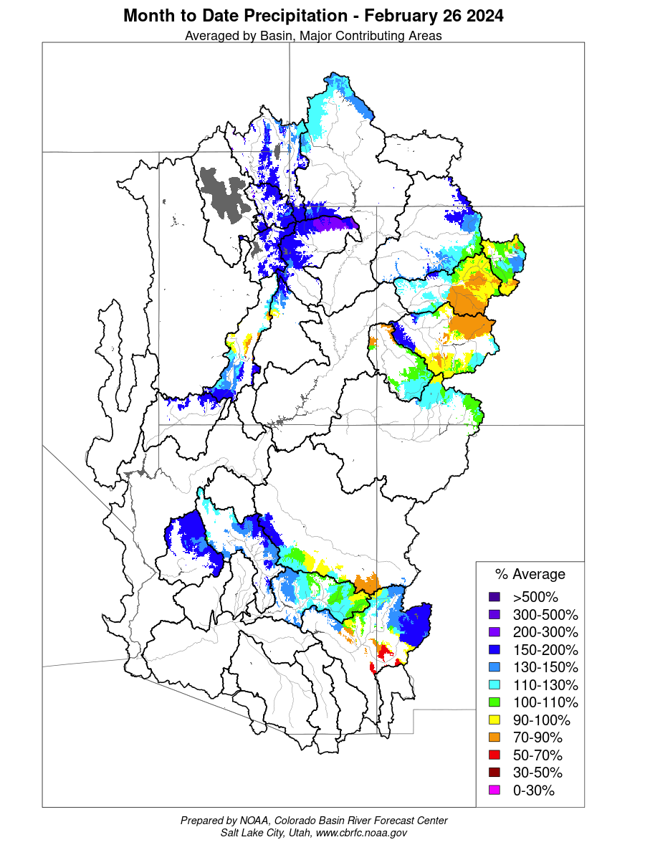
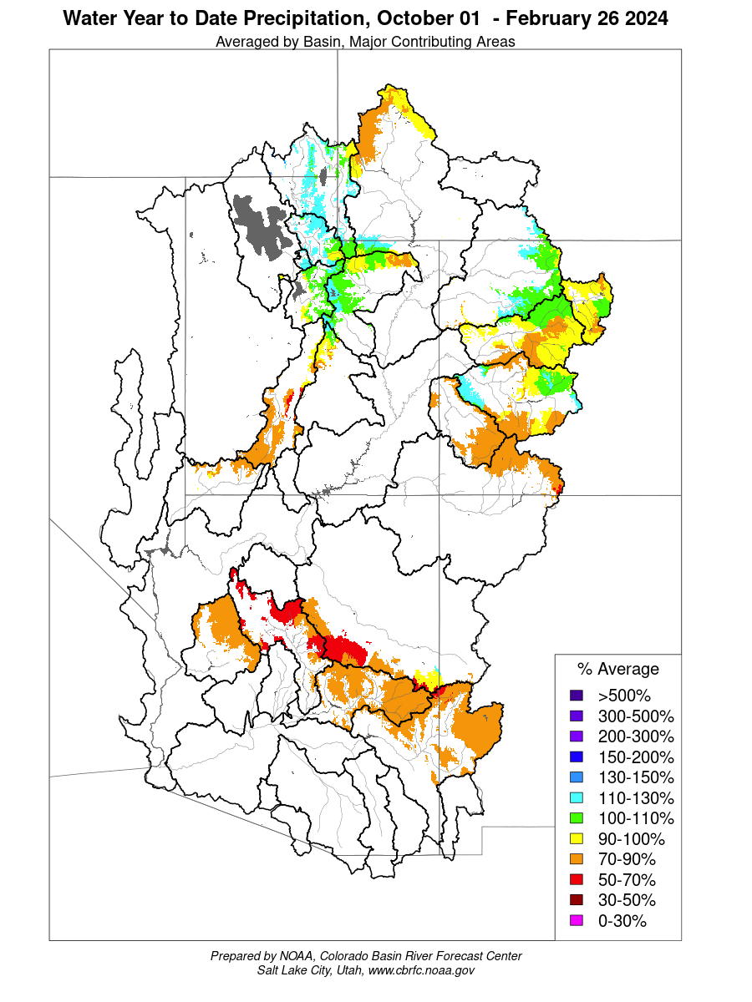
Precipitation – Month & Water Year to Date
Wet February (left)
Water year to date – average to slightly below average (right)
Drier in the San Juan and southern portion of the Basin
Notes:
Month to date precip. Wet in Feb. But looking at water year to date, have been some very dry months. Average to slightly below average for what we’re seeing for basin. Drier in san juan and southern portion of basin.

Slide 7
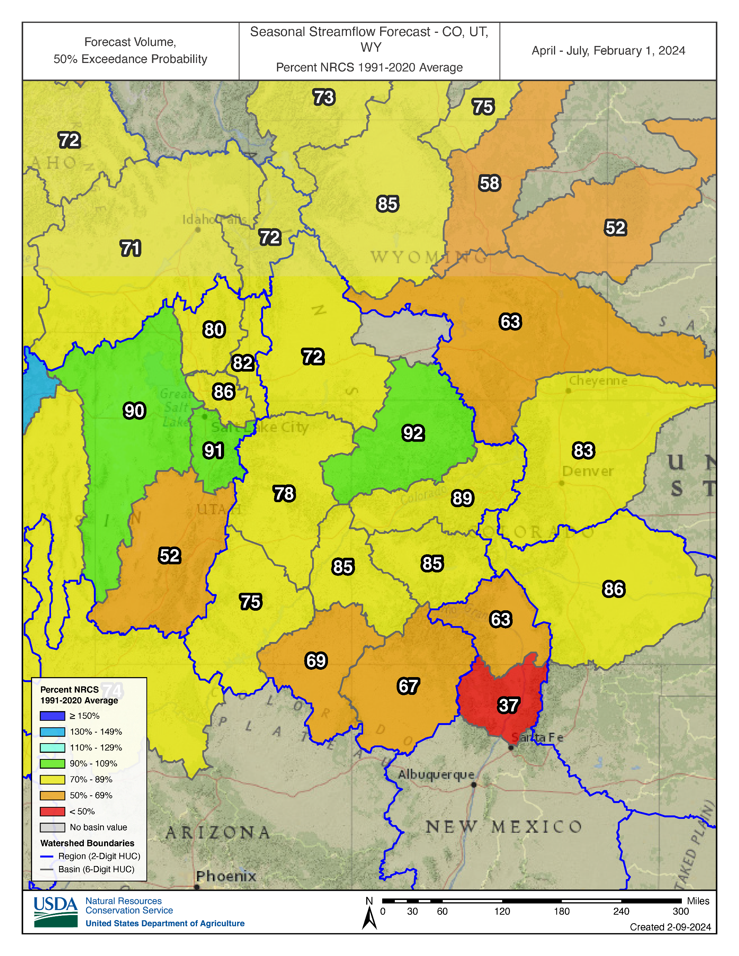
Runoff Forecast
Basin by basin, below average runoff forecasted

Slide 8
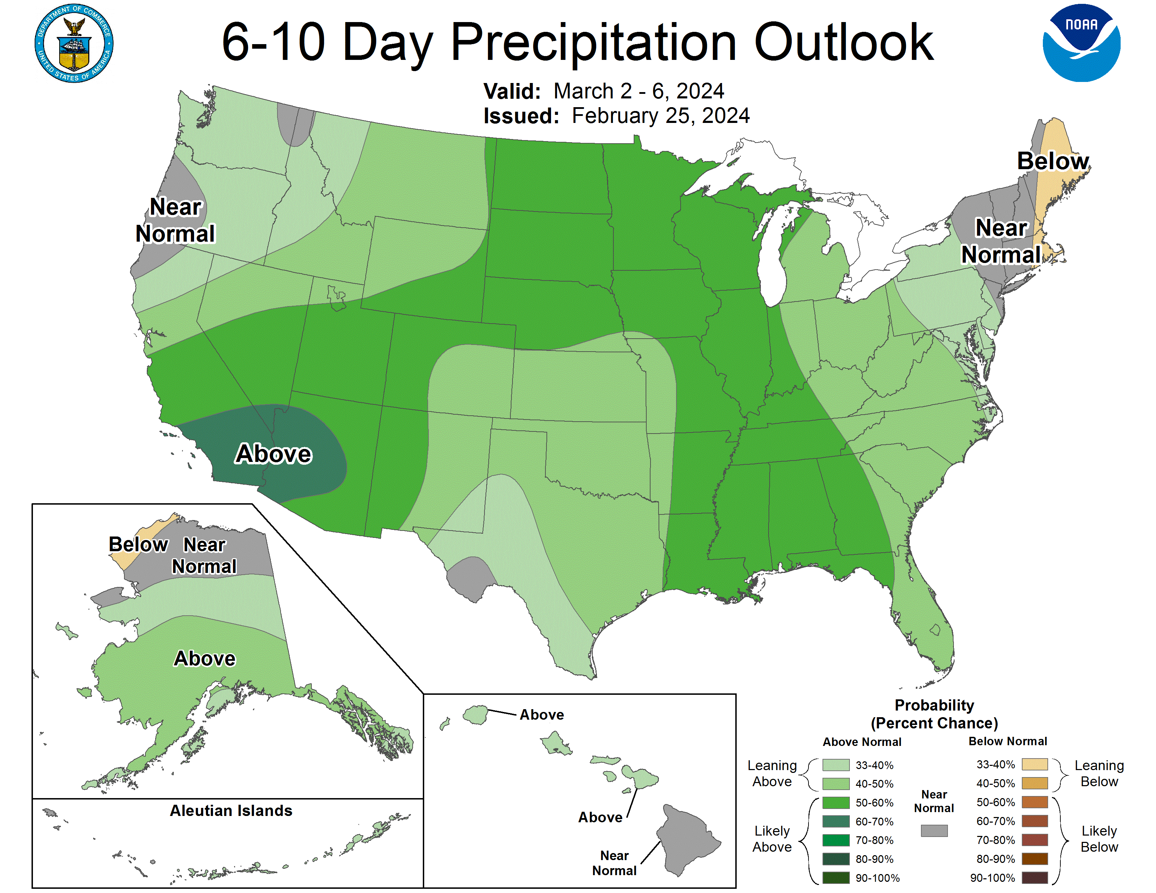
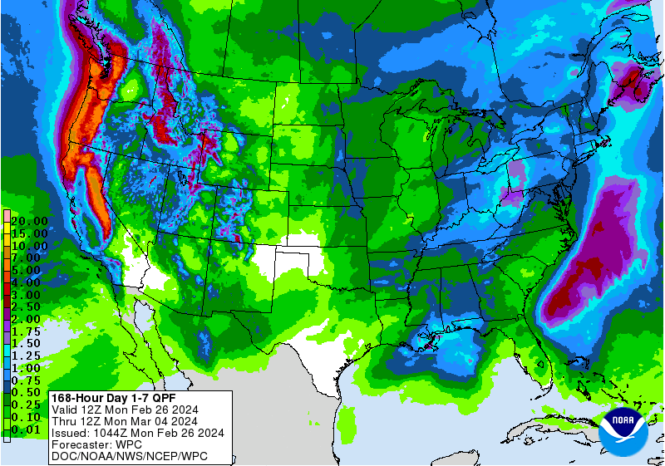
Precipitation Forecast
Notes:
Weather prediction center, climate prediction center

Slide 9
Groundhog Day – February 2, 2024
No Shadow…
Early Spring??

Slide 10
System Operations

Slide 11
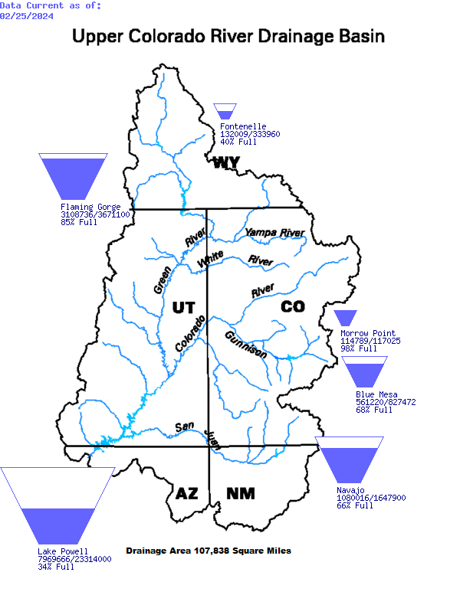
Upper Basin Storage: February 25, 2024
Notes:
Decreasing storage part of year
Because of the 7.48 release year, Lake Powell is decreasing slowly at about 1 foot per month

Slide 12
Powell, Mead and System Storage: February 25, 2024
Reservoir | Percent Full | Storage (MAF) | Elevation (feet)
Lake Powell | 34% | 7.970 | 3,562.56
Lake Mead | 37% | 9.723 | 1,076.50
Total System Content | 43% | 24.928 | NA
Total System Content (one year ago) | 32% | 18.962 | NA

Slide 13
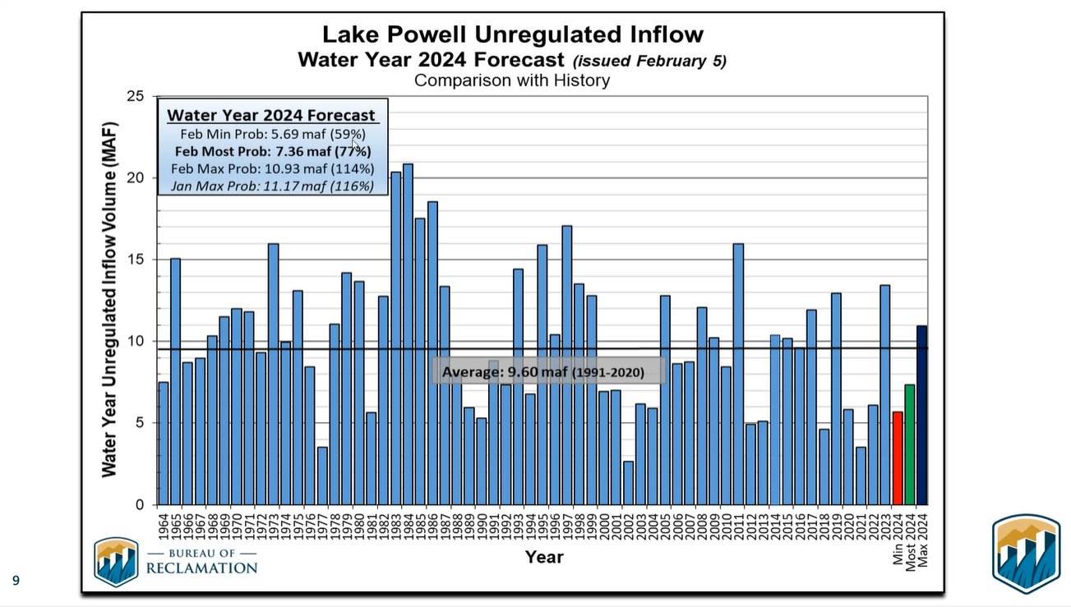

Slide 14
WY 2024 Lake Powell Unregulated Inflow Forecasts
Forecast | Sept | Oct | Nov | Dec | Jan | Feb
Min (MAF) | 6.3 | 6 | 5.57 | 4.9 | 4.95 | 5.69
Most (MAF) | 10 | 9.4 | 8.62 | 7.62 | 6.92 | 7.36
Max (MAF) | 17.6 | 17.6 | 15.42 | 13.5 | 11.1 | 10.93
Notes:
Decrease in max probable of ~4MAF since September.

Slide 15
Unregulated Inflow - Upper Basin Reservoirs
Forecasts have increased since January, but they are still below average

Slide 16
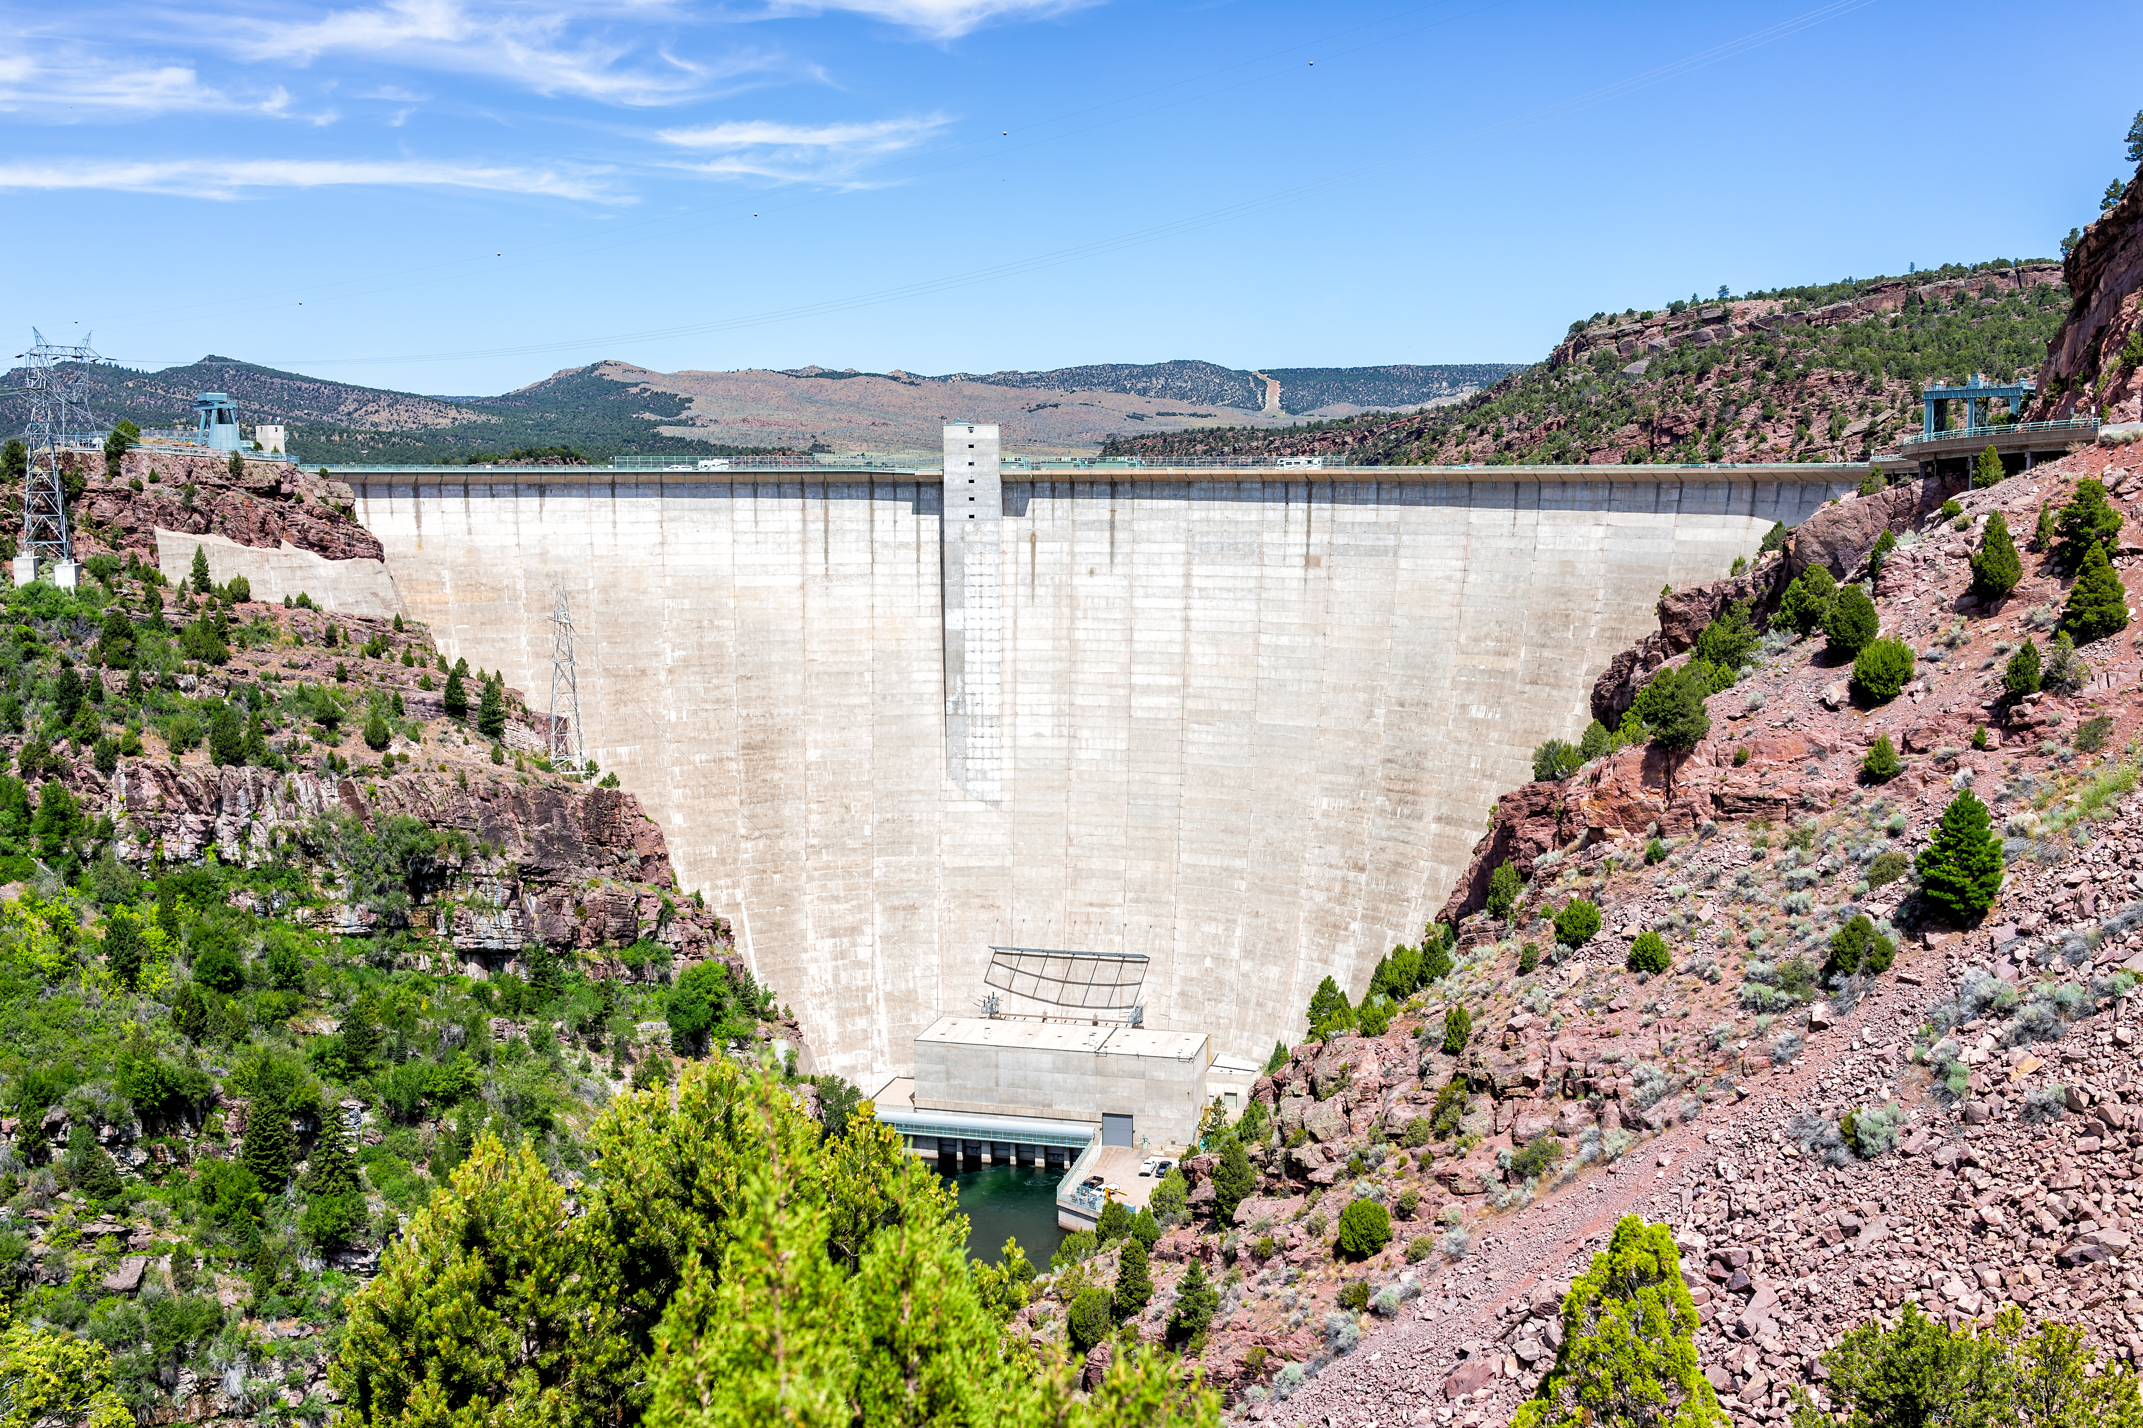
DROA Recovery
Flaming Gorge
January 2024 recovery: ~50 KAF
Projected Feb volume: ~45 KAF
Projected to achieve incremental recovery in February 2024 and the May 1 drawdown Target of 6,027’
Blue Mesa
Incremental recovery and icing target achieved Dec 2023

Slide 17
Monthly Lake Powell Release Distribution
Notes:
T

Slide 18
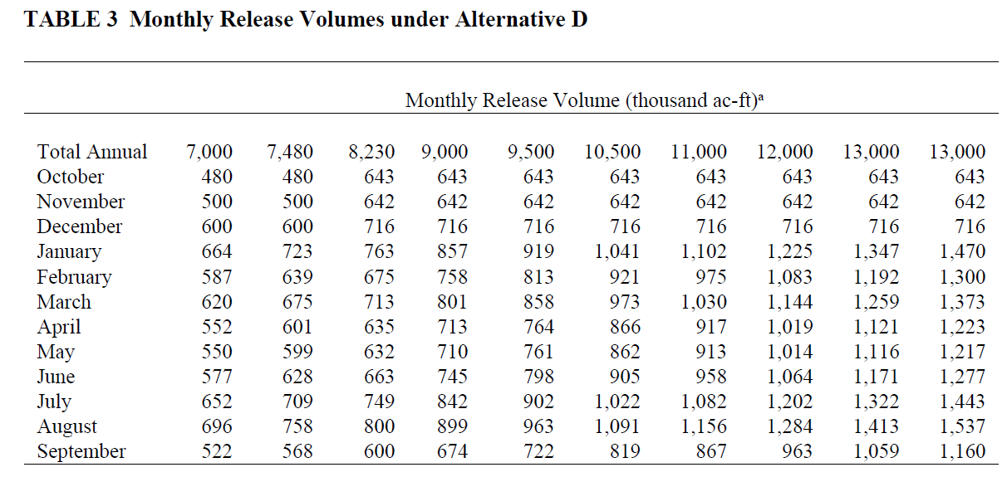
Monthly Lake Powell Release Distribution – LTEMP

Slide 19
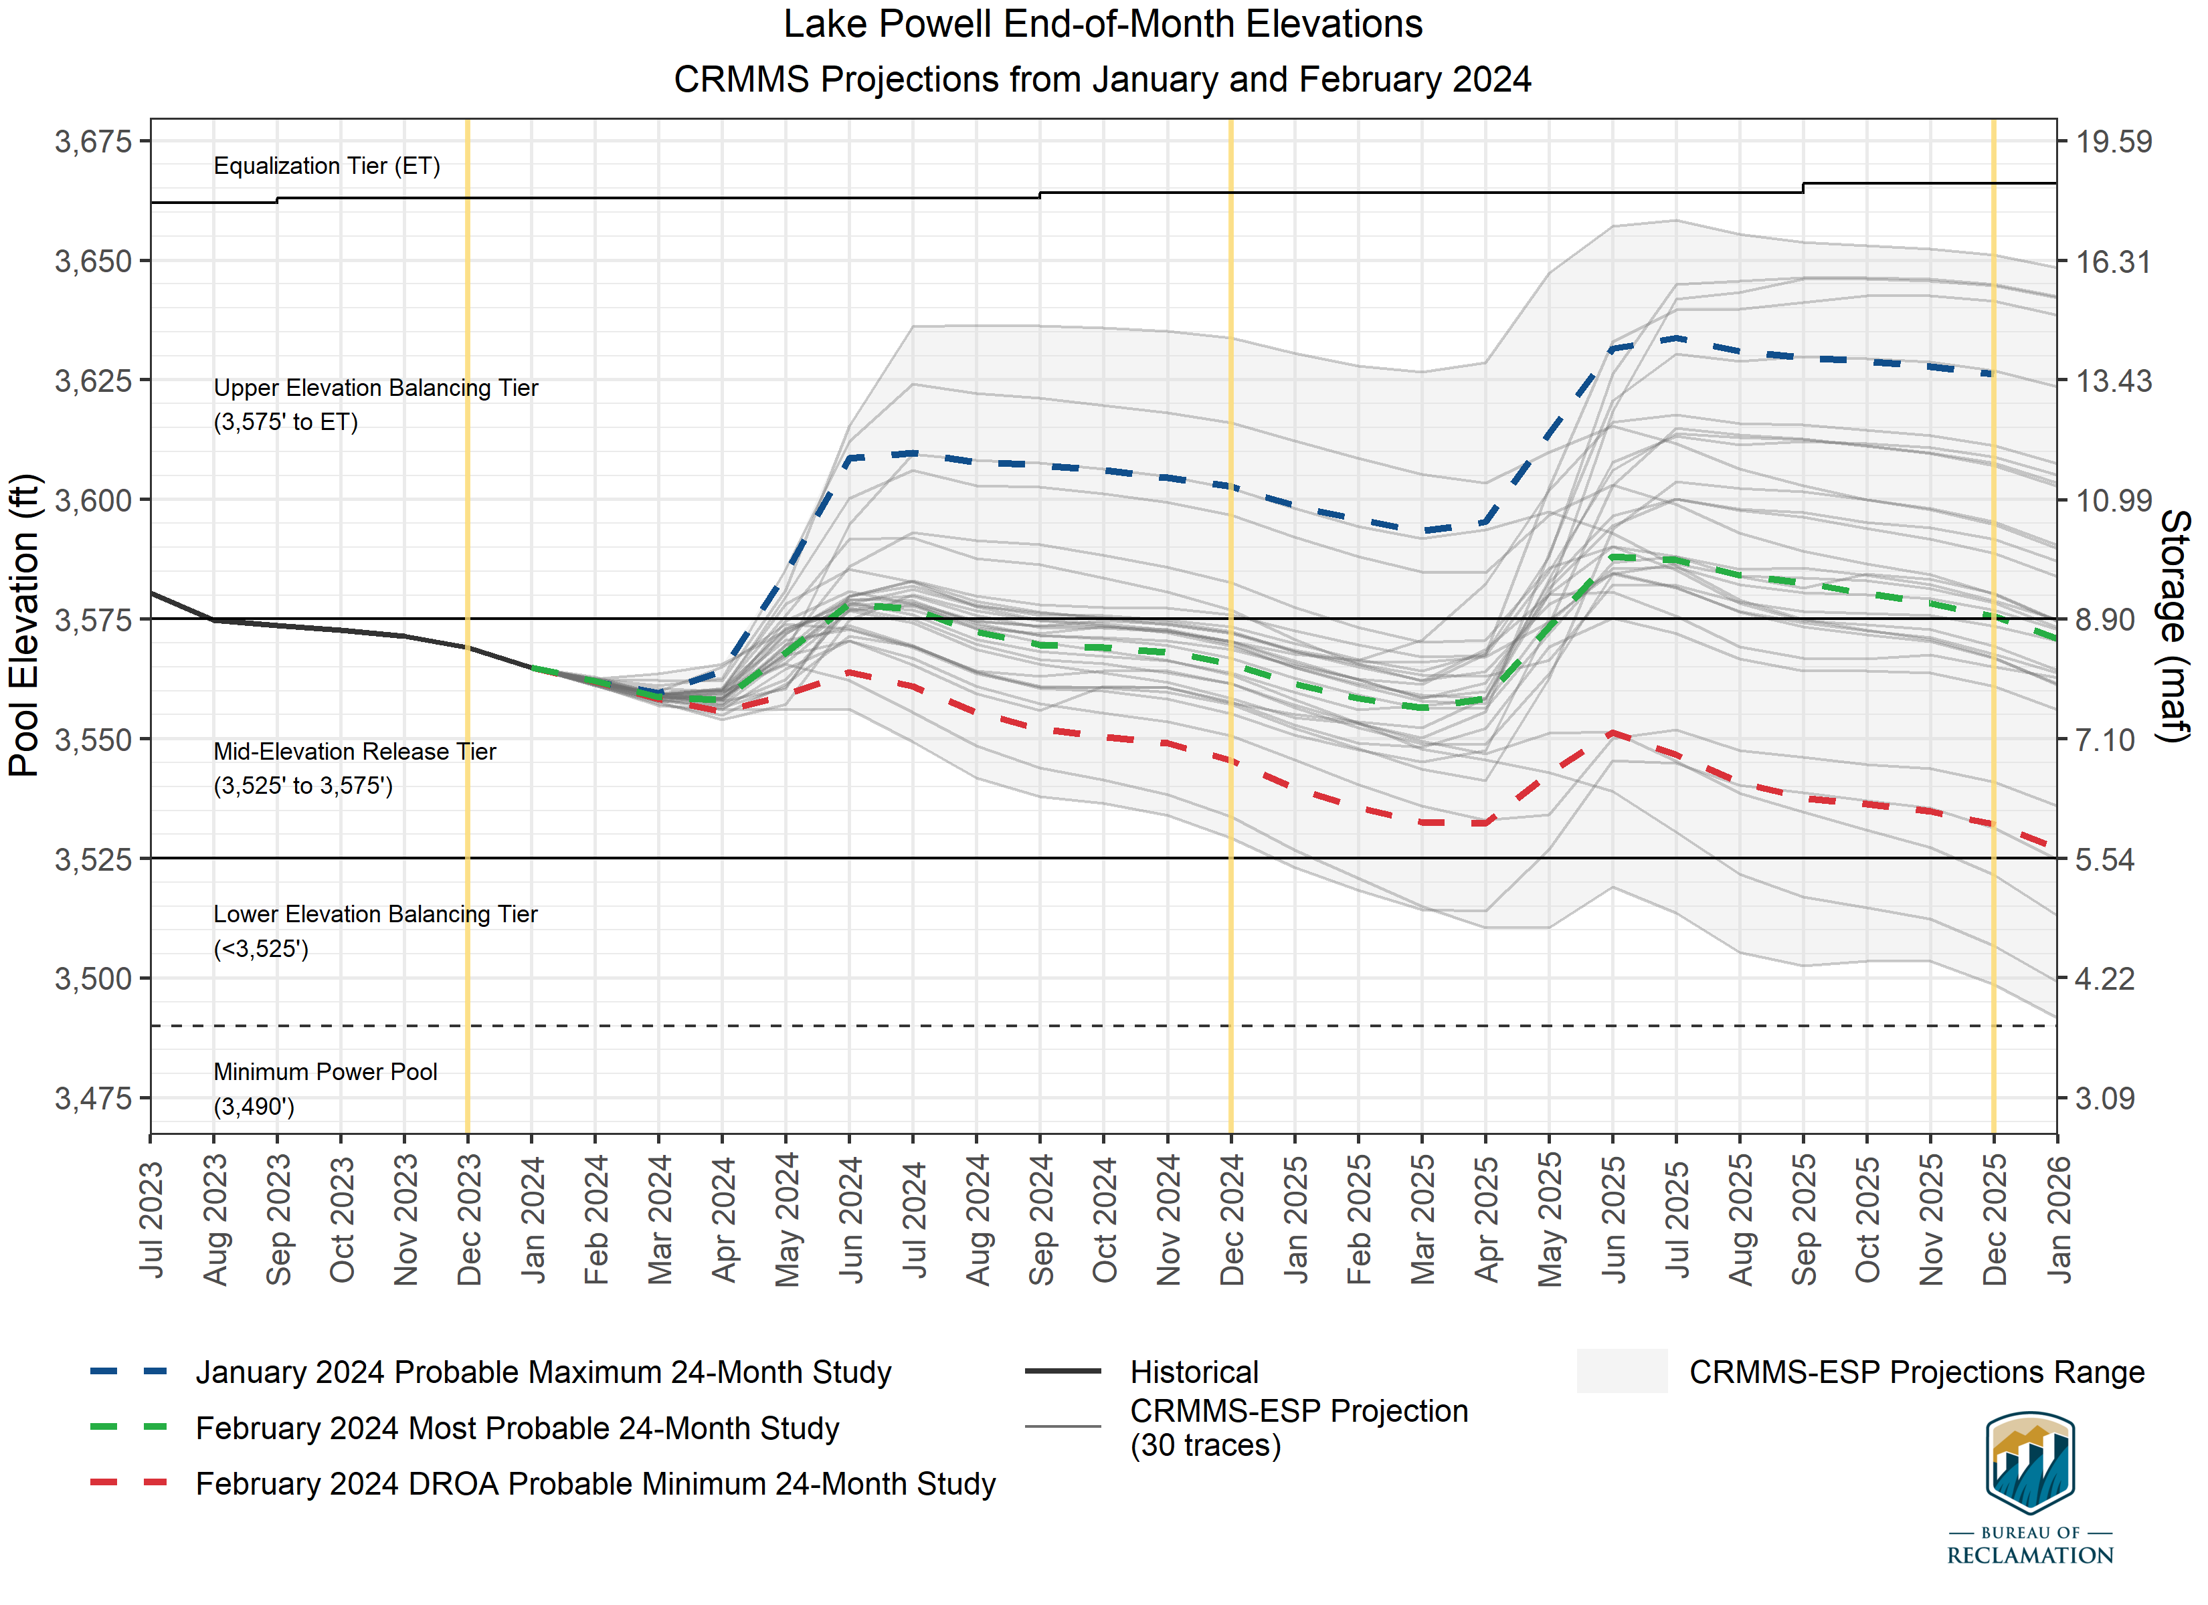
Slight forecast improvement – min probable (10th percentile) stays above 3525’ in 2025
However, three traces still drop below 3525’ in 2025

Slide 20
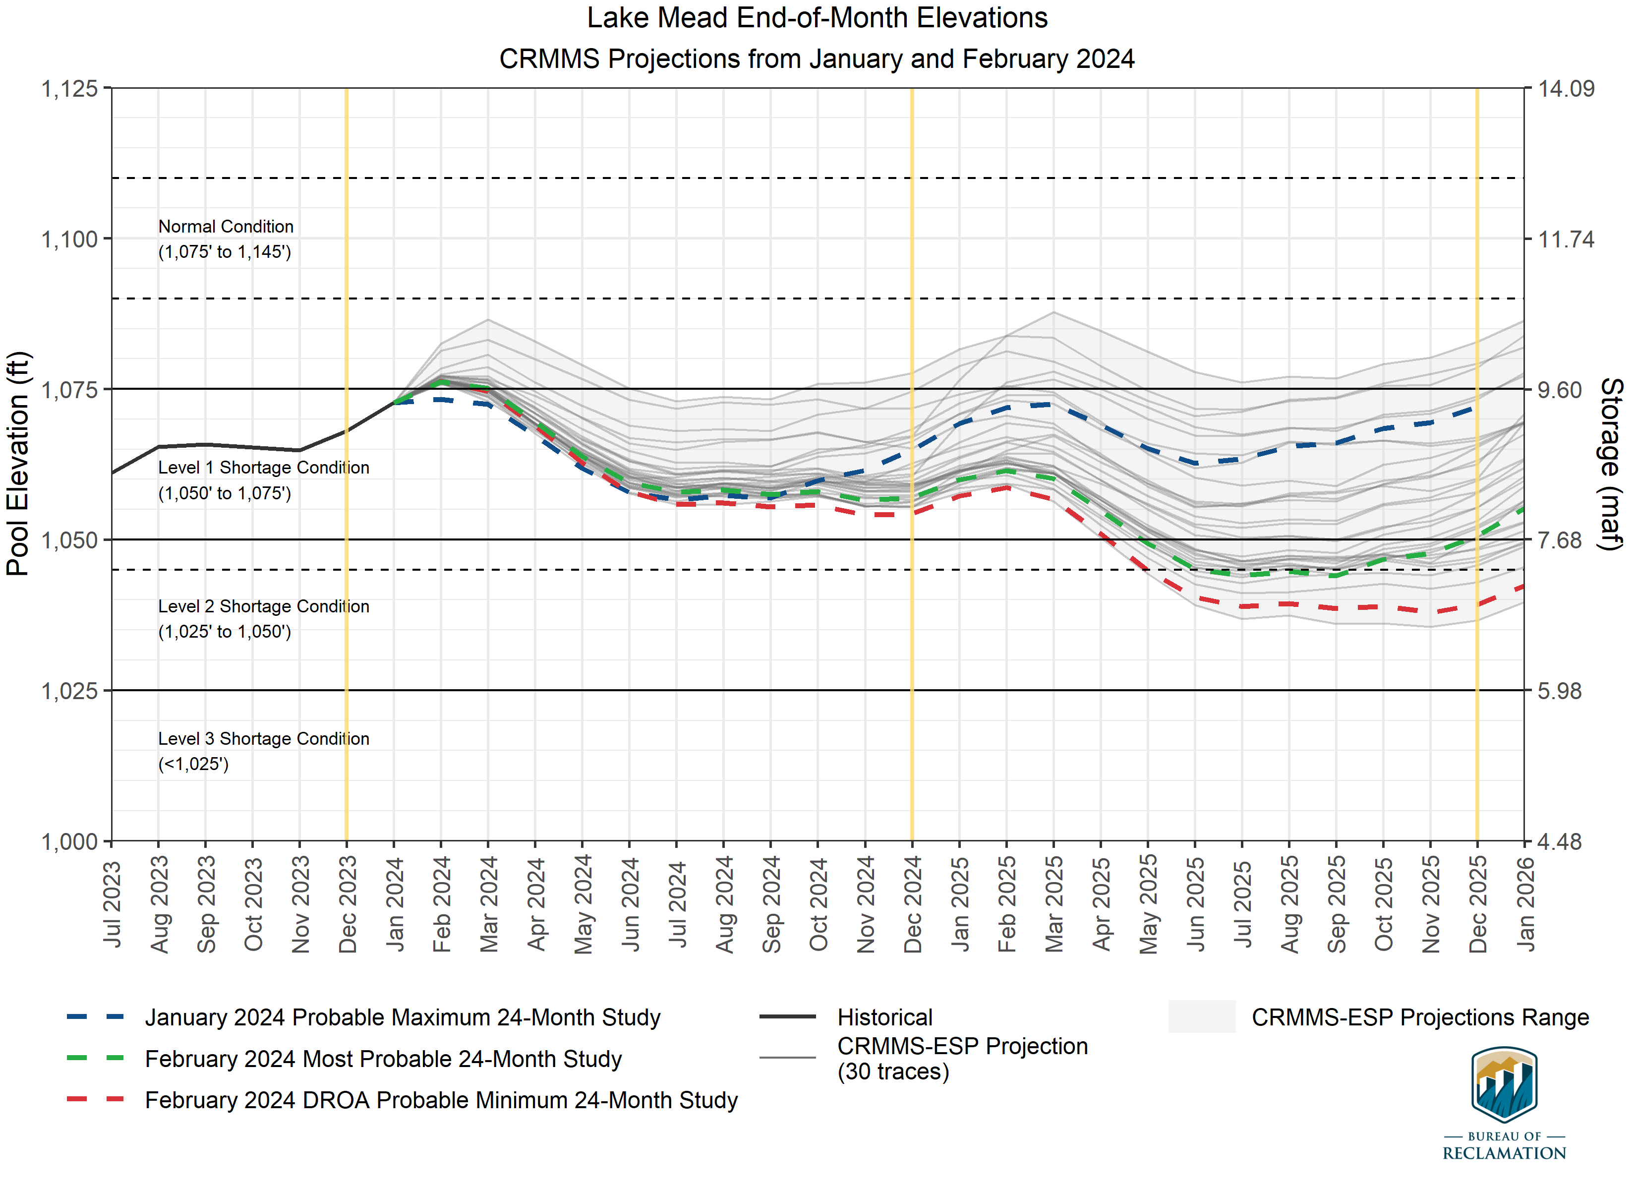
EOCY 24 – All three scenarios between 1050’ and 1075’ (Level 1 shortage)
EOCY 25 – Most probable is barely within a level 1 shortage condition (1050.64’)

Slide 21
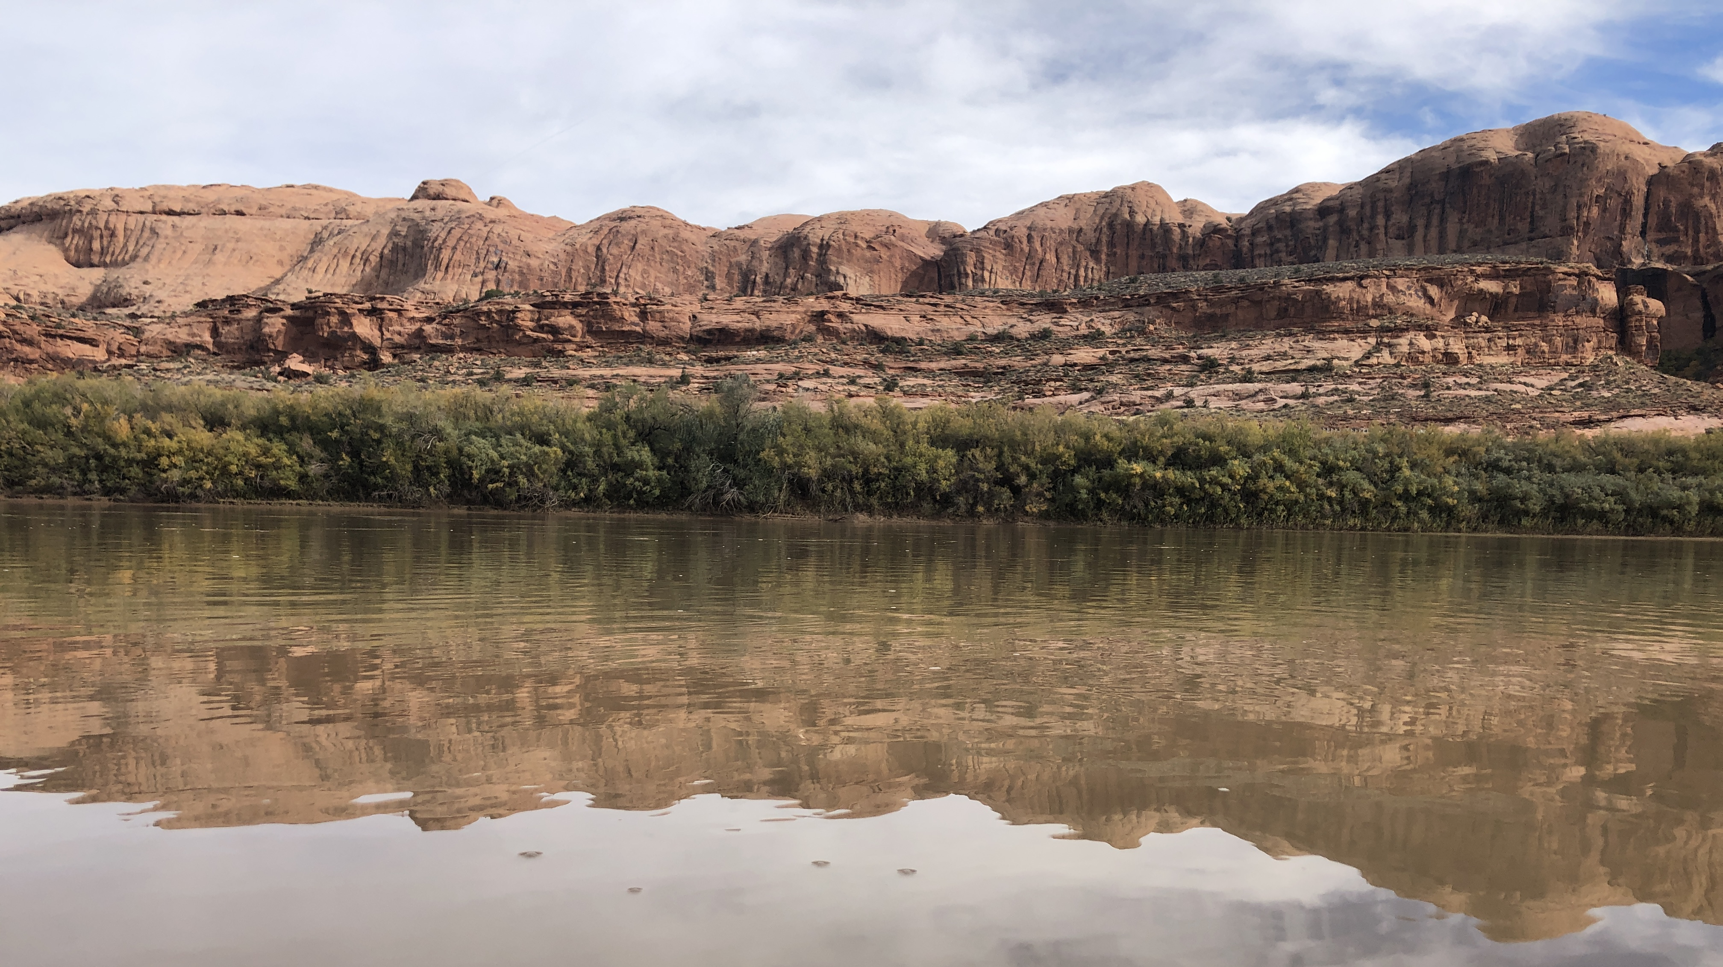
8
cra.utah.gov
@AuthorityUT
@AmyHaasColoRivr

