Slide 1
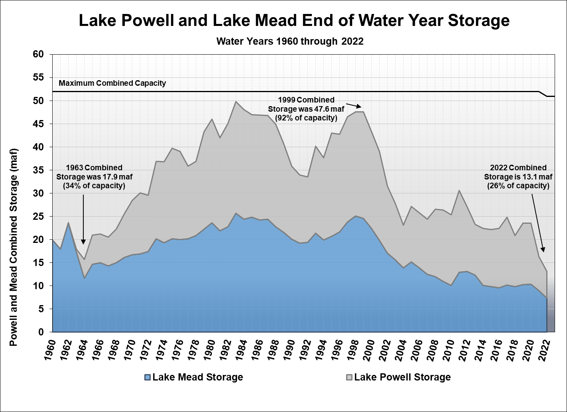
[slide courtesy of the Bureau of Reclamation]

Slide 2
