Slide 1

Flakes, Flights, and Forecasts: Snowpack Measurement Enhancements in the Uinta Mountain Headwaters
Lily Bosworth, Rachel Musil
Colorado River Authority of Utah
Central Utah Water Conservancy District
Utah Division of Water Resources
U.S. Bureau of Reclamation
Snow Water Supply Forecasting Program
MAY 21, 2024
Notes:
Mention others attending presentation

Slide 2
Background

Slide 3
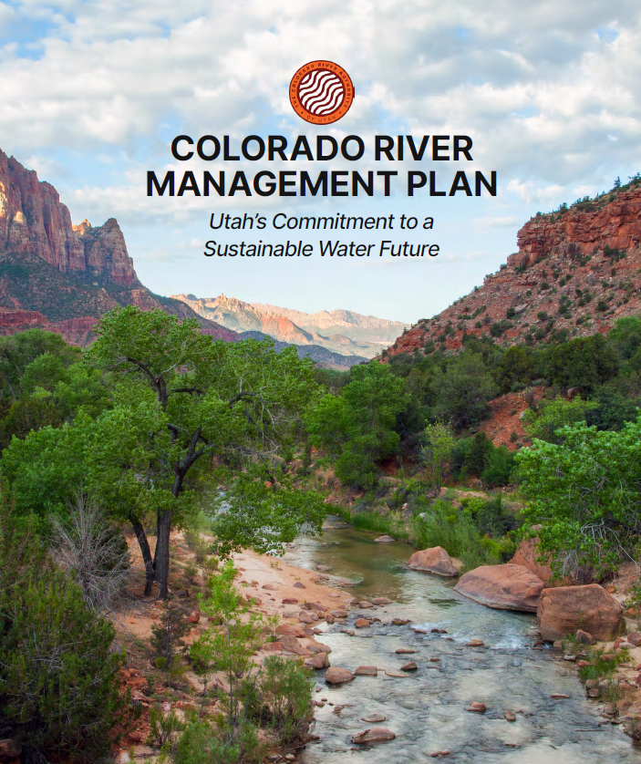
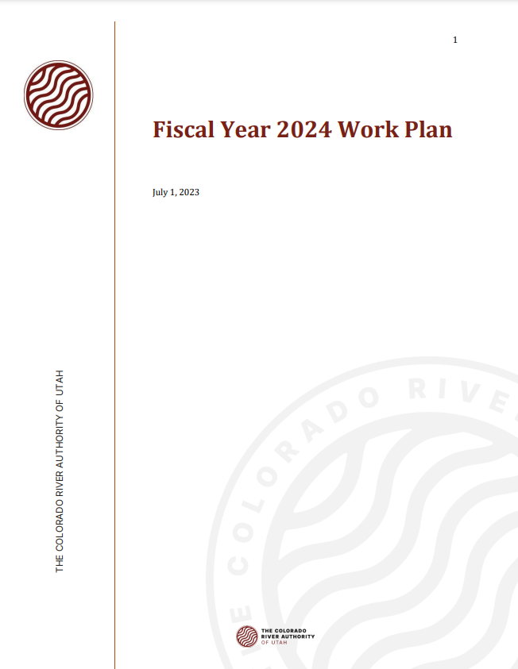

5-Year Management Plan & FY24 Work Plan
Measurement
Drought Mitigation
Hydrology & Operations
Flakes, Flights, & Forecasts
Notes:
- The Authority adopted a 5-year management plan with three priority areas.
- Measurement, Hydrology and Operations, Drought Mitigation.
- These priorities are in place for 5 years, as described in the Plan, and specific actions are described in the Fiscal Year work plans
The FY 2024 work plan is in progress
The FY 2025 work plan is in development

Slide 4

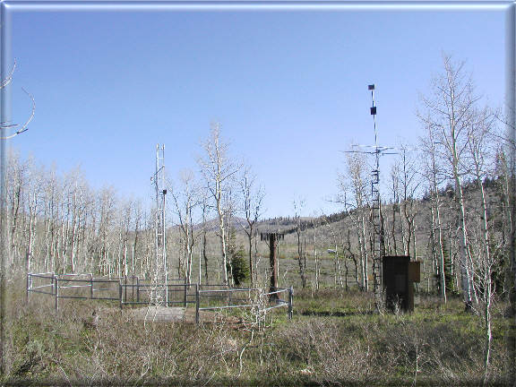
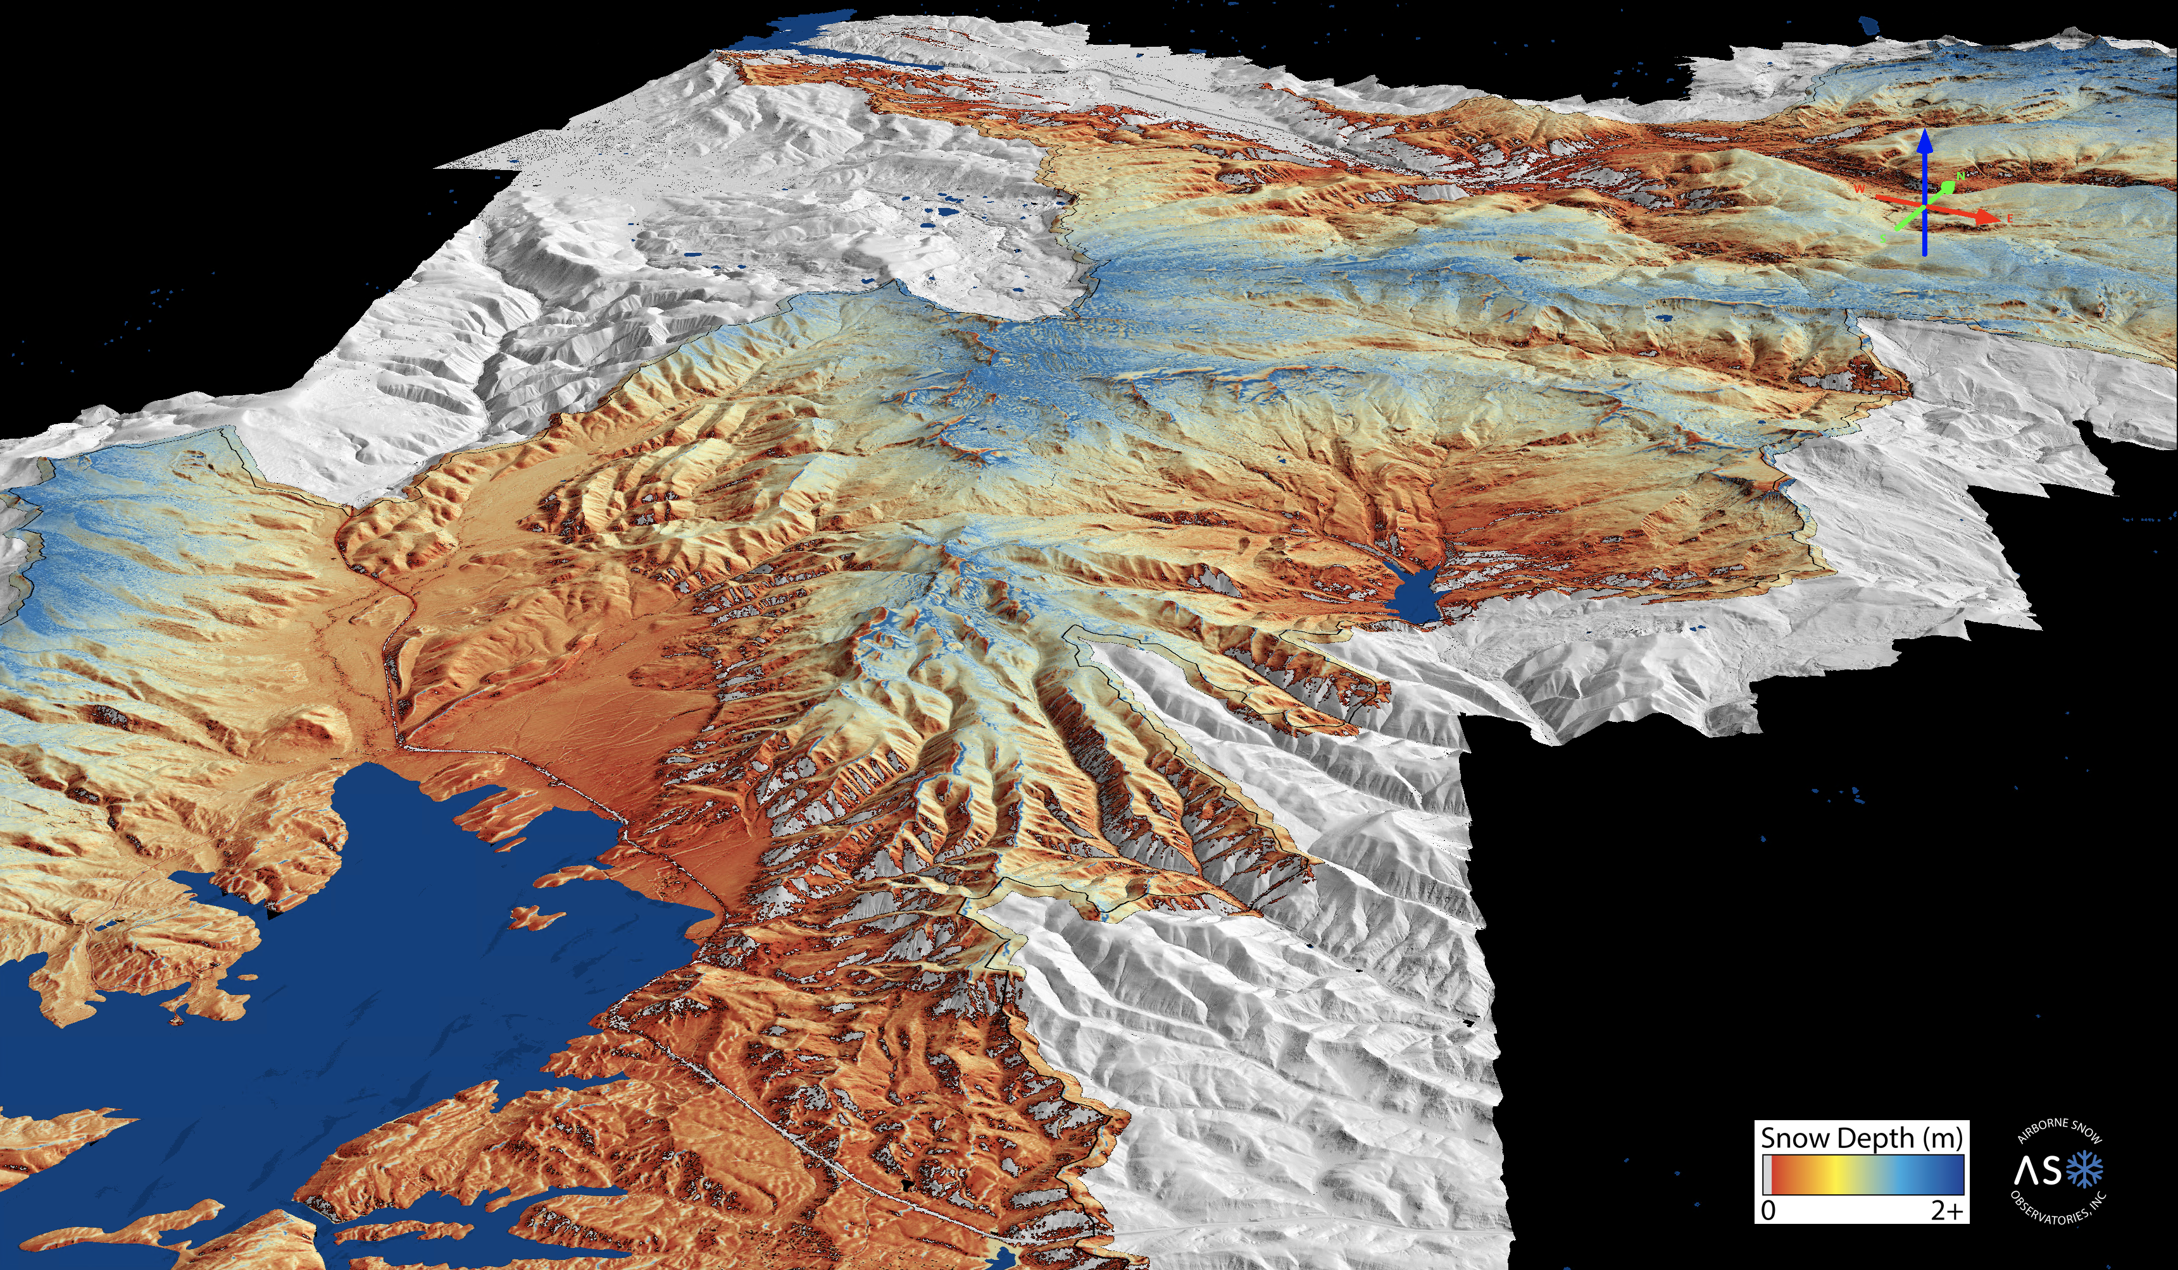
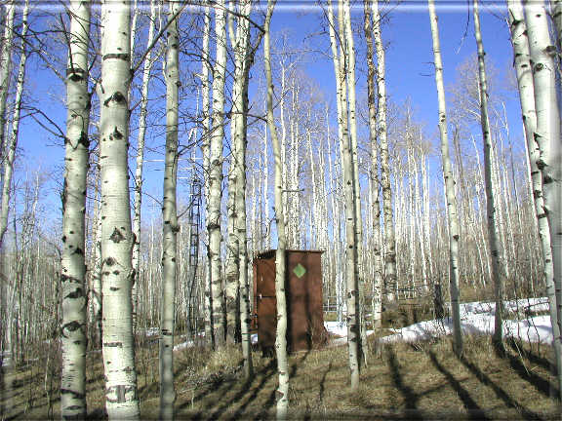
Challenge & Need
Conventional snow monitoring misses important dynamics. Improved data is needed to support decision making.
Daniels-Strawberry
Currant Creek
Strawberry Reservoir
Notes:
Candice

Slide 5
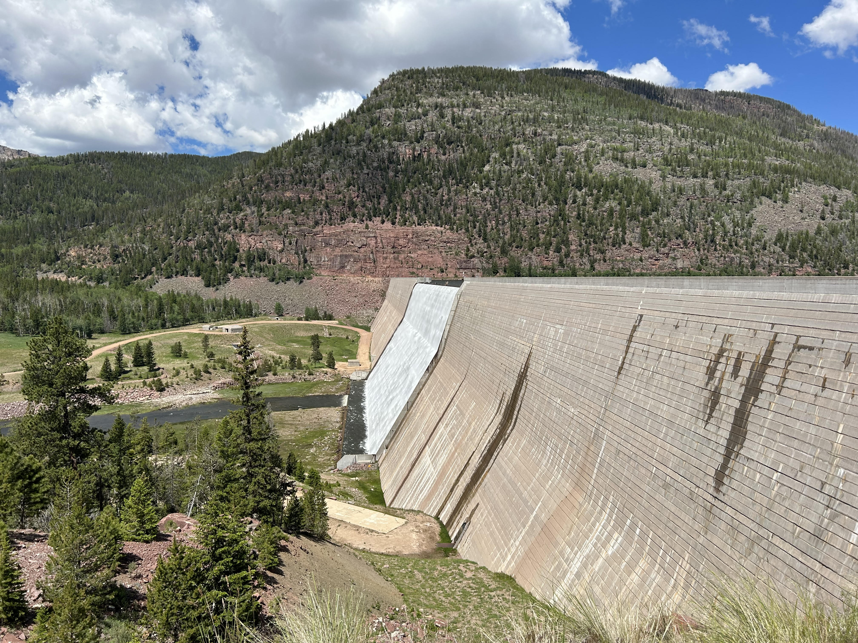
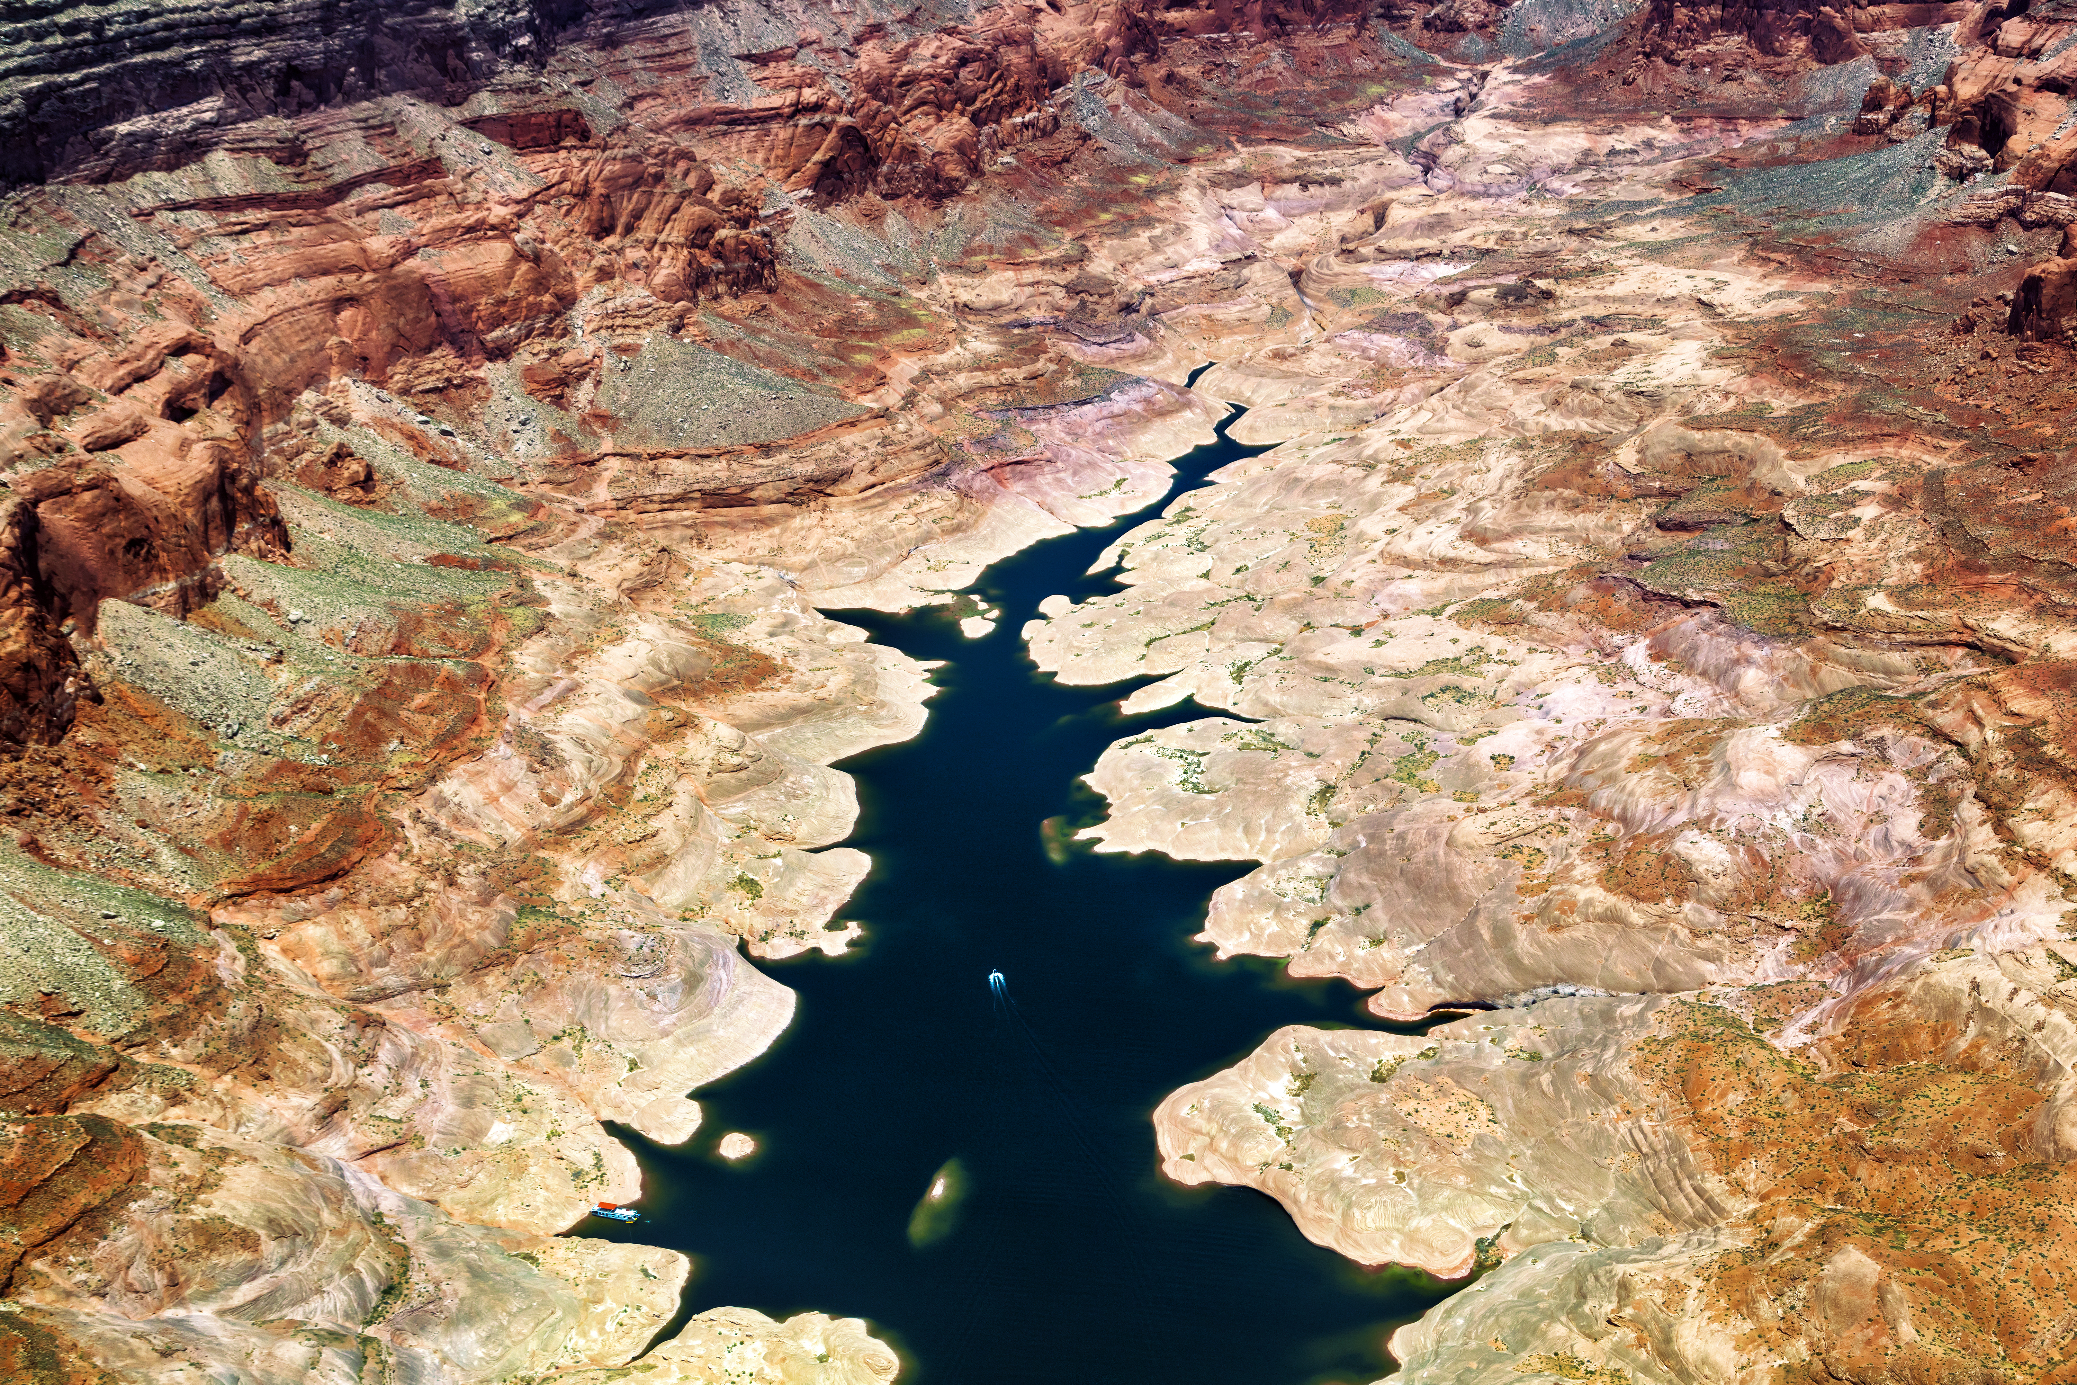
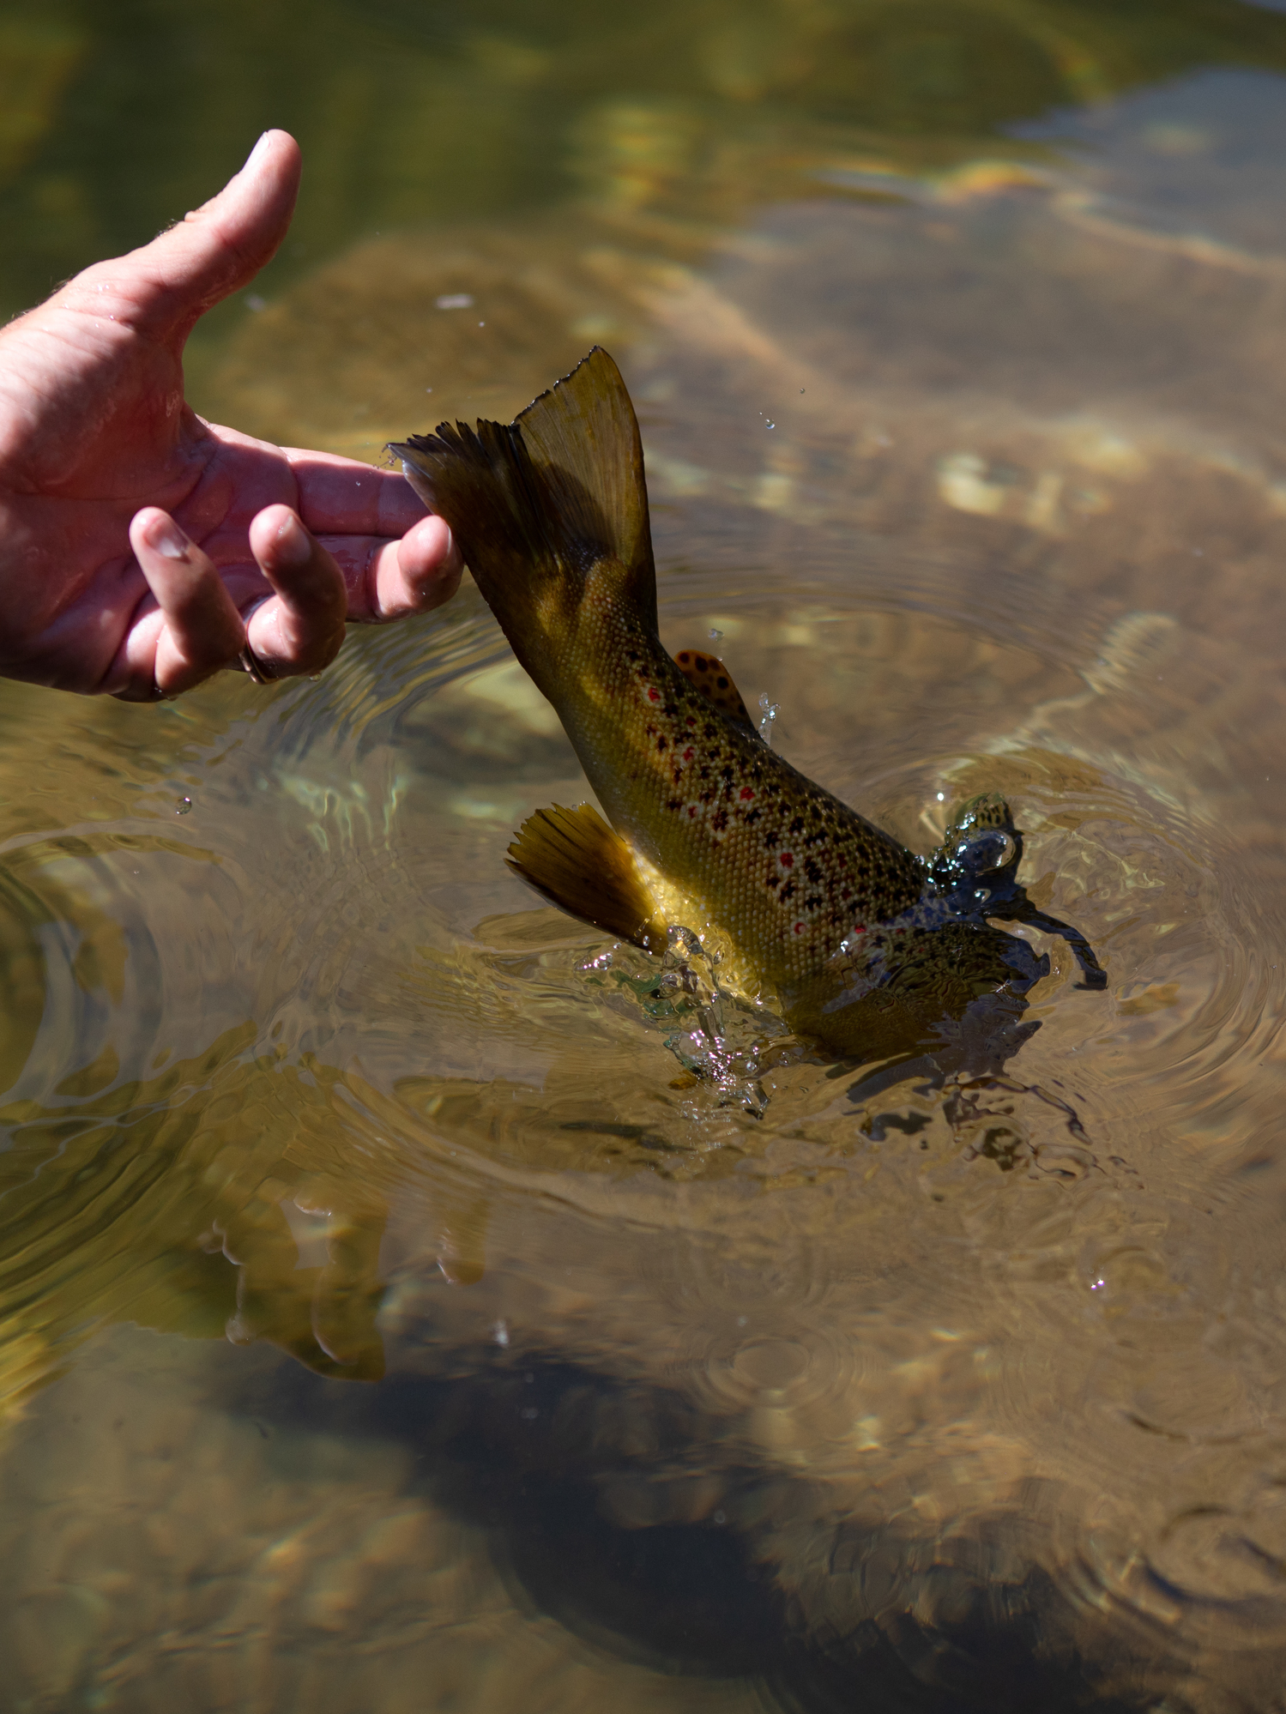
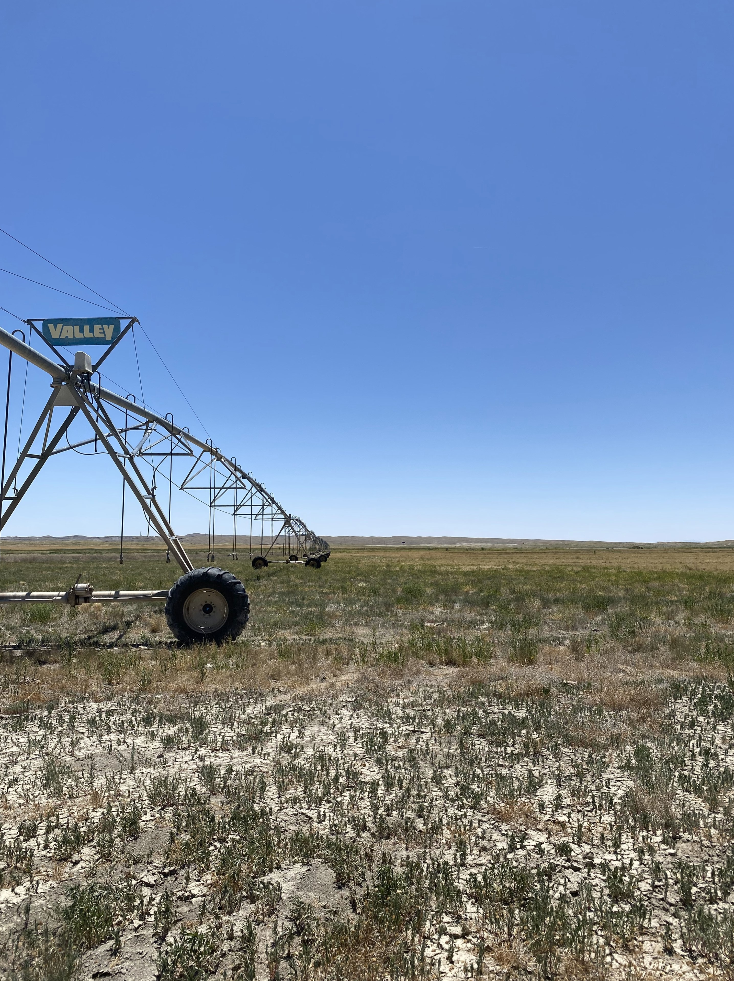
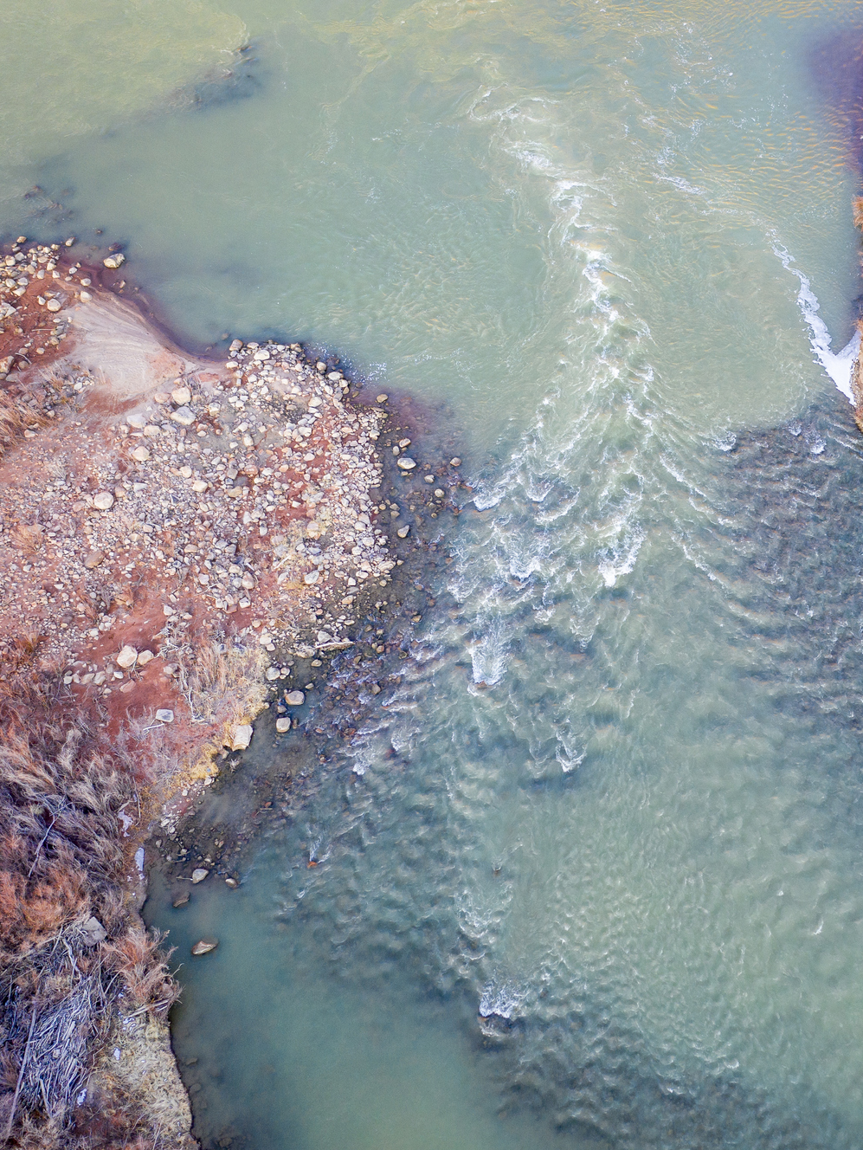
Project Objectives
1
2
3
4
5
Optimized flood control operations of federal facilities
Short- and long-term water management decisions
Environmental protection
Drought mitigation and resilience
Disseminate results to other watersheds throughout the state
Notes:
Candice

Slide 6
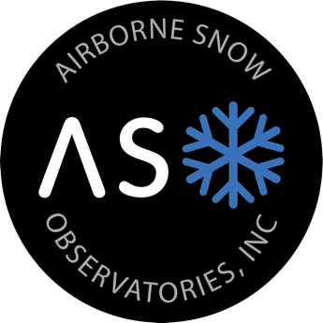
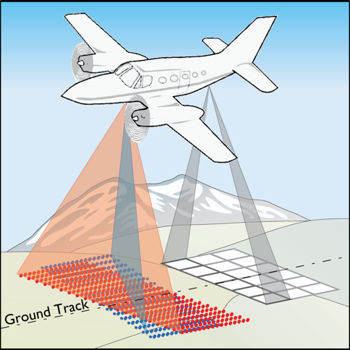
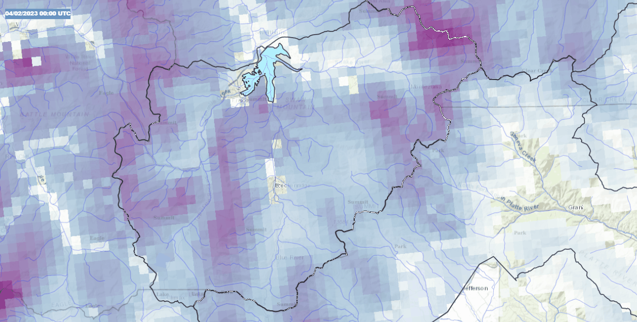
Airborne Snow Observatories, Inc.
Snow-Free Flight = Lidar
Snow-On Flights = Lidar + Spectrometry
Model Snowpack = iSnobal
Forecast Runoff = WRF-Hydro
Compare = CBRFC, SNOTEL
Operate = SACS
Plan = UCRAF
Established
Experimental
Notes:
Beginning at the NASA Jet Propulsion Laboratory 10 years ago, and currently as a Public Benefit Corporation, ASO combines measurements from airborne lidar and spectrometer sensors with physical models of the snowpack and hydrology to produce the best-available snowpack monitoring to support runoff prediction.
Build on the foundation provided by the existing station and manual measurements to capture complete, high-resolution, and high-accuracy measurements of the mountain snowpack to support greater accuracy in runoff forecasting.

Slide 7
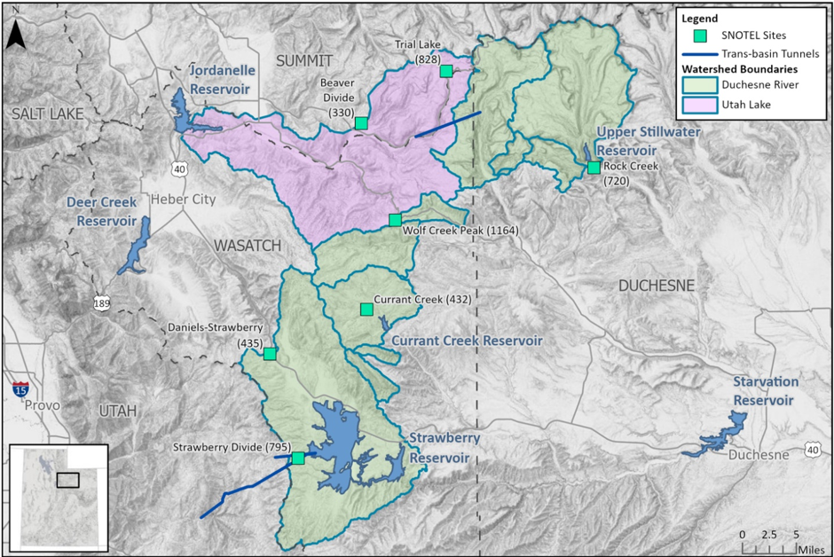
Project Location

Slide 8





Budget & Timeline
FUNDING SOURCES​ | AMOUNT​
Non-Federal Entities​
1. Colorado River Authority of Utah​ | $ 650,000.00​
2. Central Utah Water Conservancy District​ | $ 250,000.00​
3. Utah Division of Water Resources​ | $ 100,000.00​
Non-Federal Subtotal​ | $1,000,000.00​
Reclamation Federal Funding​ | $ 999,999.00​
TOTAL PROJECT COST​ | $1,999,999.00​
‘23
‘24
‘25
‘26
‘27

Slide 9

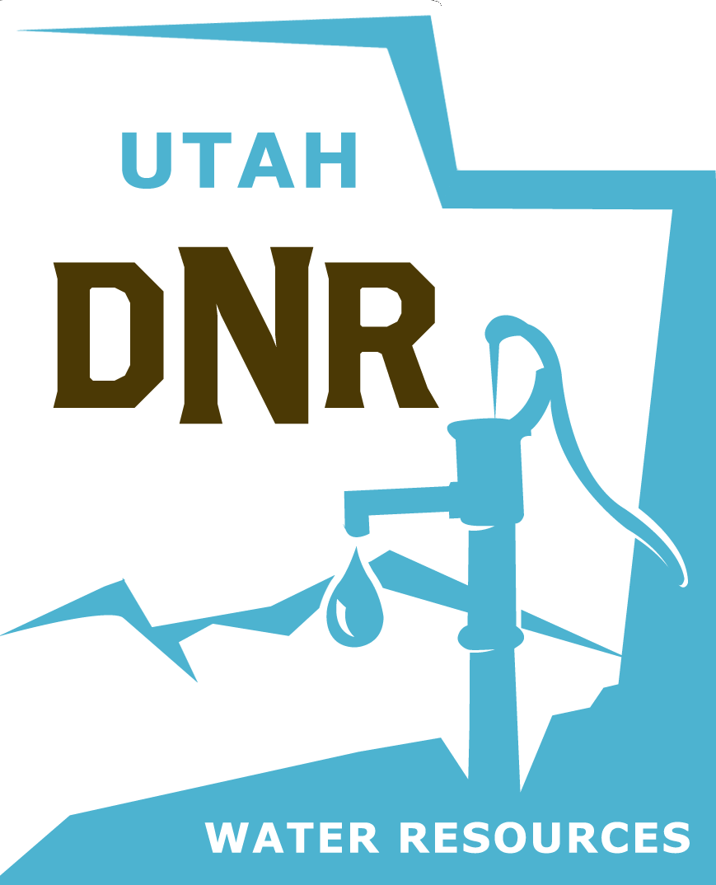
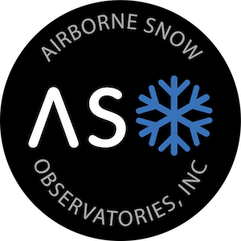
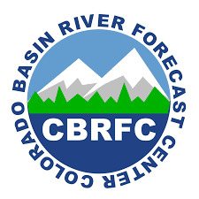








Support

Slide 10
Year 1
Measurement
& Modeling

Slide 11
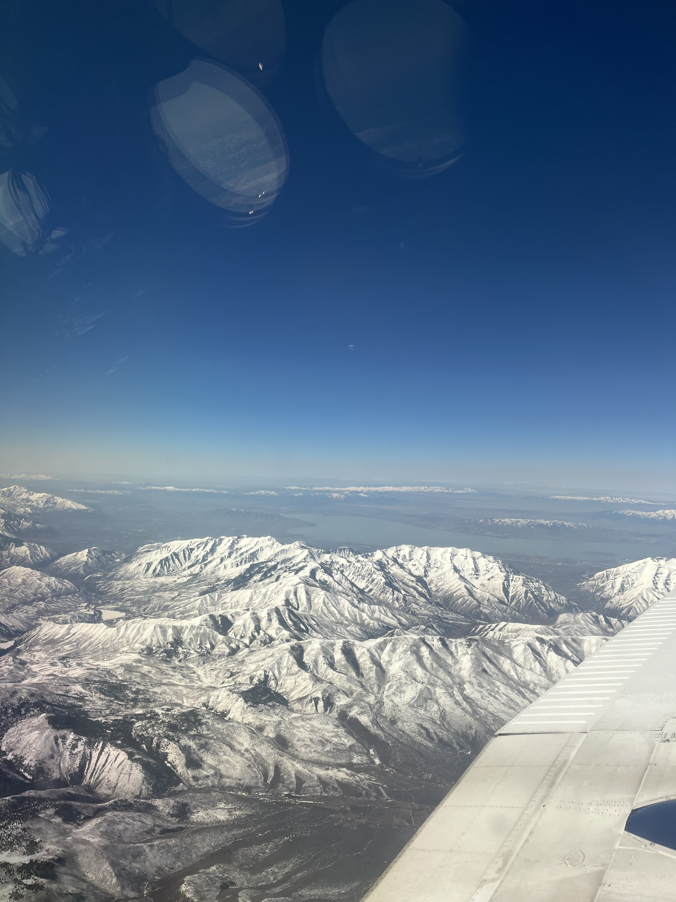
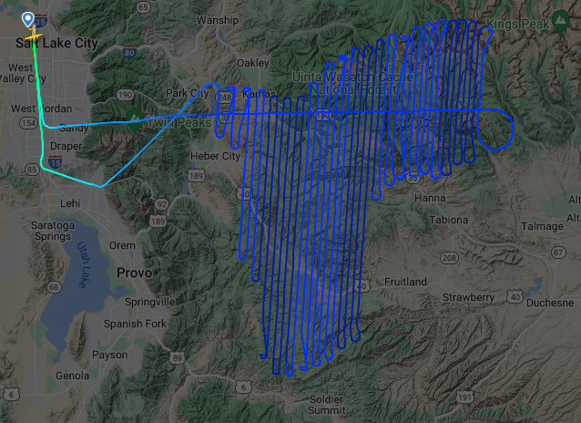
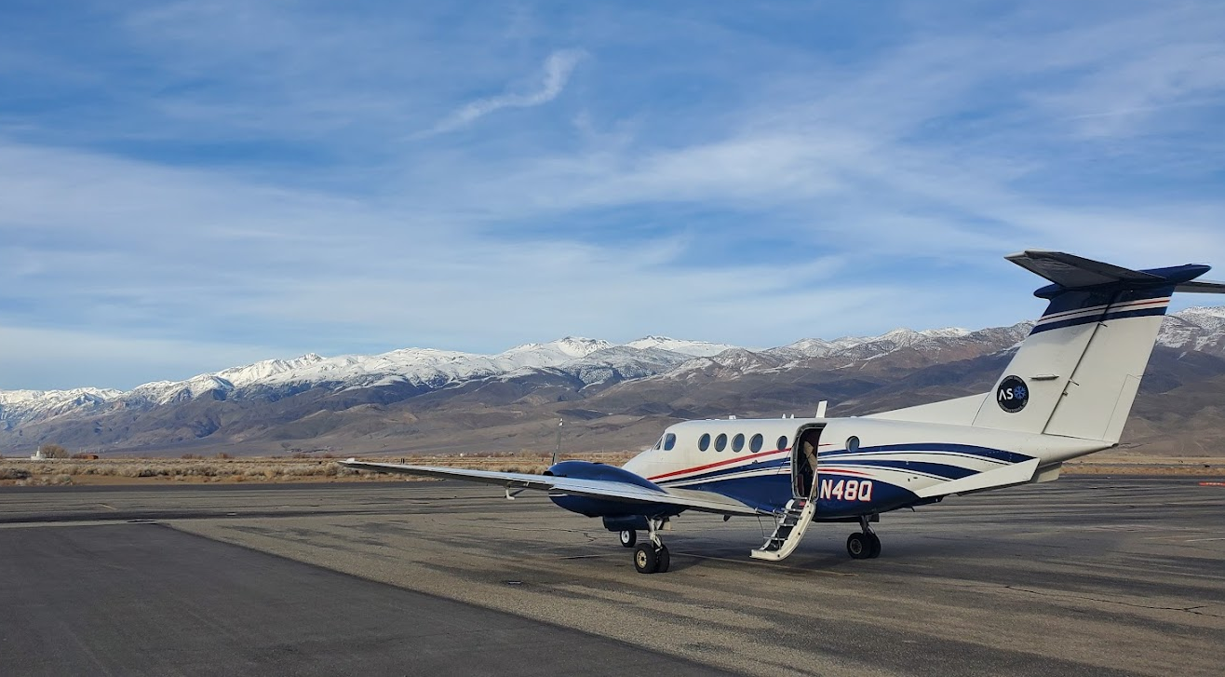
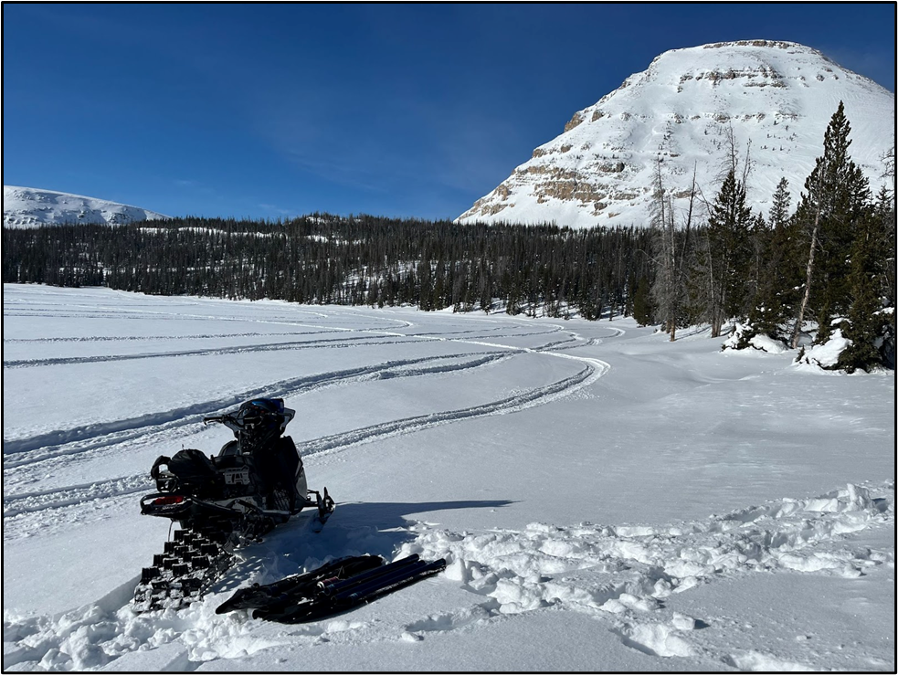
Year 1 Measurement
11
10/19
‘24
1/16
3/19
4/13
5/16
Notes:
Per survey, ASO produces 3m and 50m resolution snow depth, 50m SWE, and 50m snow albedo data products – available 3 days post-flight.
These products are provided along with a data report and several graphical and text-based distillations, and are used by our modeling teams to continually track the snowpack state and hydrologic forecasts.
ASO:
Flights to obtain high-resolution snow depth, snow-water equivalent (SWE), and snow albedo mapping
Lidar and imaging spectrometer mapping of mountain snow cover
Seamless, continuous integration with WRF-Hydro and iSnobal
iSnobal is snowpack energy balance model which uses ASO snow depth measurements and produces a snow density map at 50m resolution, the provides a SWE map and then melt rates (see Proposal pg 5)
WRF-Hydro = Weather Research and Forecasting Hydrological modeling system
WRF-Hydro modeling software
Combined with inputs from ASO flights results in real-time weather and hydrologic information including soil moisture, snowpack, shallow groundwater, evapotranspiration, flood inundation, and streamflow
Provides real-time snowpack and water supply forecastingwater and energy budget accounting and operational forecasting data

Slide 12
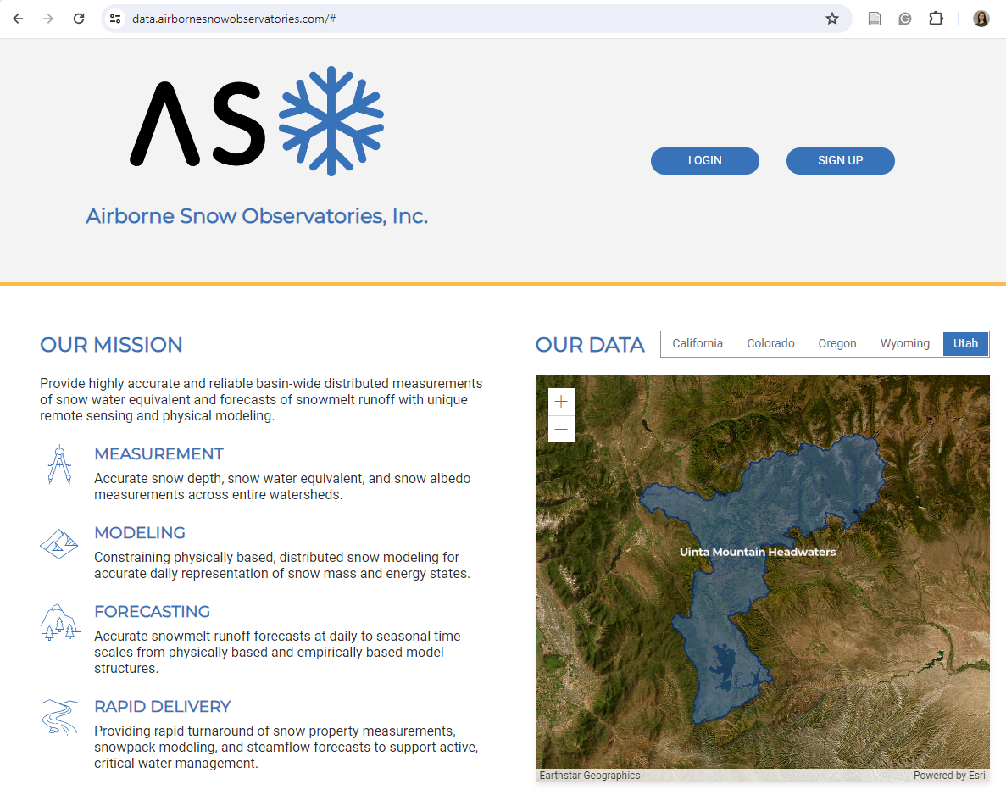
Year 1 Reports
12
10/19
‘24
1/16
3/19
4/13
5/16
Reports:
Data
iSnobal Modeling
WRF Hydro Forecast Modeling
Available online publicly
Notes:
Per survey, ASO produces 3m and 50m resolution snow depth, 50m SWE, and 50m snow albedo data products – available 3 days post-flight.
These products are provided along with a data report and several graphical and text-based distillations, and are used by our modeling teams to continually track the snowpack state and hydrologic forecasts.
ASO:
Flights to obtain high-resolution snow depth, snow-water equivalent (SWE), and snow albedo mapping
Lidar and imaging spectrometer mapping of mountain snow cover
Seamless, continuous integration with WRF-Hydro and iSnobal
iSnobal is snowpack energy balance model which uses ASO snow depth measurements and produces a snow density map at 50m resolution, the provides a SWE map and then melt rates (see Proposal pg 5)
WRF-Hydro = Weather Research and Forecasting Hydrological modeling system
WRF-Hydro modeling software
Combined with inputs from ASO flights results in real-time weather and hydrologic information including soil moisture, snowpack, shallow groundwater, evapotranspiration, flood inundation, and streamflow
Provides real-time snowpack and water supply forecastingwater and energy budget accounting and operational forecasting data

Slide 13
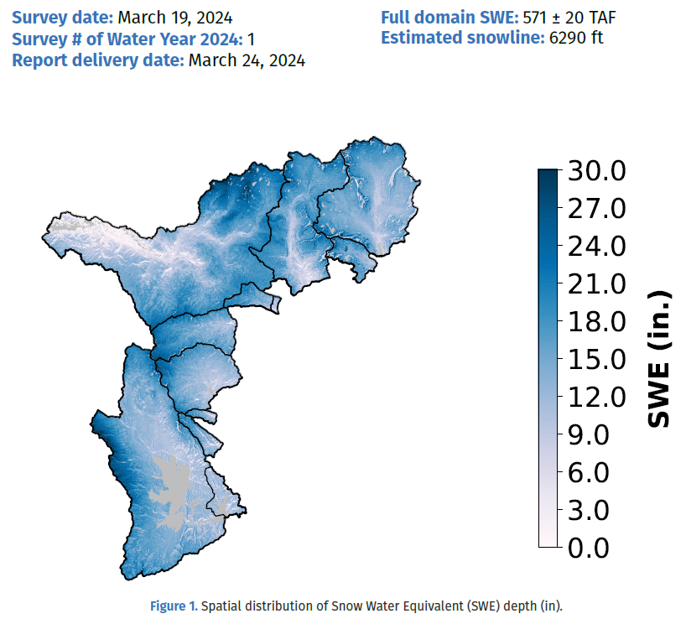
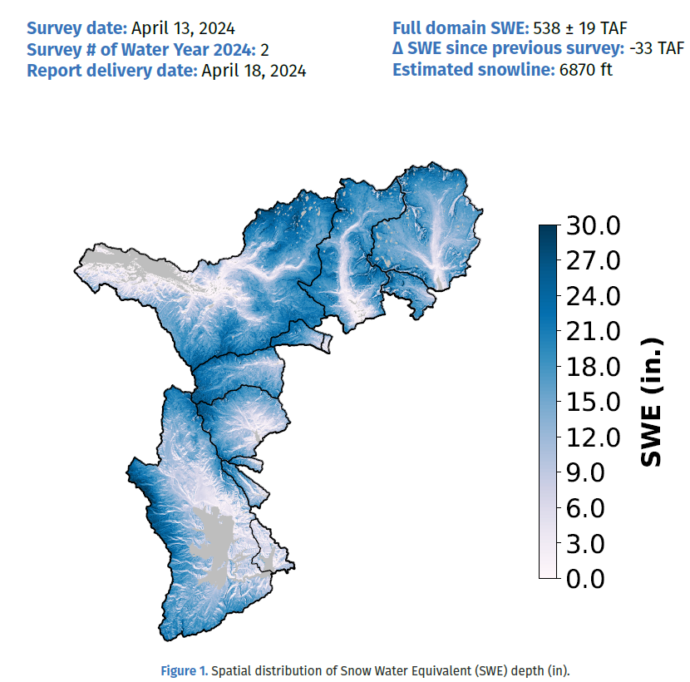
Year 1 Results
13
Notes:
Per survey, ASO produces 3m and 50m resolution snow depth, 50m SWE, and 50m snow albedo data products – available 3 days post-flight.
These products are provided along with a data report and several graphical and text-based distillations, and are used by our modeling teams to continually track the snowpack state and hydrologic forecasts.
ASO:
Flights to obtain high-resolution snow depth, snow-water equivalent (SWE), and snow albedo mapping
Lidar and imaging spectrometer mapping of mountain snow cover
Seamless, continuous integration with WRF-Hydro and iSnobal
iSnobal is snowpack energy balance model which uses ASO snow depth measurements and produces a snow density map at 50m resolution, the provides a SWE map and then melt rates (see Proposal pg 5)
WRF-Hydro = Weather Research and Forecasting Hydrological modeling system
WRF-Hydro modeling software
Combined with inputs from ASO flights results in real-time weather and hydrologic information including soil moisture, snowpack, shallow groundwater, evapotranspiration, flood inundation, and streamflow
Provides real-time snowpack and water supply forecastingwater and energy budget accounting and operational forecasting data

Slide 14
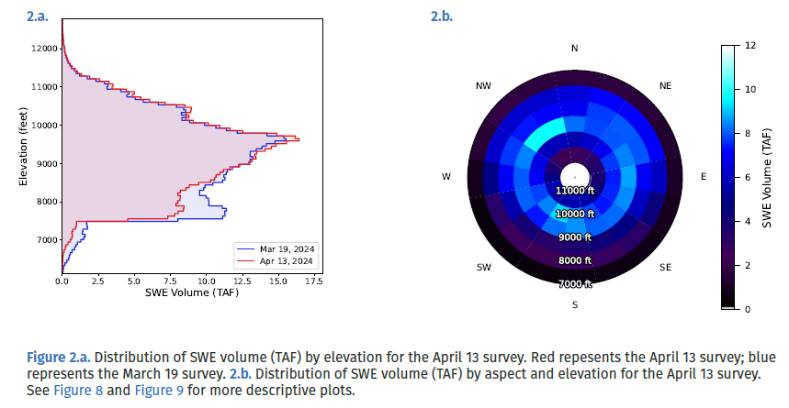
Year 1 Results
14
Notes:
Per survey, ASO produces 3m and 50m resolution snow depth, 50m SWE, and 50m snow albedo data products – available 3 days post-flight.
These products are provided along with a data report and several graphical and text-based distillations, and are used by our modeling teams to continually track the snowpack state and hydrologic forecasts.
ASO:
Flights to obtain high-resolution snow depth, snow-water equivalent (SWE), and snow albedo mapping
Lidar and imaging spectrometer mapping of mountain snow cover
Seamless, continuous integration with WRF-Hydro and iSnobal
iSnobal is snowpack energy balance model which uses ASO snow depth measurements and produces a snow density map at 50m resolution, the provides a SWE map and then melt rates (see Proposal pg 5)
WRF-Hydro = Weather Research and Forecasting Hydrological modeling system
WRF-Hydro modeling software
Combined with inputs from ASO flights results in real-time weather and hydrologic information including soil moisture, snowpack, shallow groundwater, evapotranspiration, flood inundation, and streamflow
Provides real-time snowpack and water supply forecastingwater and energy budget accounting and operational forecasting data

Slide 15
Applications

Slide 16
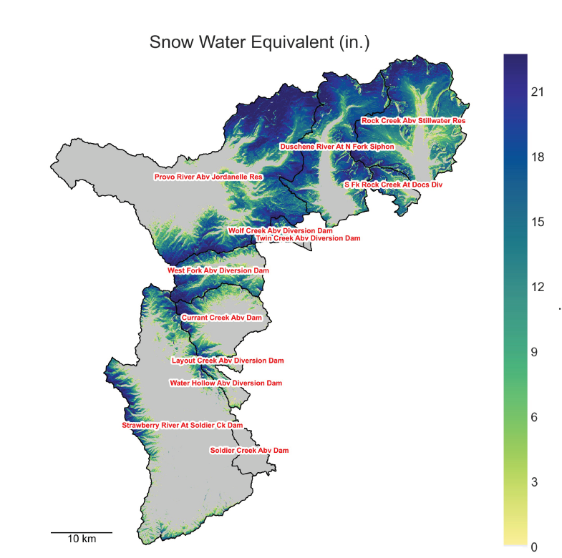
Runoff and Reservoir Inflow Forecast
16

Slide 17
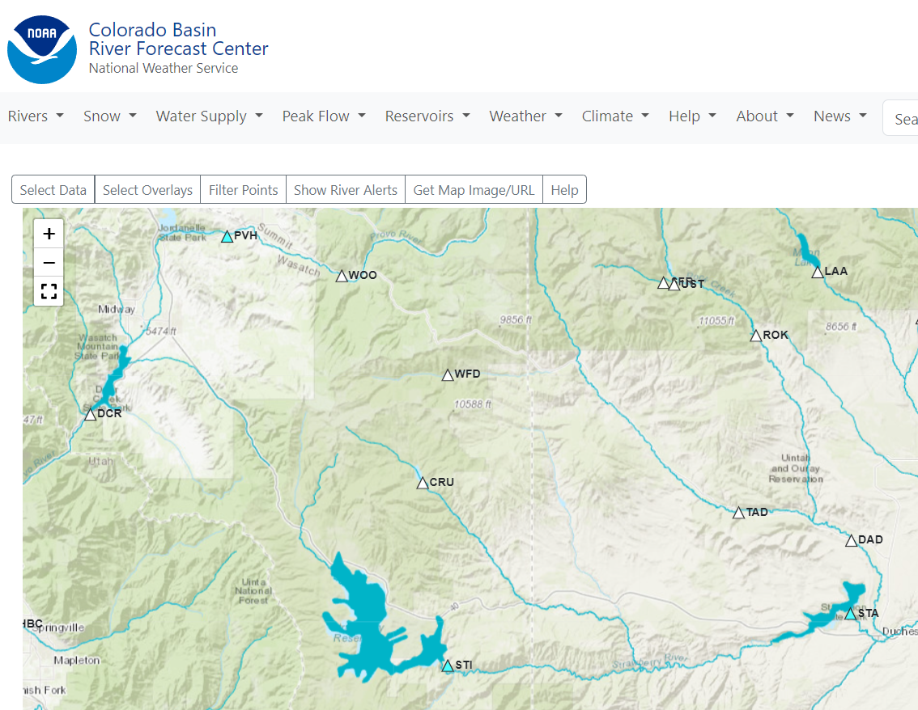
17

Slide 18
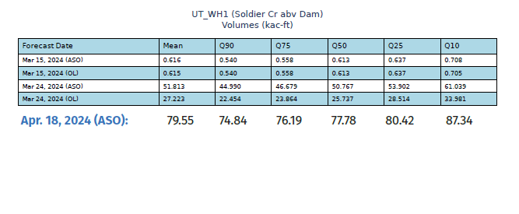
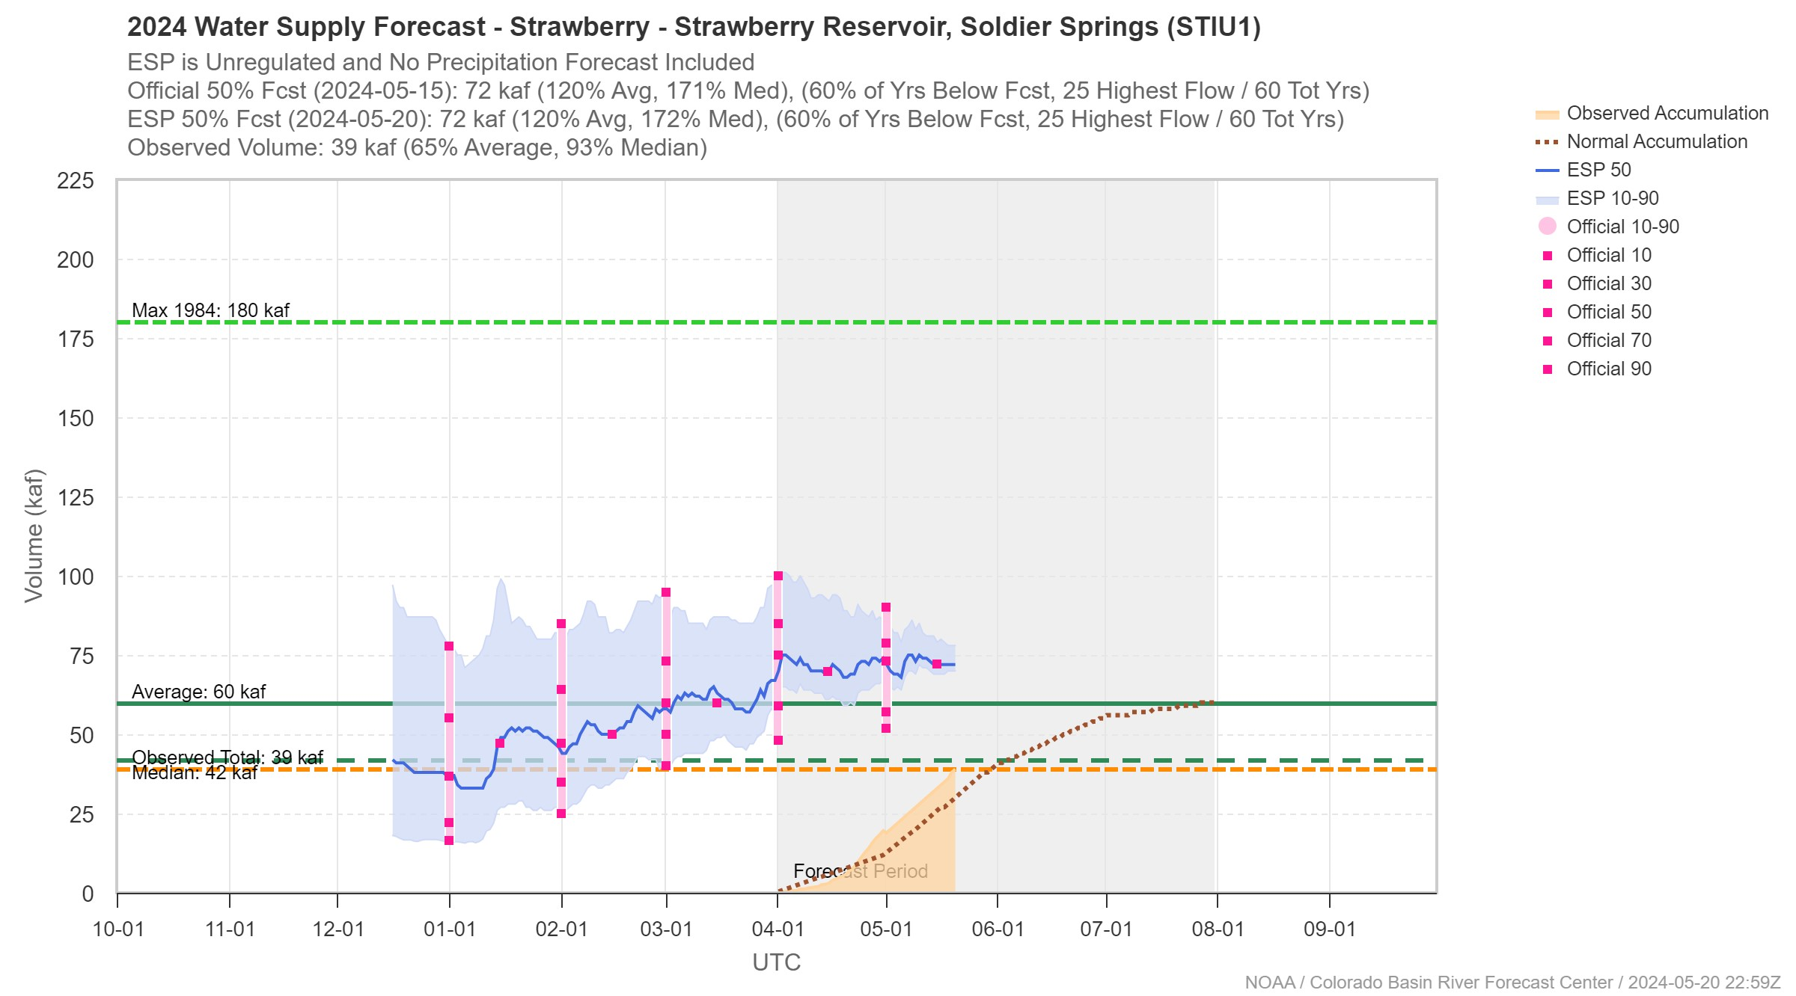
Soldier Creek Dam Inflow Forecast
18
ASO 50%: 77.78 KAF
CBRFC 50%: 72 KAF

Slide 19
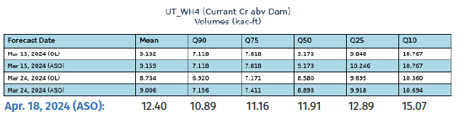
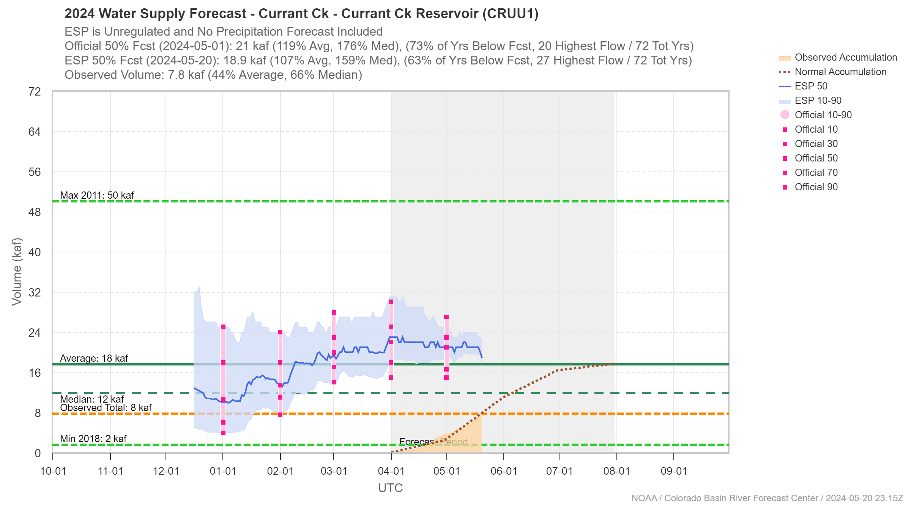
Currant Creek Inflow Forecast
19
ASO 50%: 11.91 KAF
CBRFC 50%: 21 KAF

Slide 20
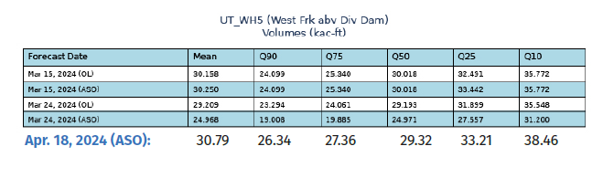
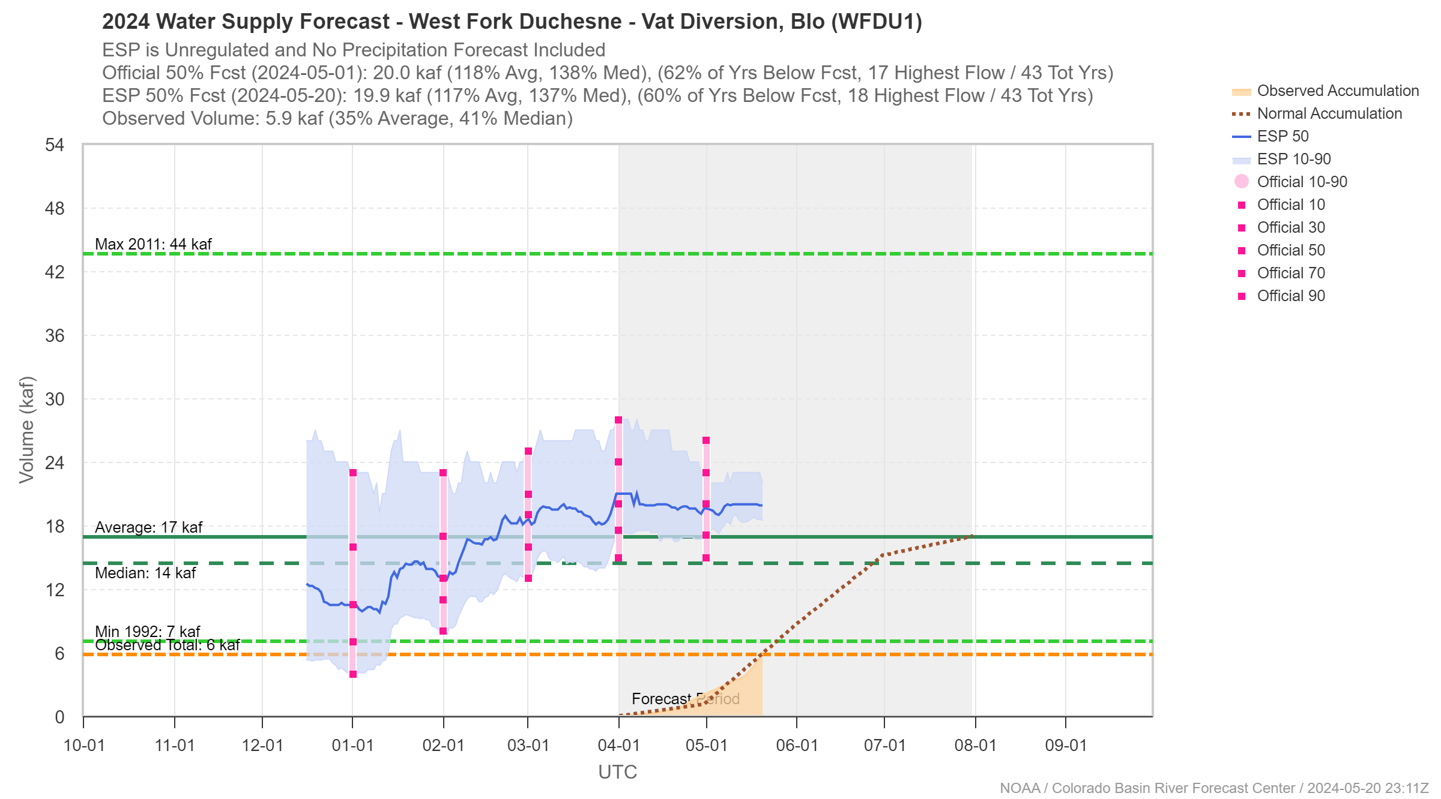
West Fork of Duchesne Inflow Forecast
20
ASO 50%: 29.32 KAF
CBRFC 50%: 20 KAF

Slide 21
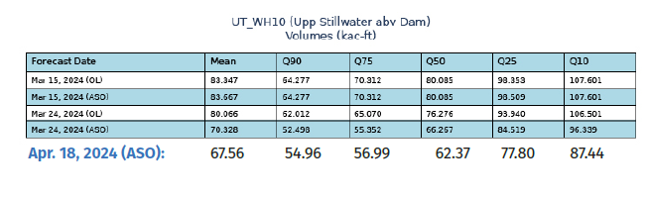
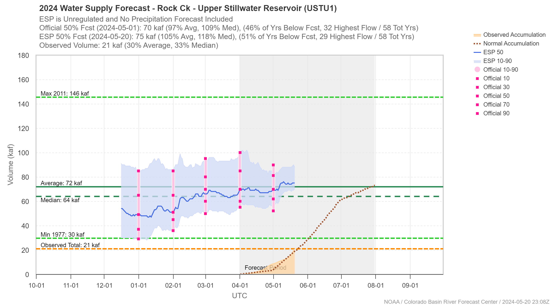
Upper Stillwater Inflow Forecast
21
ASO 50%: 62.37 KAF
CBRFC 50%: 70 KAF

Slide 22
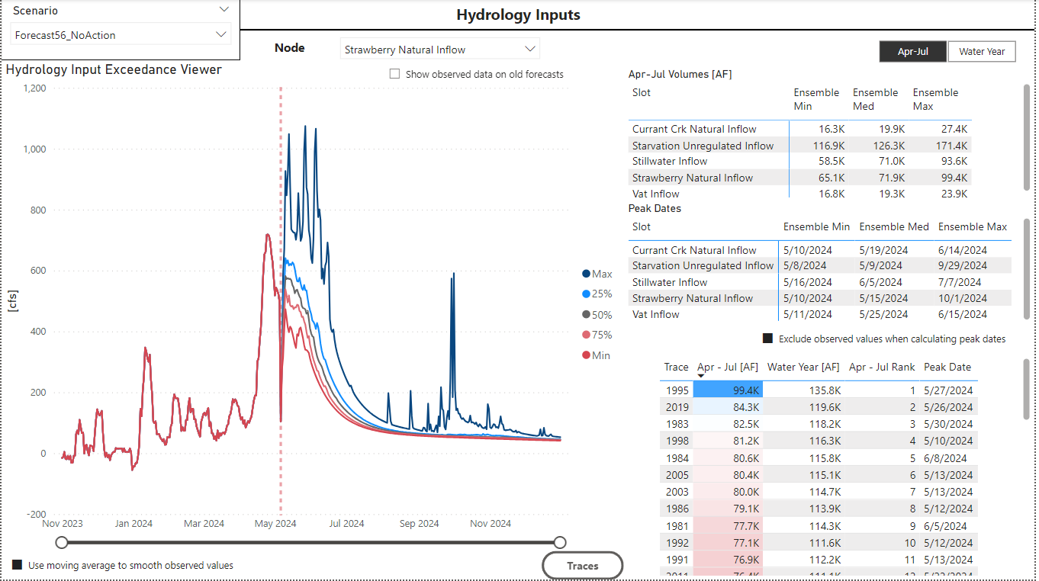
Hydrology Inputs to Operations Models
22

Slide 23
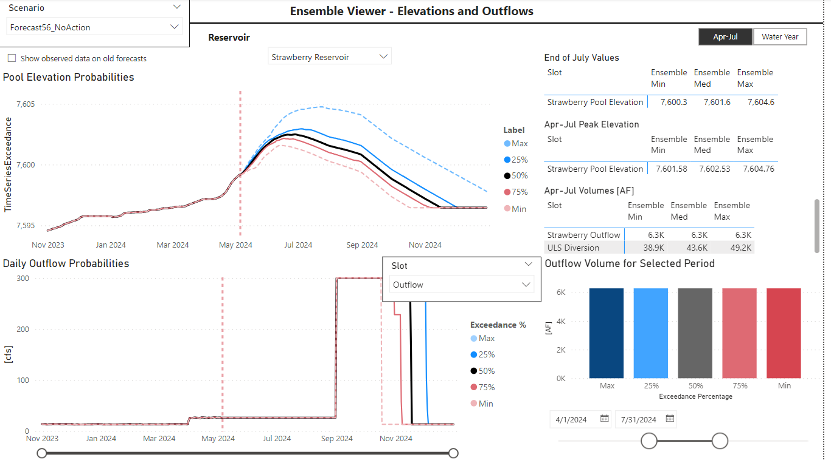
Strawberry Operations Forecast
23

Slide 24
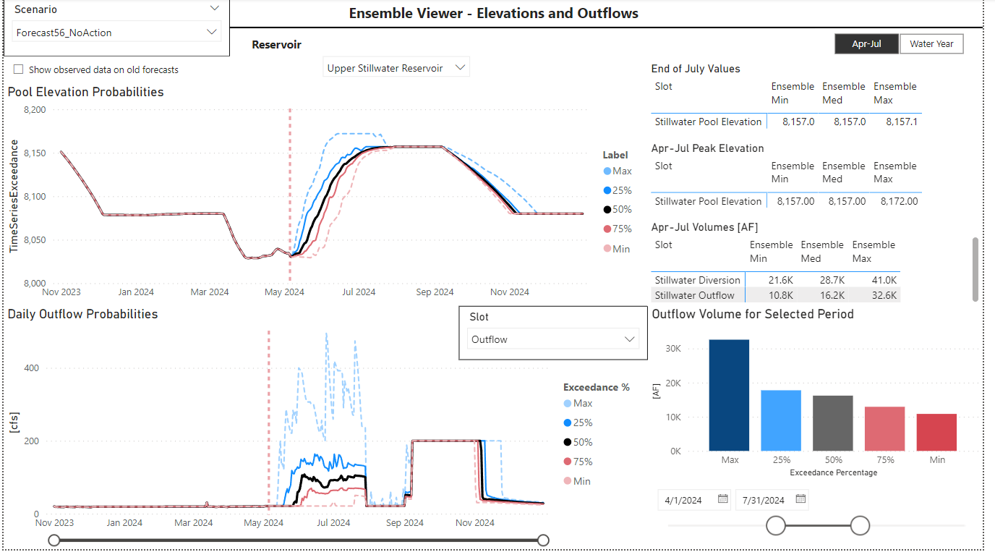
Upper Stillwater Operations Forecast
24

Slide 25
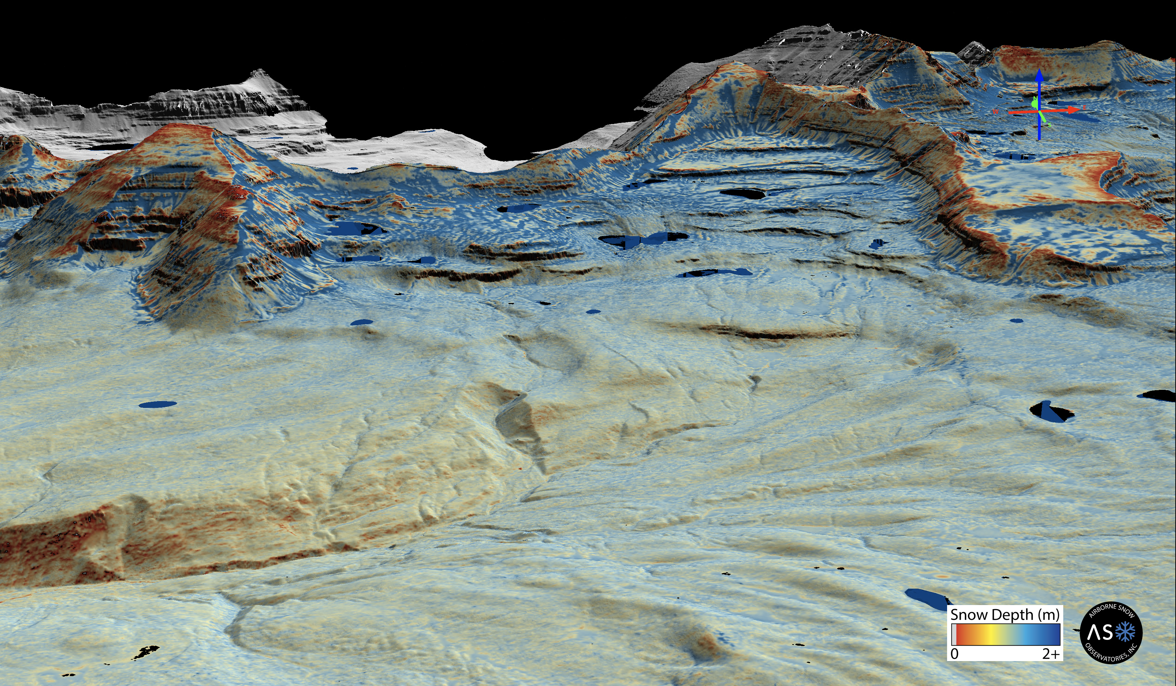




25
Defending Every Drop
cra.utah.gov
@AuthorityUT
@AmyHaasColoRivr

Slide 26
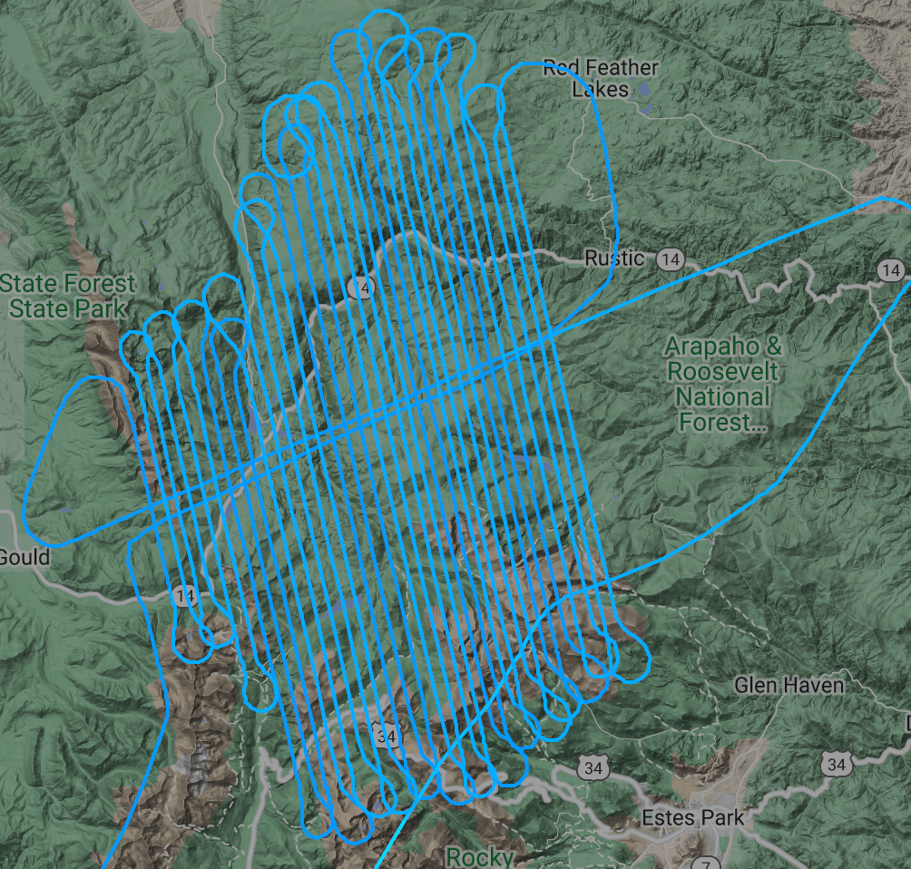
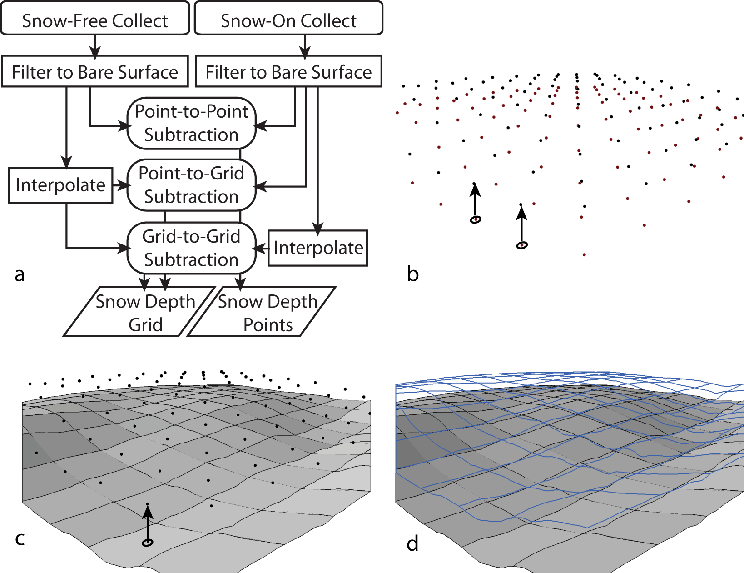
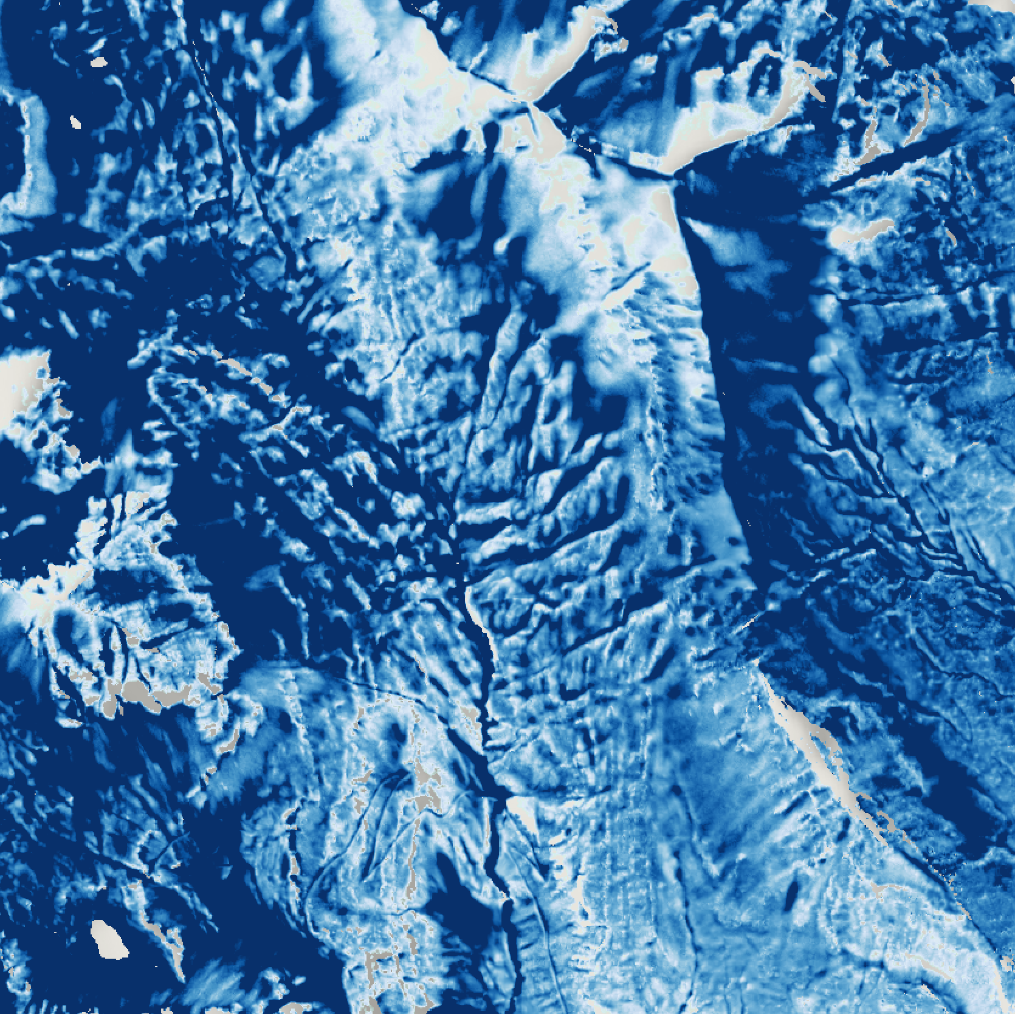
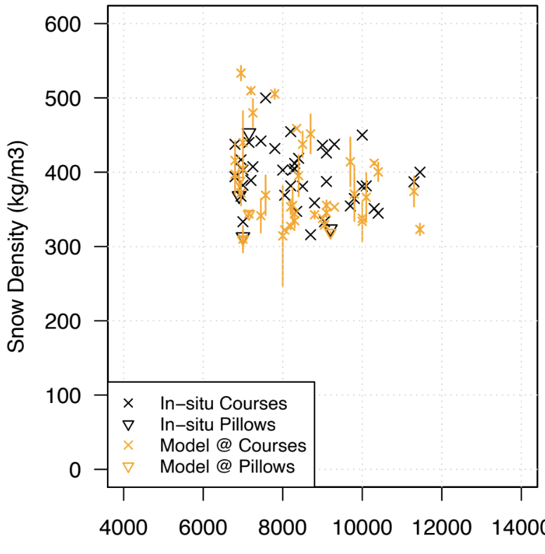
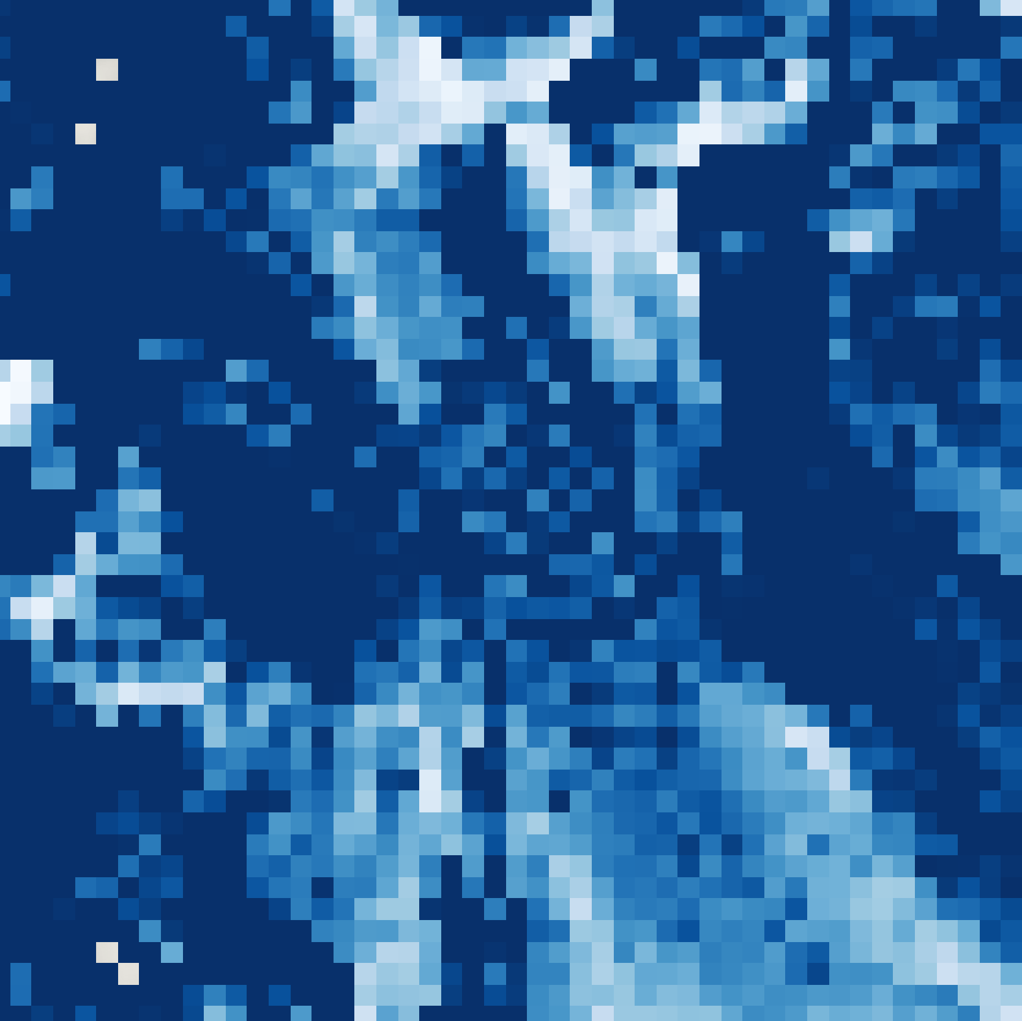
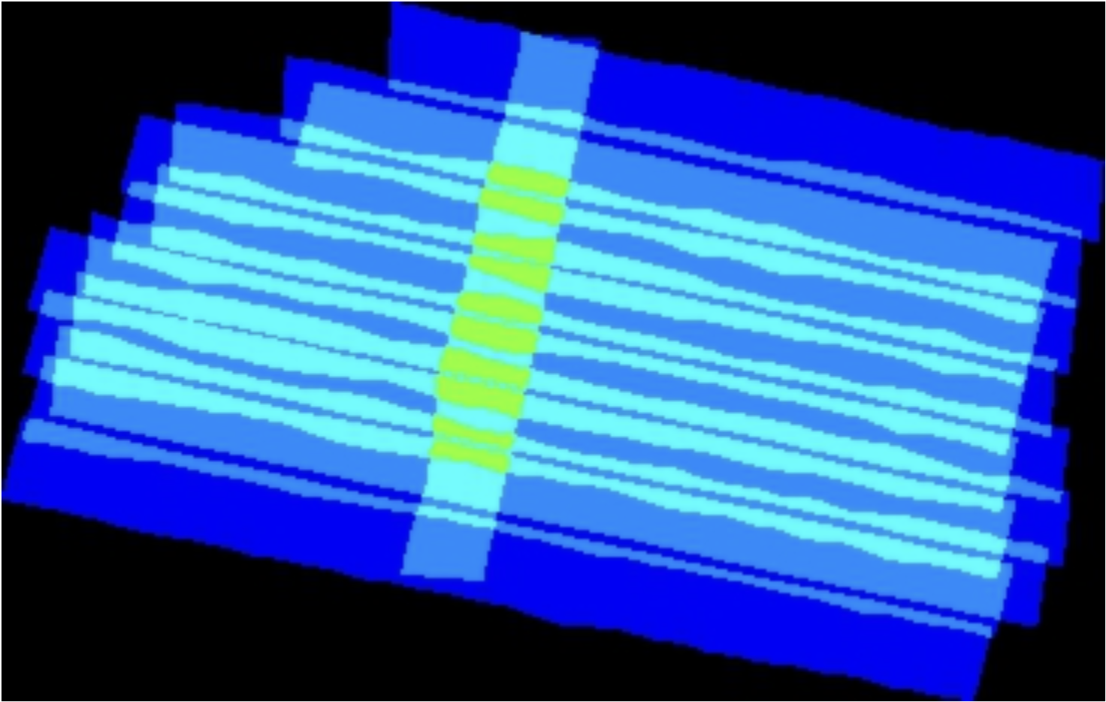
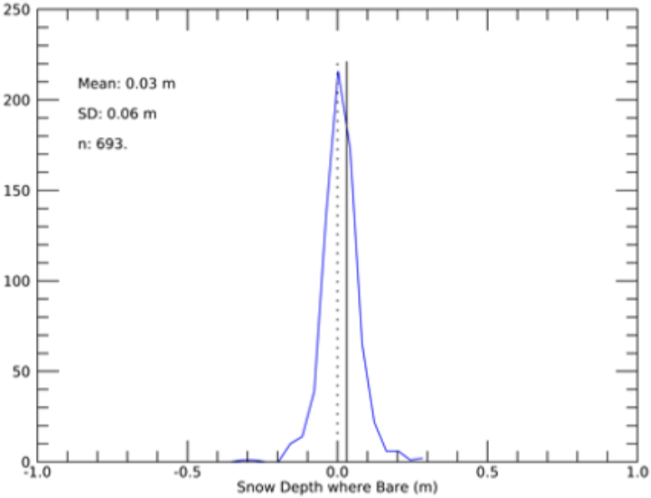
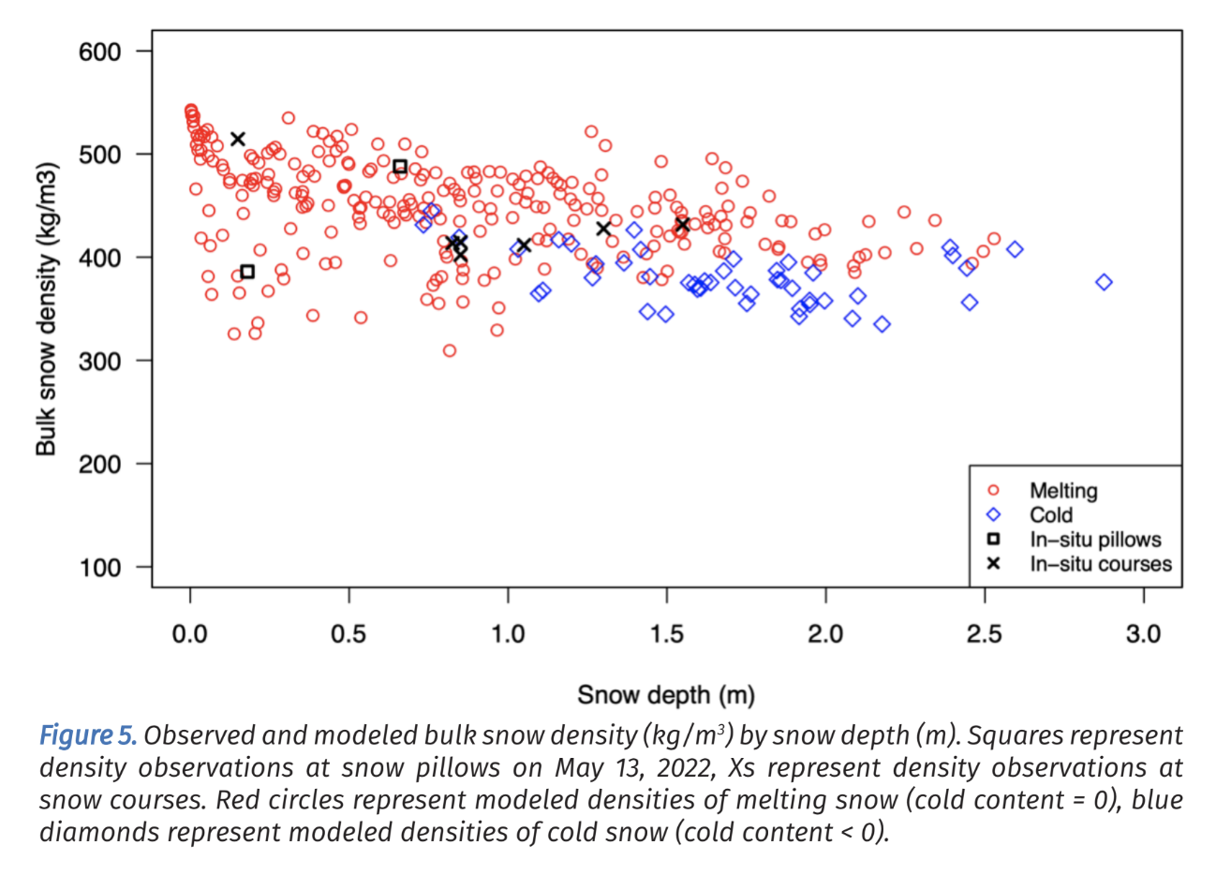
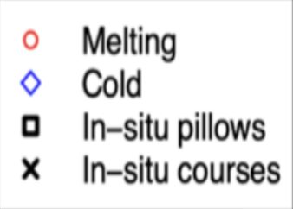
QAQC is integral to the ASO production pipeline
Register Snow-off
& Snow-on Data
Calculate & Validate
Snow Depth
Bias-correct
Modeled Density
Calculate SWE
& Estimate Error
Airborne Survey
Process Raw Data
Lidar
Point cloud extract
Line-to-line correct
Terrain filter gridding
Spectrometer
Radiance extract
Surface classify
Structural components enforce accuracy
Line-to-line correction:
full-domain consistent accuracy
Co-registration:
minimizes depth bias
Provides depth uncertainty estimate
Depth validation:
Verifies registration
Model density bias adjust:
Informs density & SWE uncertainty
Mean = 0.03m
SD = 0.06m
N = 693
Density
RMSE 0.02m
HS In-Situ Station Validation | Mean | SD | Min | Max
With HS=0 | -0.66 cm | 4.22 | -13.0 | 11.9
Without HS=0 | -0.93 cm | 4.98 | -13.0 | 11.9
Snow Depth
Notes:
The ASO snow depth and SWE calculation pipeline has several critical QA/QC steps built in to ensure accuracy.
- Flightline overlap is leveraged to ensure basin-wide data consistency.
- Registration of the snow-on and snow-free data provides reliable and precise depth retrieval, along with an uncertainty estimate on the 3m snow depths, which is checked against in-situ depth measurements (typically 5cm or better).
- The 3m depth error compresses to a very small number (< 1cm) when aggregated to 50m.
- Modeled snow density is evaluated against in-situ measurements and bias-corrected as needed.
Density bias scenarios are used to evaluate SWE sensitivity to the density distribution and inform SWE uncertainty.
ASO – refining the process over the last 10 years
Water managers in neighboring states
Structural elements to ensure data consistency and accuracy
Technical/scientific integrity
Baseline snow-free flight – minimizes errors
Flight patterns provide 4 unique angles for every location
Validate measurements
Testing forecast improvements

Slide 27
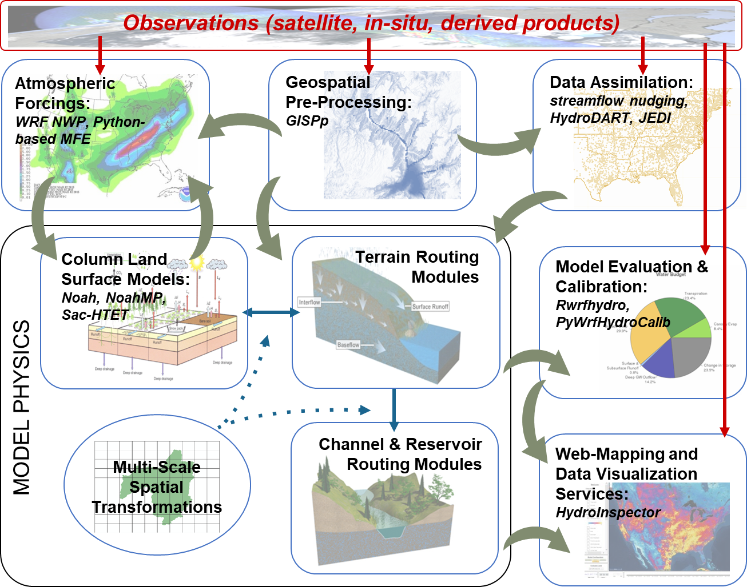
WRF-Hydro Forecast Integration
Task C.3: Hydrologic Forecasting
NCAR WRF-Hydro group operationally produces ASO-constrained hydrologic forecasts using:
ensemble methods (conditioning, scenarios)
other data integrations
performance assessment methods
Notes:
Seamless, continuous integration with WRF-Hydro and iSnobal
iSnobal is snowpack energy balance model which uses ASO snow depth measurements and produces a snow density map at 50m resolution, the provides a SWE map and then melt rates (see Proposal pg 5)
WRF-Hydro = Weather Research and Forecasting Hydrological modeling system
WRF-Hydro modeling software
Combined with inputs from ASO flights results in real-time weather and hydrologic information including soil moisture, snowpack, shallow groundwater, evapotranspiration, flood inundation, and streamflow
Provides real-time snowpack and water supply forecasting water and energy budget accounting and operational forecasting data
State of the art column land surface thermodynamics
Dynamic, hyper-resolution terrestrial overland, sub-surface & channel routing
Multi-spatial framework support
Current configuration using 1km column physics with 250m terrain routing
Plan to enable Targeted, refined forecasts for drought mitigation specifically. More localized/better localized forecasts than cbrfc.
How does the project plan to evaluate improvements in accuracy and reliability of water supply forecast model skill with a limited period of record? How will skill improvement be quantified? – wrf hyrdo measured against CBRFC AND actual runoff. Limited period of record, two comparison points. More years (3) will give us a sense of the range of accuracy. Best time to take action is today. Reminder: what’s novel is applying this to Utah.
Jeff: compare open loop wrf hdro to one with aso. Opportunity for aso to refine cbrfc forecast
In many cases, future weather outcomes, not snowpack initial conditions, remain the largest source of water supply forecast uncertainty. How will this be factored into water supply forecast skill? Our goal is to evaulate one variable in the forecasting equation. The weather variables are outside the scope of this study, even though they are impactful. Hopefully ASO will help us allocate resources to areas with impactful and under-measured areas.
Jeff: all models suffer from uncertainty, snowpack is best predictor of water supply, while weather is greatest source of uncertainty. Ensemble forecasting accounts for a range of scenarios. Ensemble can be conditioned.

