Slide 1
Hydrology & System Status Update May 2024
Colorado River Authority of Utah Board Meeting
Betsy Morgan, Staff Engineer
Lily Bosworth, Staff Engineer
MAY 21, 2024
SALT LAKE CITY, UTAH

Slide 2
Hydrology

Slide 3
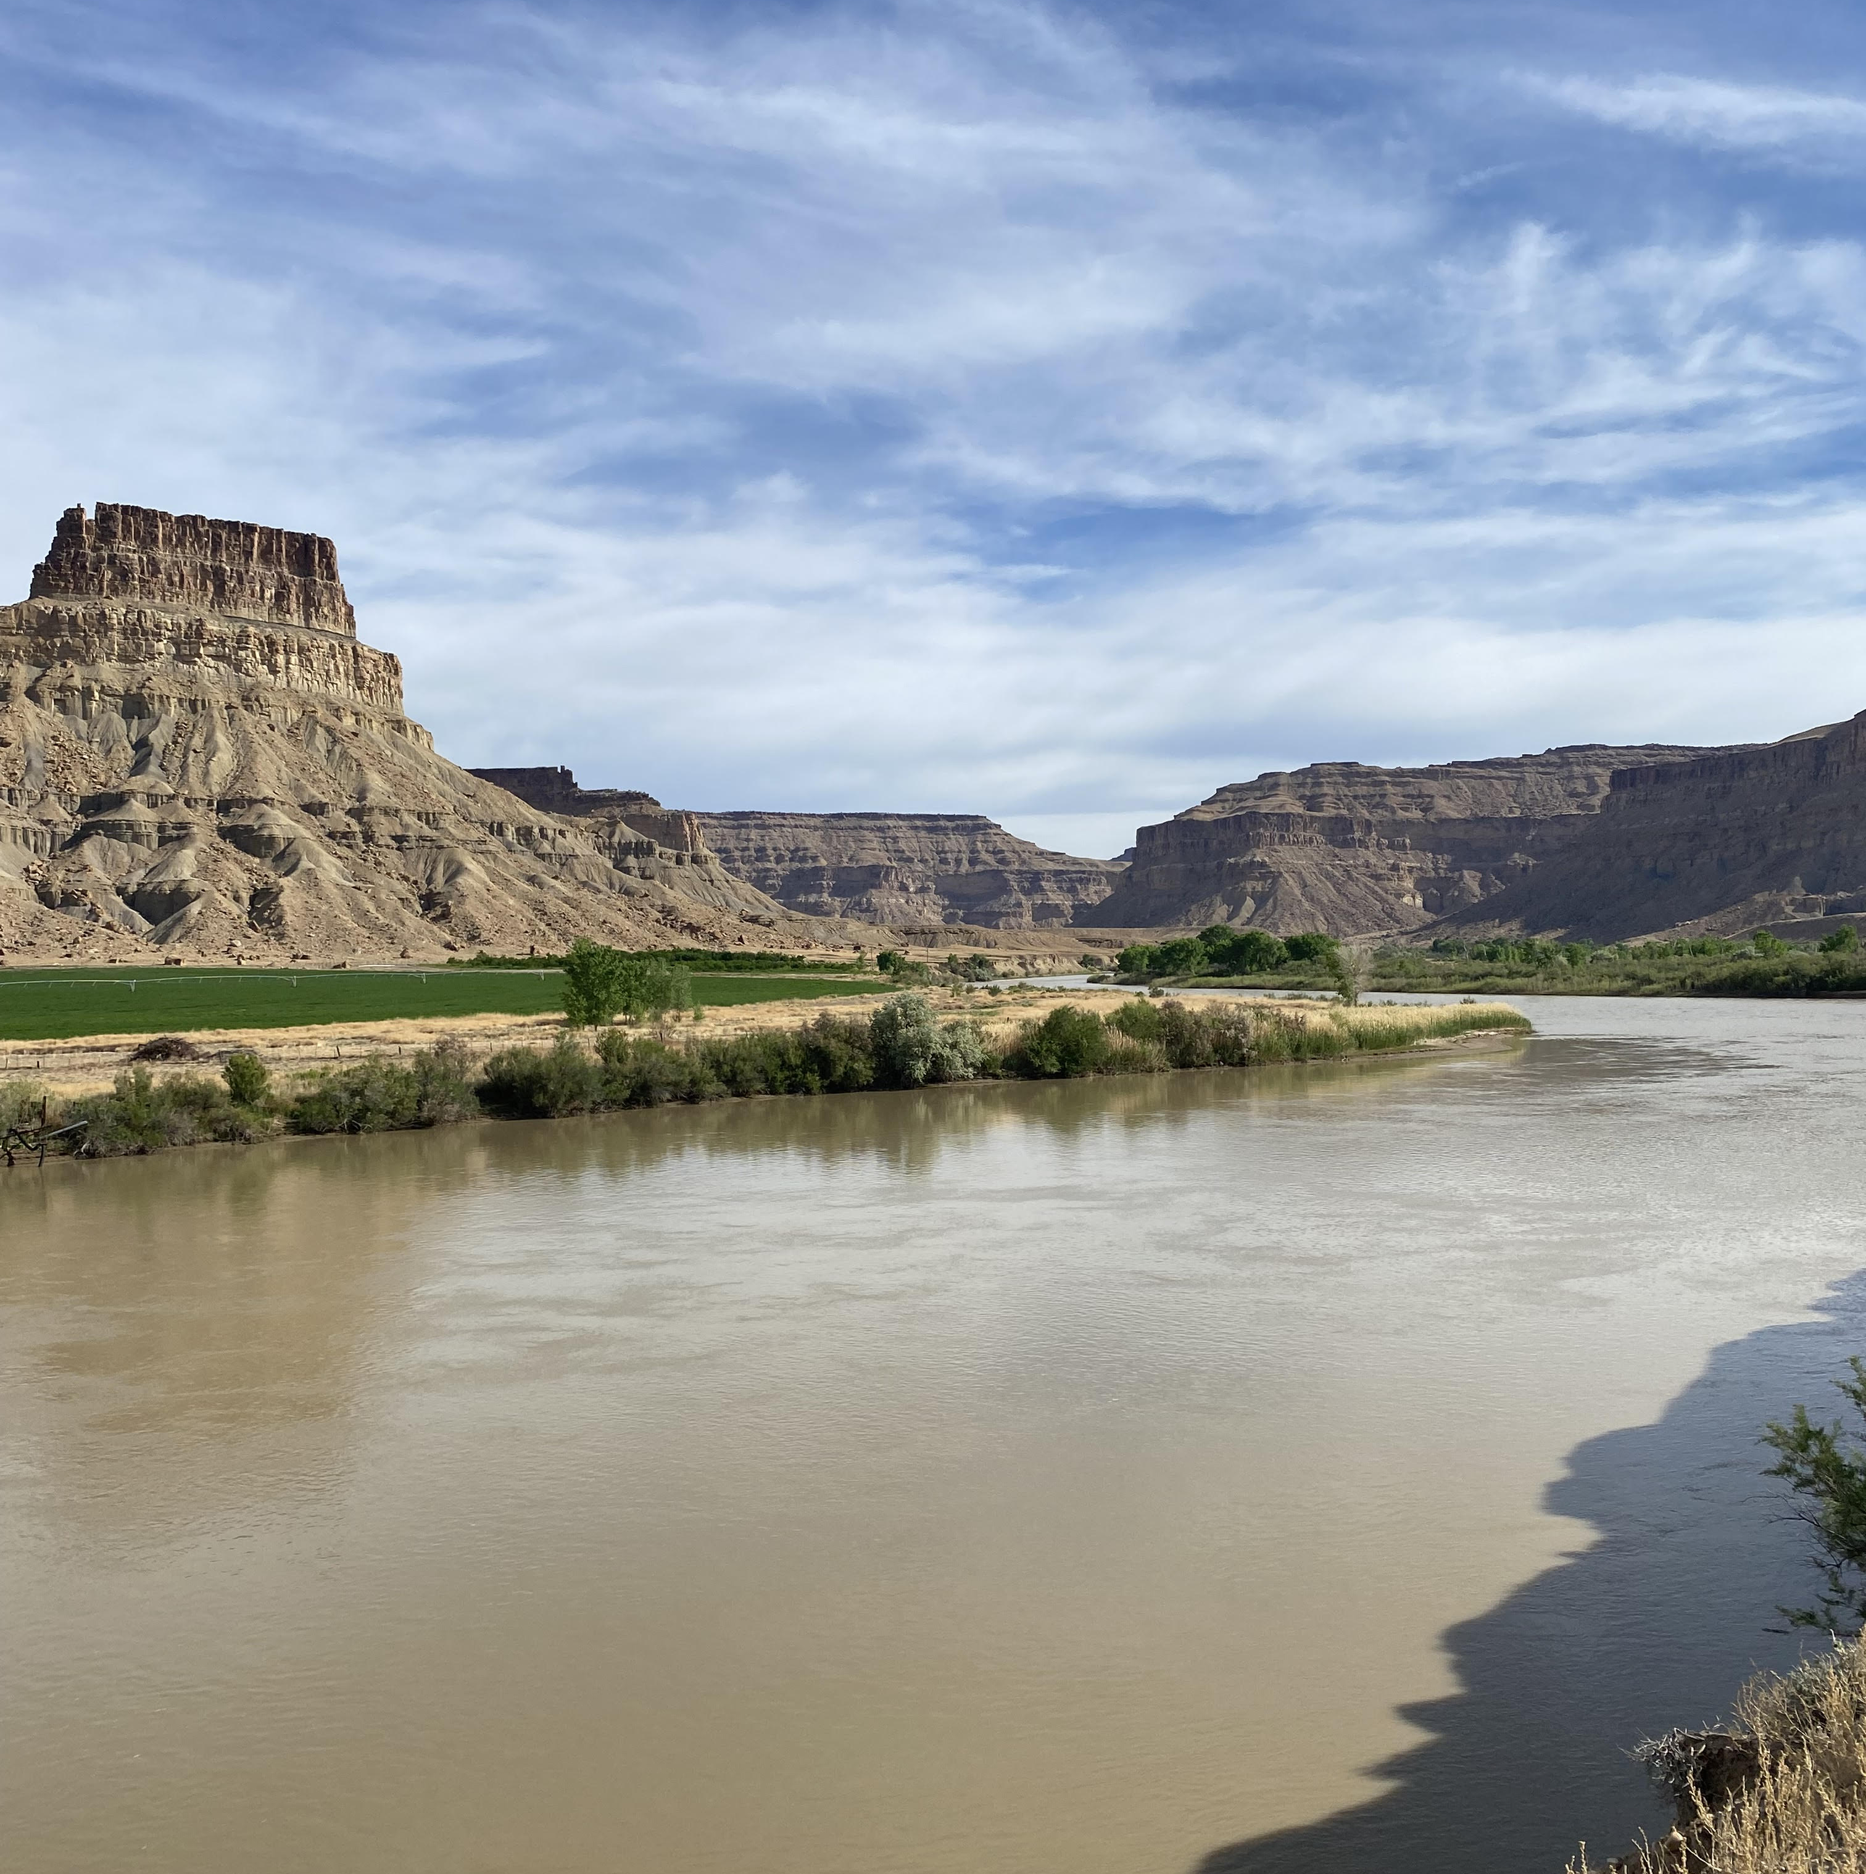
Green River, UT May 15 2024

Slide 4
Today’s data:
Ground-up
Present and future
Upper Colorado River Basin

Slide 5
Subsurface Hydrology: May 2024
Shallow Groundwater
Root Zone Soil Moisture
Surface Soil Moisture
Dry subsurface conditions suggest long-term drought impacts remain

Slide 6
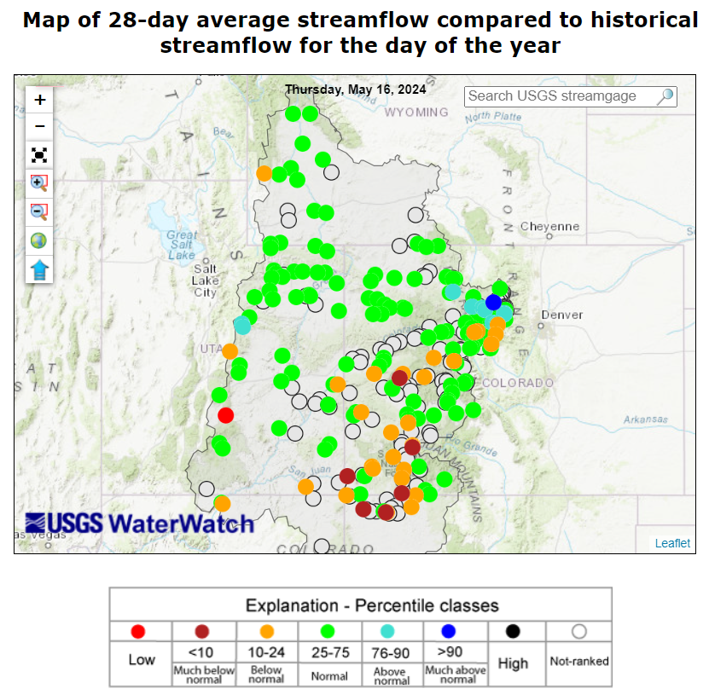
Surface Hydrology: May Streamflow
Normal to below normal flow across Upper Basin

Slide 7
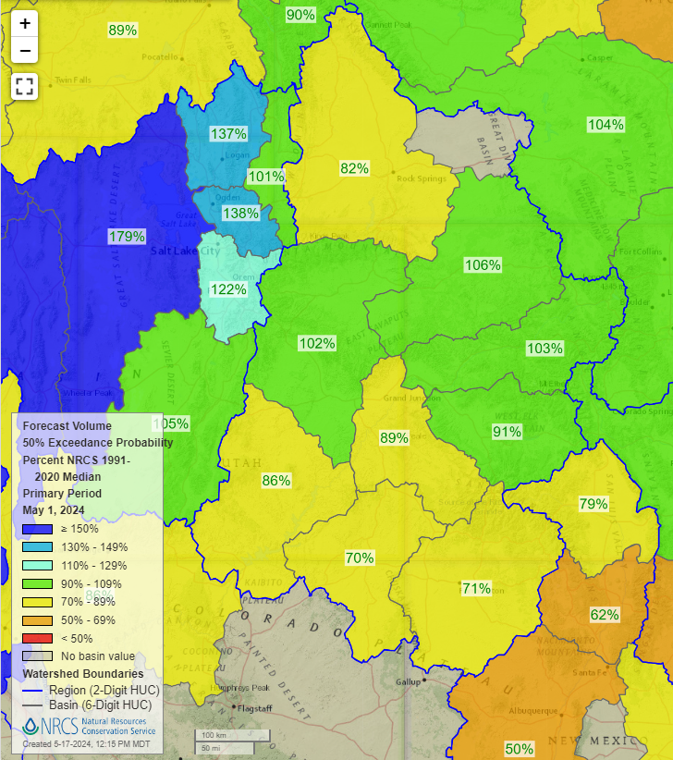
Surface Hydrology: Runoff Forecast
Normal to below normal runoff forecasted across Upper Basin

Slide 8
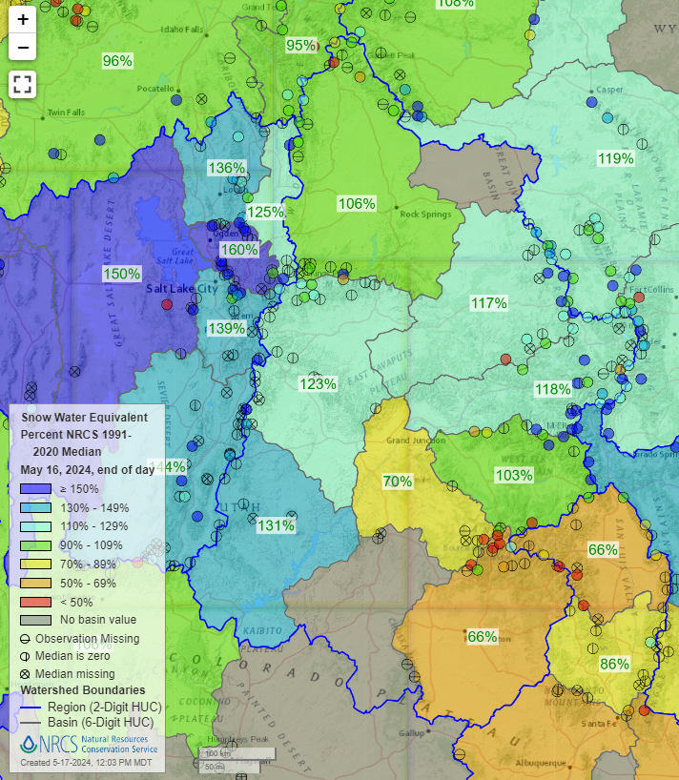
Surface Hydrology: May Snow
Above normal to below normal snowpack across Upper Basin
Low runoff efficiency persists

Slide 9
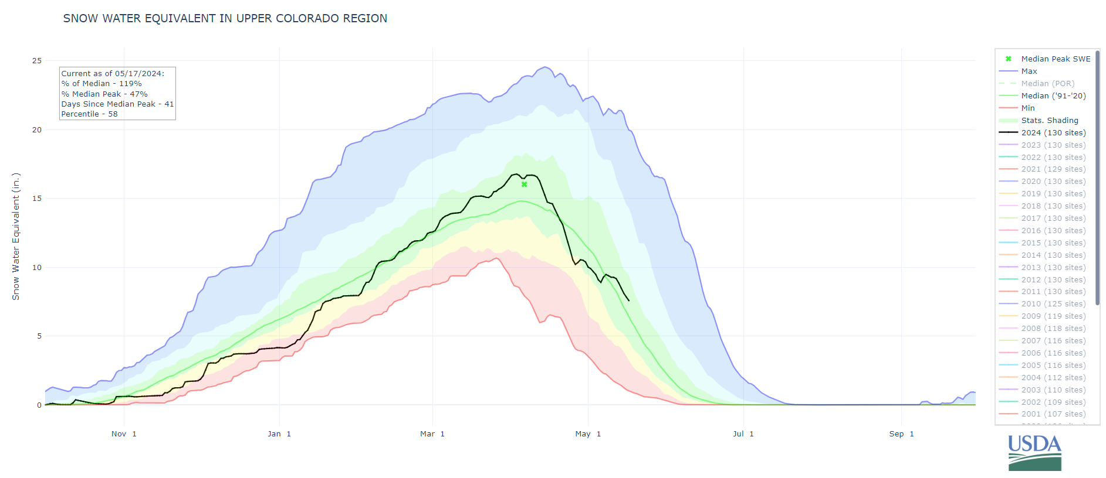
Surface Hydrology: Water Year 2024 Snow
Below normal SWE progressed to normal SWE during snow season across Upper Basin

Slide 10
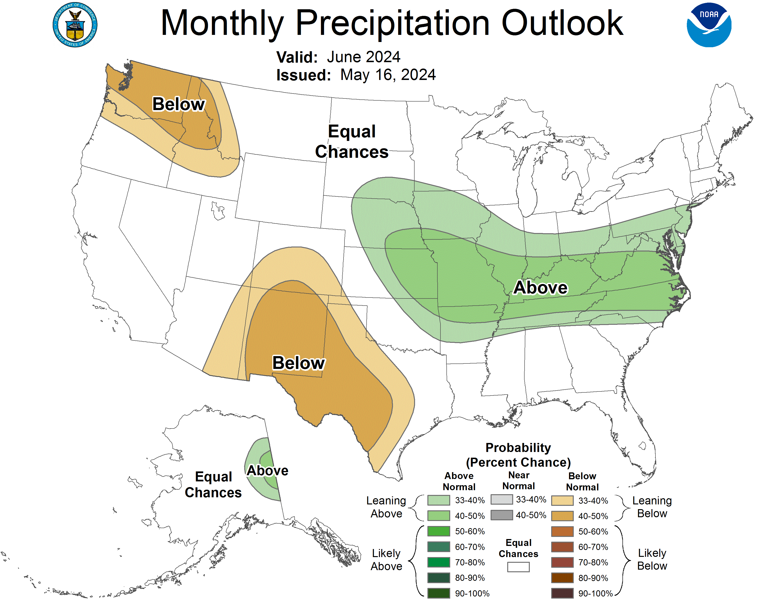
Atmospheric Hydrology: Precipitation Outlook
Equal chances and below normal precipitation in June

Slide 11
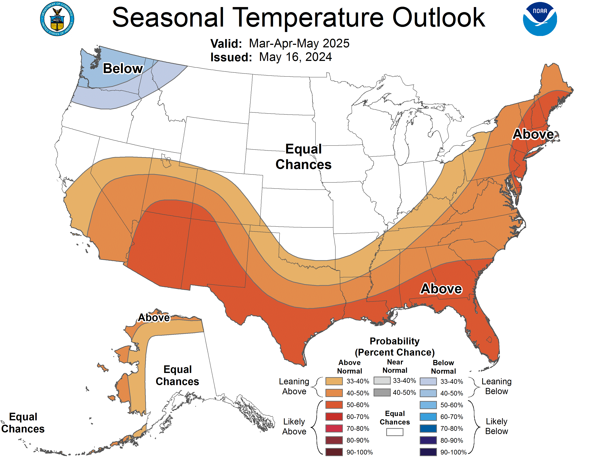
Atmospheric Hydrology: Temperature Outlook
Above normal temperatures in June

Slide 12
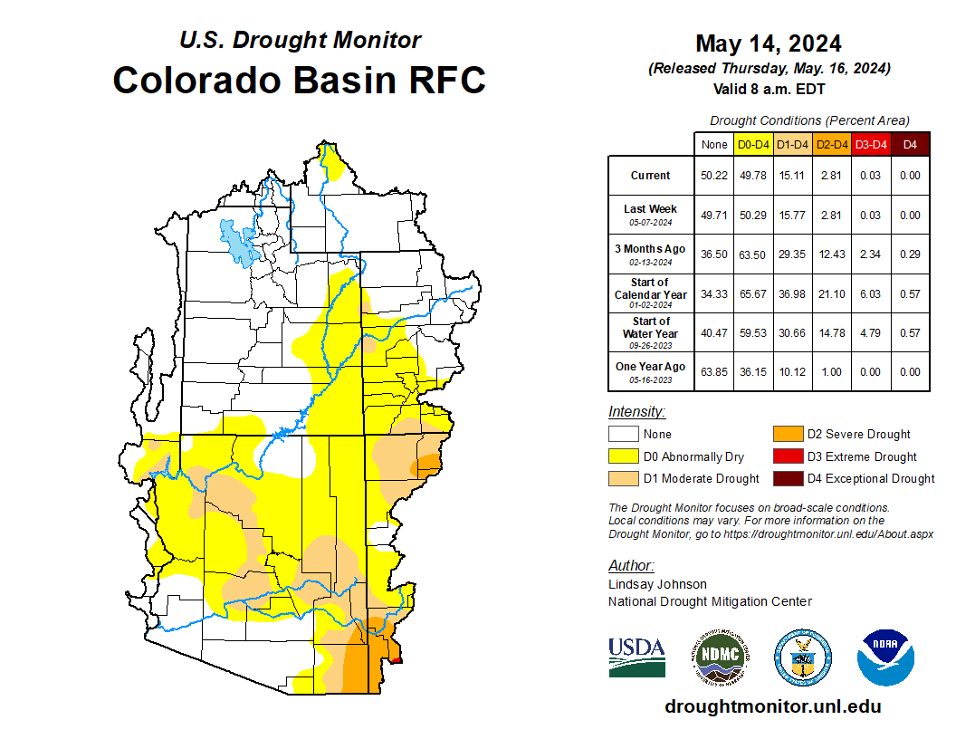
Drought Conditions: U.S. Drought Monitor
None to Moderate drought in Upper Colorado River Basin
Drought conditions persist in the Colorado River Basin

Slide 13
System Operations

Slide 14
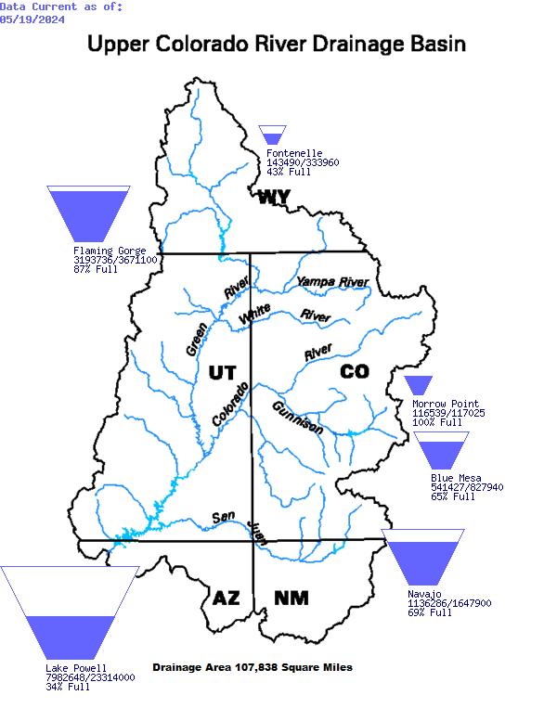
Upper Basin Storage: May 19, 2024
Notes:
Since we are in spring runoff, reservoirs have begun to increase in storage. Blue Mesa has begun it’s spring peak, FG expected to begin spring peak in next few weeks, Fontenelle is filling, and Navajo won’t be having a peak this year.

Slide 15
Powell, Mead and System Storage: May 19, 2024
Reservoir | Percent Full | Storage (MAF) | Elevation (feet)
Lake Powell | 34% | 7.983 | 3,562.74
Lake Mead | 35% | 9.123 | 1,069.04
Total System Content | 42% | 24.536 | NA
Total System Content (one year ago) | 37% | 21.688 | NA

Slide 16
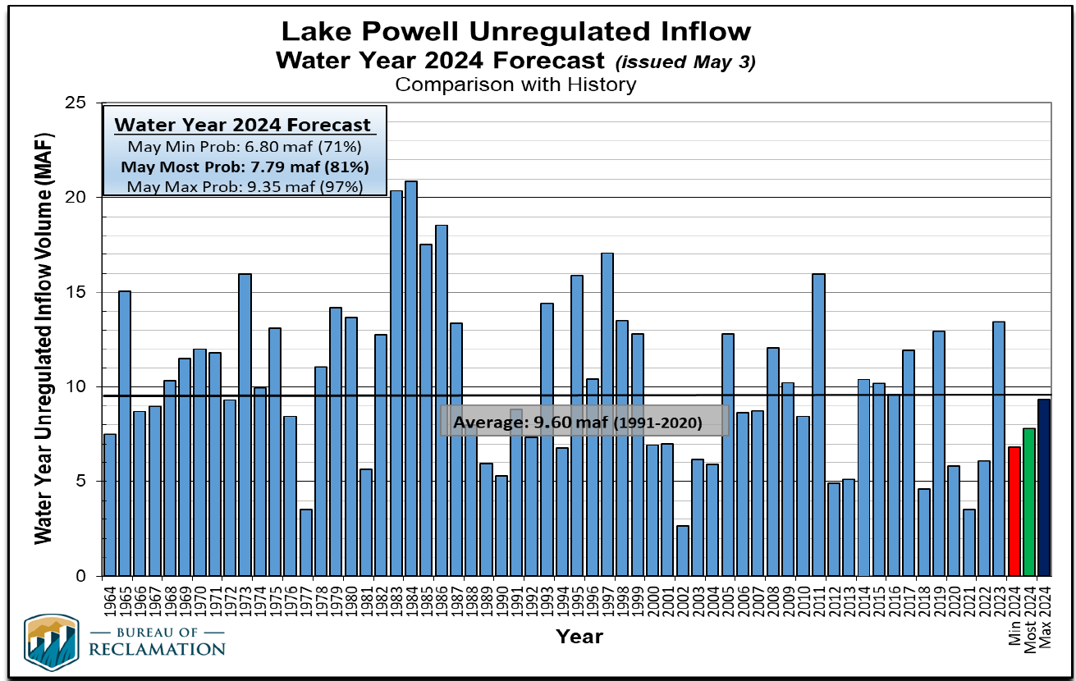
Notes:
All forecasts are now below the 1991-2020 average of 9.6 MAF, so at this point, we’re not looking at any above average forecasts this year.
Min: 6.8, Most: 7.79, max: 9.35

Slide 17
WY 2024 Lake Powell Unregulated Inflow Forecasts
Forecast | Sept | Oct | Nov | Dec | Jan | Feb | Mar | Apr | May
Min (MAF) | 6.3 | 6.0 | 5.57 | 4.9 | 4.95 | 5.69 | 6.15 | 7.11 | 6.80
Most (MAF) | 10.0 | 9.4 | 8.62 | 7.62 | 6.92 | 7.36 | 7.66 | 8.39 | 7.79
Max (MAF) | 17.6 | 17.6 | 15.42 | 13.5 | 11.1 | 10.93 | 10.90 | 11.33 | 9.35
Notes:
Table shows sequential unregulated inflow forecasts as months have progressed
Saw modest increases in the forecast between February to April, but a decrease in May due to a drier April.
Max probable decreased almost 2 MAF from last month.

Slide 18
Unregulated Inflow - Upper Basin Reservoirs

Slide 20
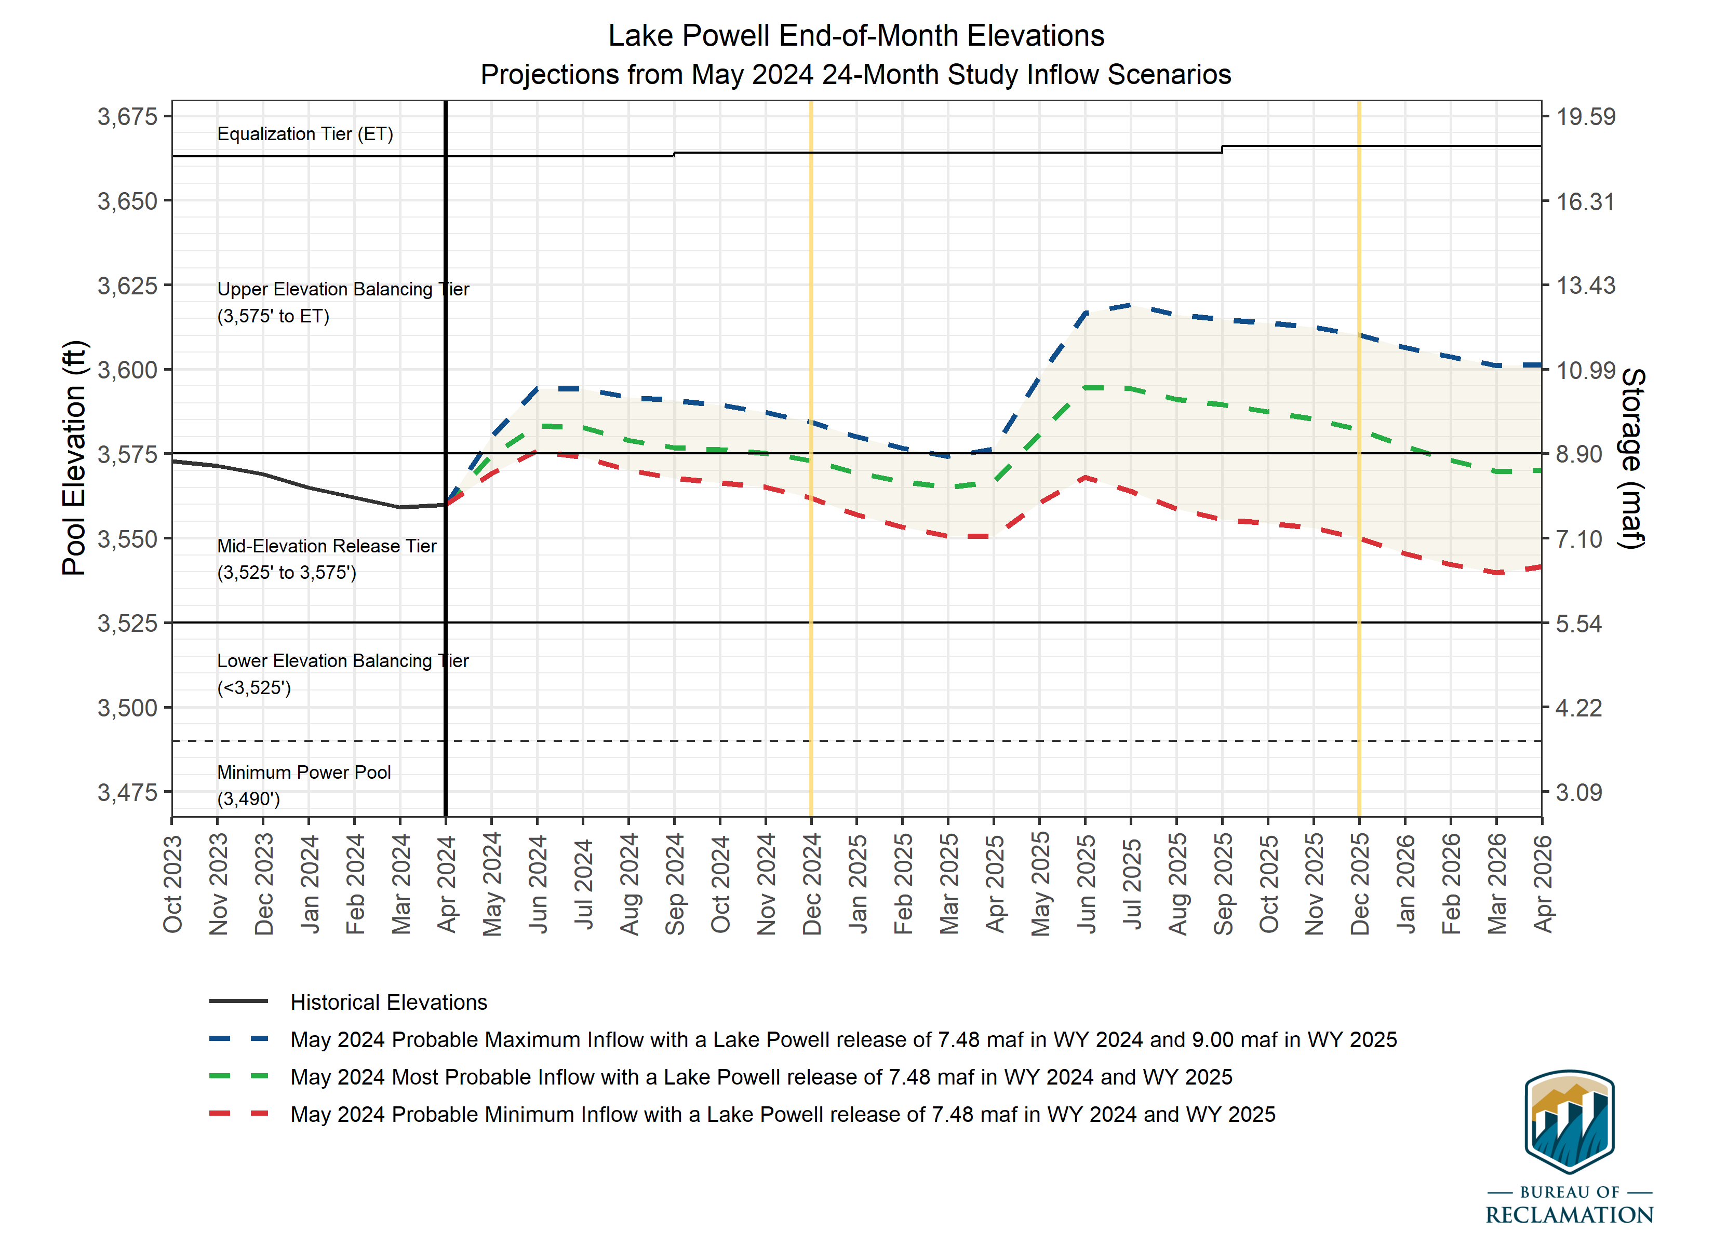
Most probable end of CY25: 3,582.12’ (41% full)
Min/Max Range: 3,550.06’ – 3,610.17’
Uncertainty is narrowing in 2024 projections
April probabilistic projections show no traces below 3525’ in 2024 or 2025
Most probable end of CY24: 3,572.92’ (37% full)
Notes:
May 24 Month Study was released last week (single input traces>> min, most, and max probable)
Reclamation will be publishing CRMMS 2 and 5 year probabilistic projections (30 traces, cloud) towards the end of the month. These runs will include the near term SEIS ruleset, so additional work is needed to add these.

Slide 21
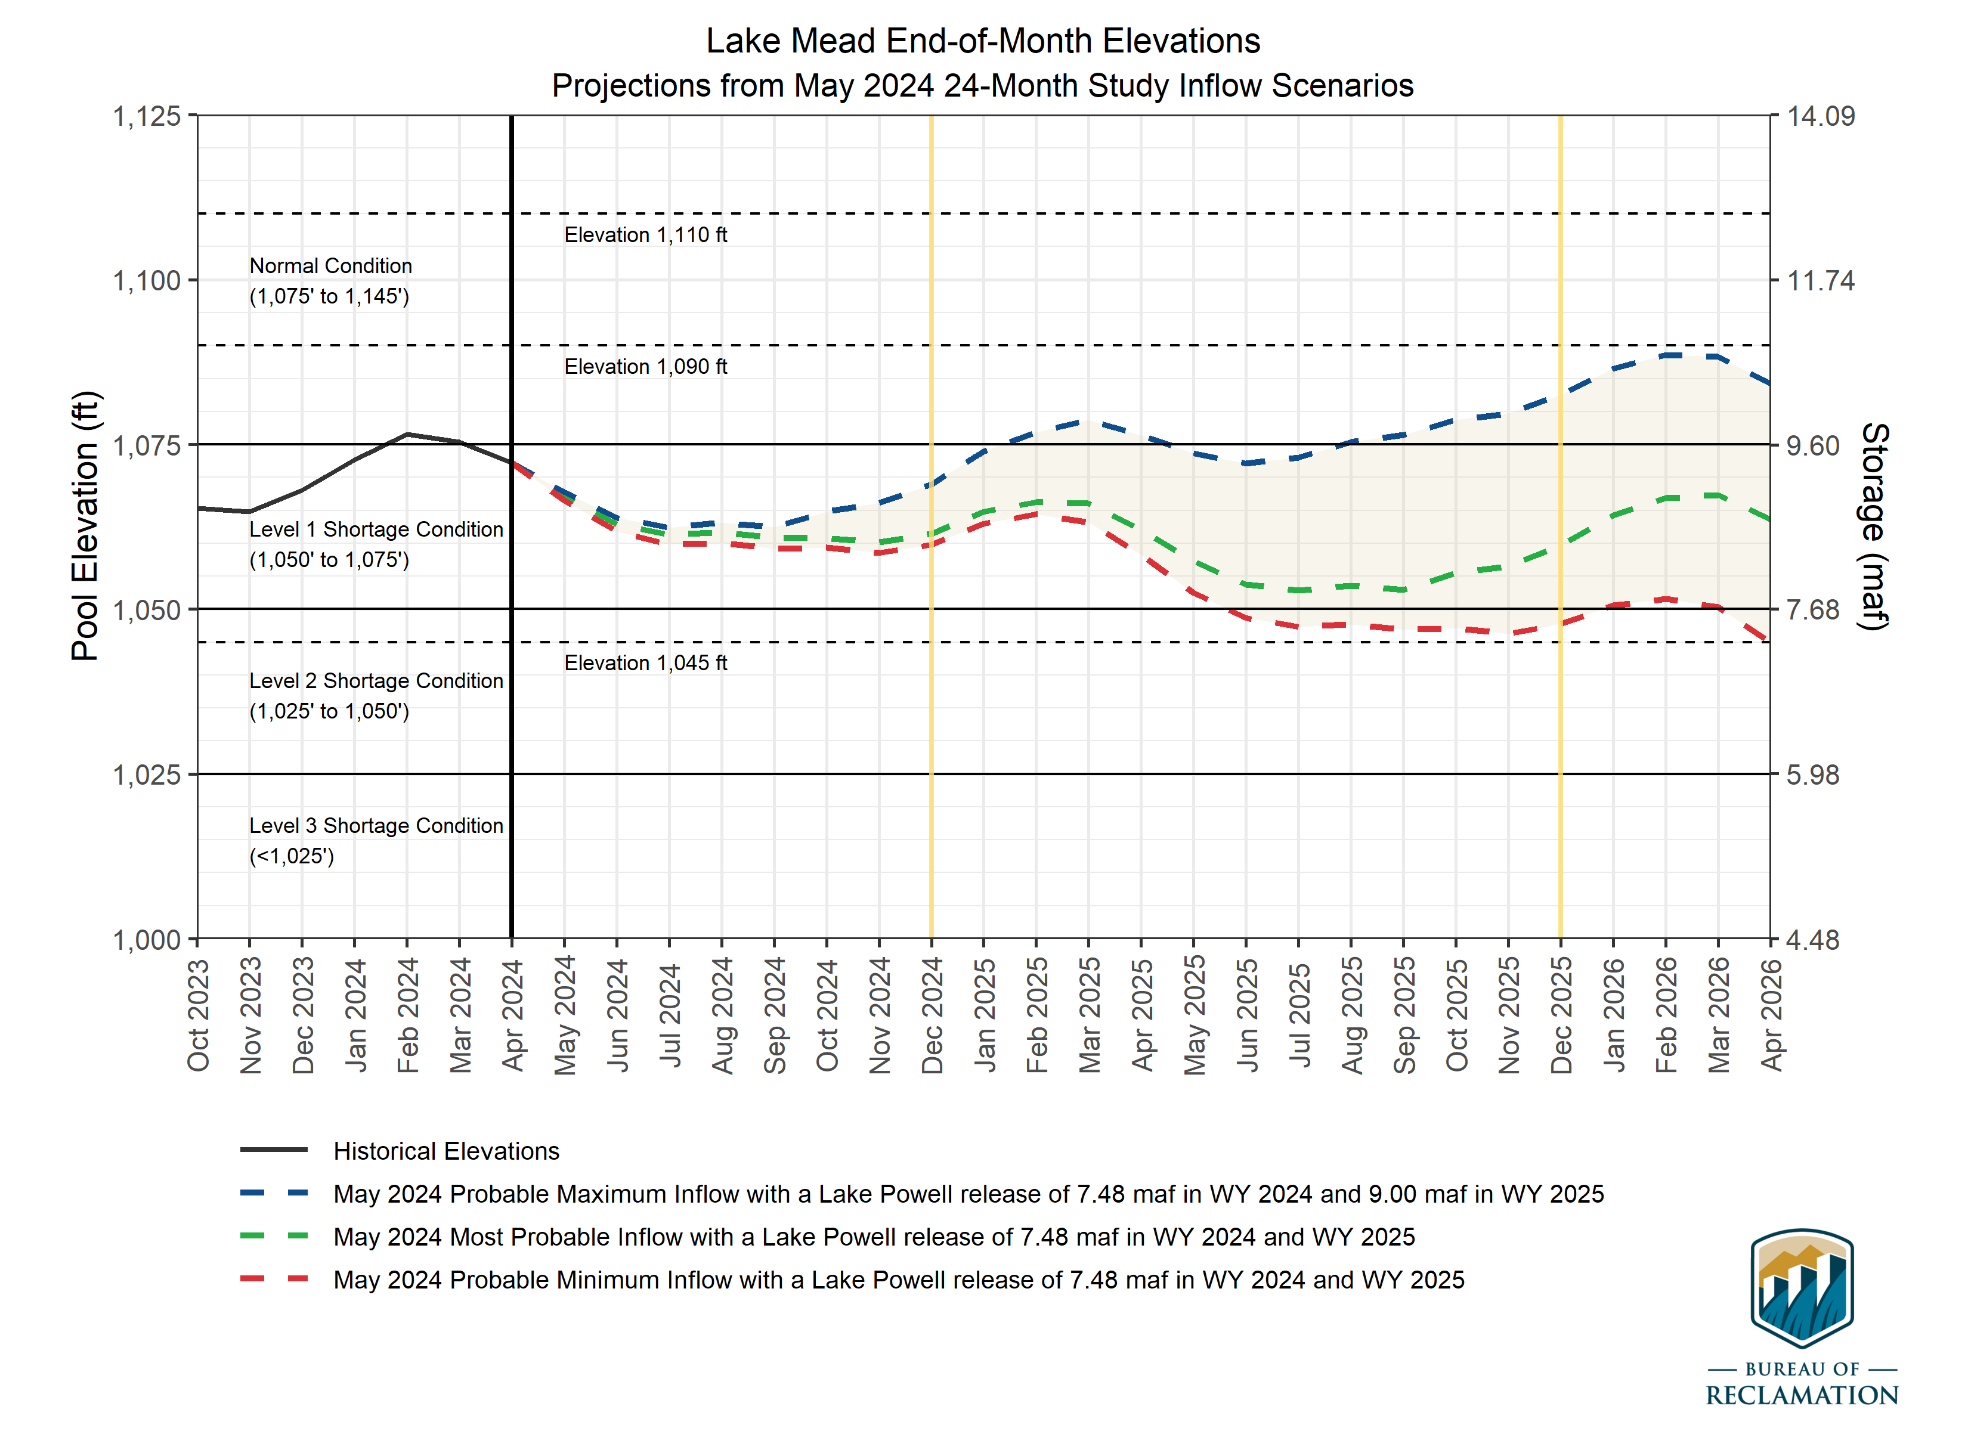
Most probable end of CY25: 1,059.62’ (32% full)
Min/Max Range: 1,047.75’ – 1,082.51’
End of CY25
Min – Level 2 shortage
Most – Level 1 shortage
Max - Normal
Most probable end of CY24: 1,061.41’ (33% full)

Slide 22
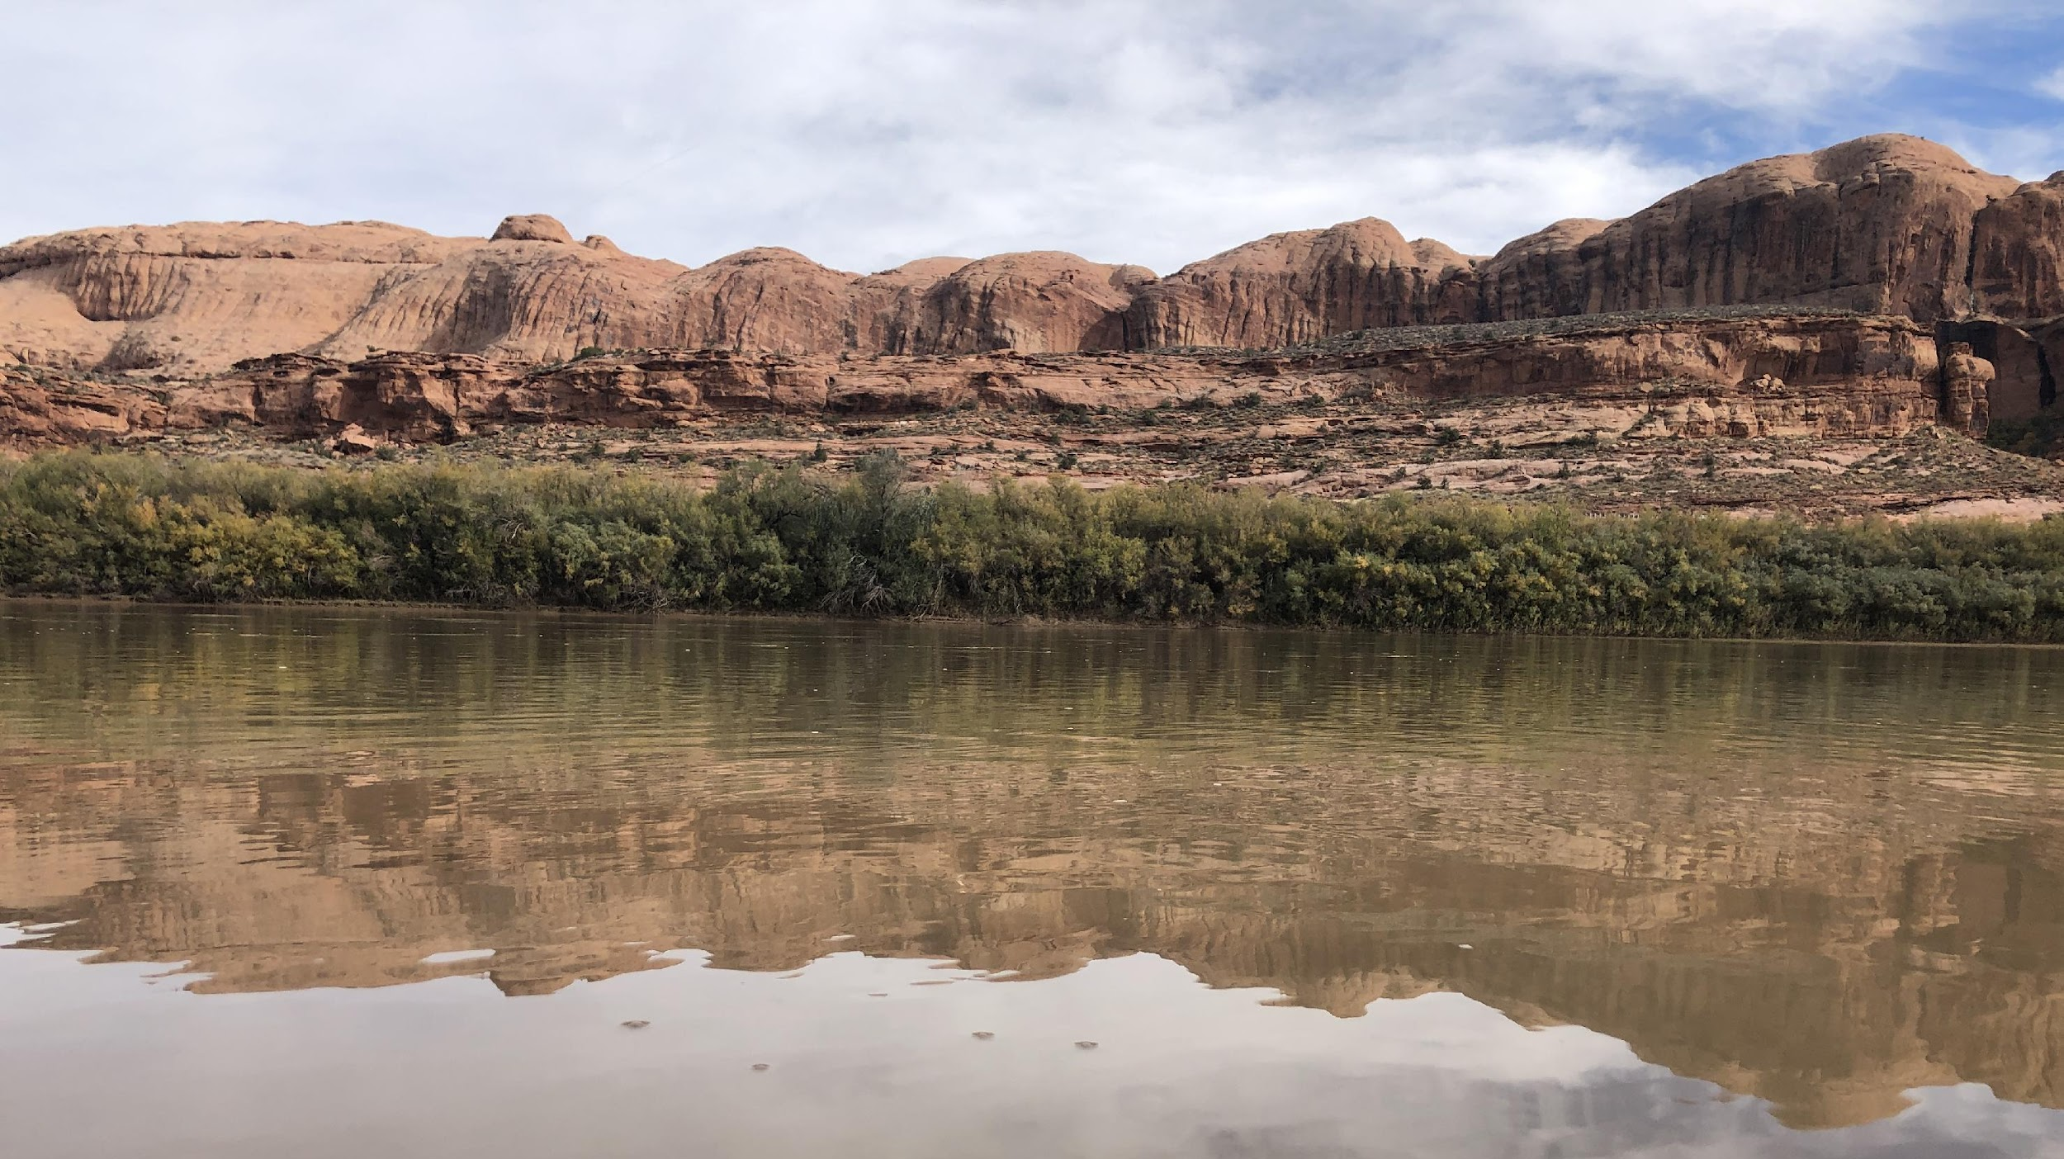
8
Defending Every Drop
cra.utah.gov
@AuthorityUT
@AmyHaasColoRivr

