Slide 1
Hydrology & System Status Update May 2025
Colorado River Authority of Utah Board Meeting
Amy Haas, Executive Director
May 22, 2025
SALT LAKE CITY, UTAH

Slide 3
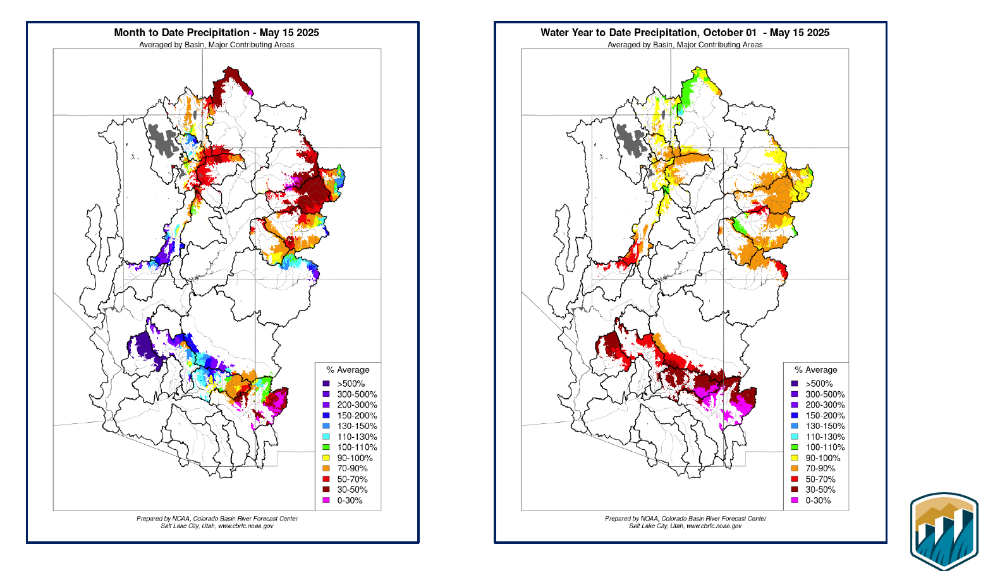

Slide 7
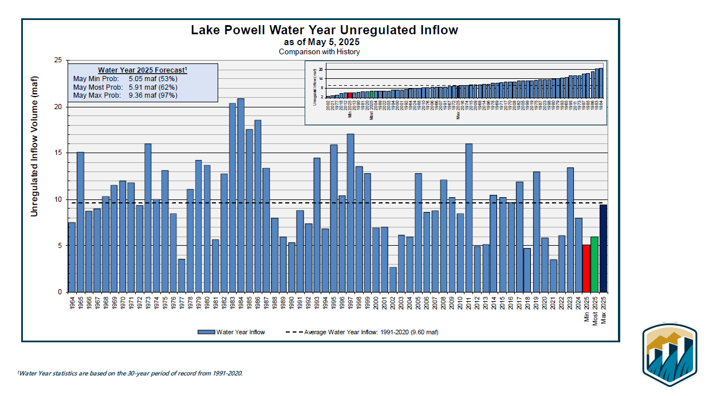

Slide 8
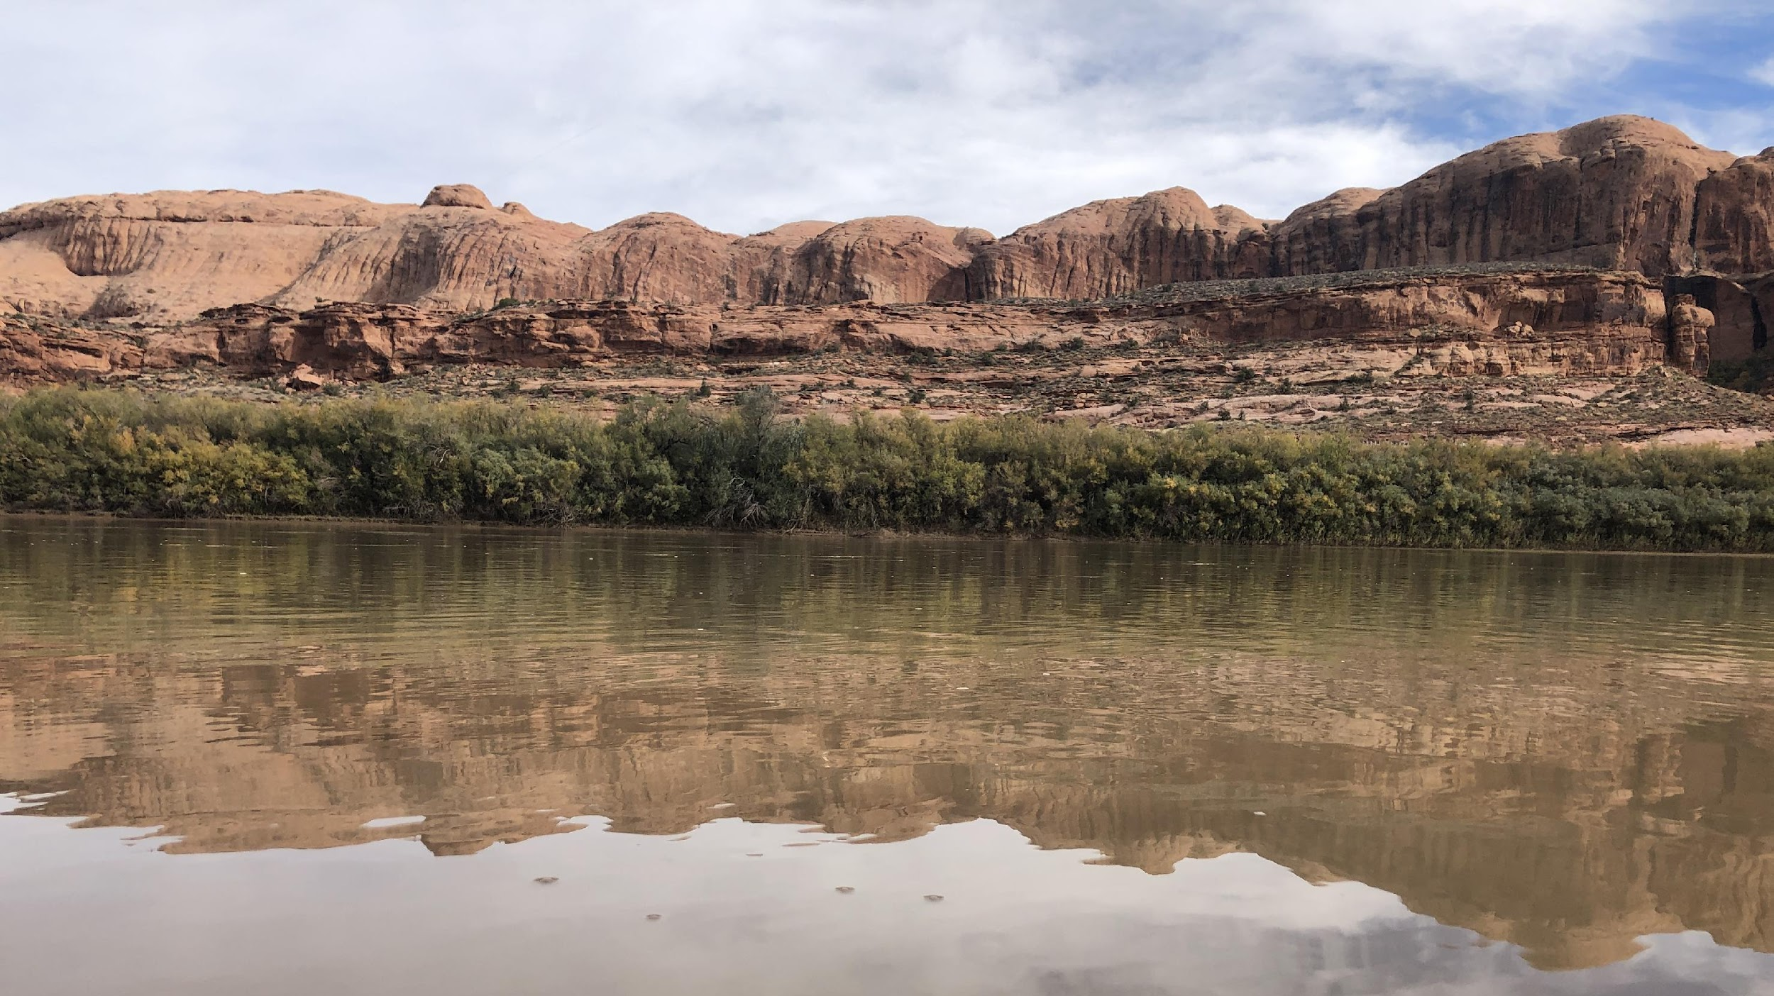
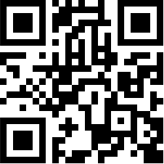
8
Defending Every Drop
cra.utah.gov
@AuthorityUT
@AmyHaasColoRivr

